Slide 1
Spatial Computing & the Future of 3D & GEOINT Tradecraft in an Ubiquitously Mapped World
August 2020 at P3DL, Ash M Richter & Andy Ku

Slide 2
IQT govt tech to comm tech shift
Sid Meier’s Civilization tech tree—doesn’t matter ifyou’re after a Cultural Victory or a Military Victory—the technology tree is KEY
?
What’s
Non-profit venture capital firm
Founded in 1999 to deal with:
On behalf of:
Federal & Business Shares of US R&D Expenditures, 1953-2018
+
Source: CRS Analysis of the National Science Foundation, National Patterns of R&D Resources, January 2020
To keep expanding:
Notes:
Jan 2020 Report from the Federation of American Science’s Congressional Research Serviceshttps://fas.org/sgp/crs/misc/R44307.pdf

Slide 3
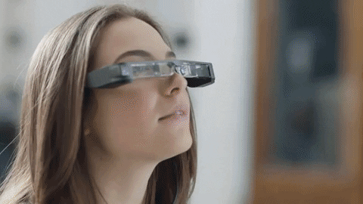
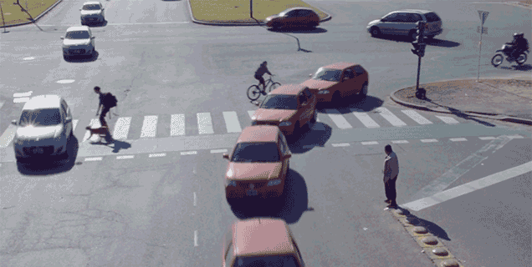
The Value of 3D Data
Aerial & terrestrial LiDAR, SfM,
SLAM, vSLAM, SLS, RTI, BIM,+++++
--aka point clouds and poly meshes+ -
The value of traditional mapping is undisputed
But without the ability to “see & analyze in 3D”,
we cannot achieve a
A machine-readable world
*feedback loop
A fully visualized and annotated world for human use & information engagement
Via Digital Interfaces (like Mixed Reality)
Autonomous Systems
Automatic Semantic Analysis
Of Space/Time
Robotics

Slide 4
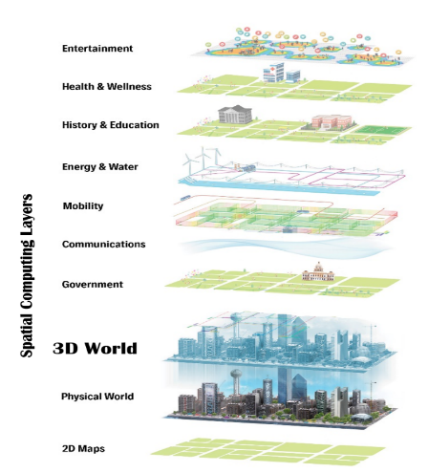
What is Spatial Computing?
Geospatial Mapping
Mixed Reality
3D Data Capture
Annotation & Activity Based Intelligence Systems
Artificial Intelligence/Computer Vision & Autonomous Systems
= The Next Generation of Mapping & GEOINT
Spatial Computing*
Digitize & Embed Space/Time
“Digitally mapping
Space and Time
to use the resulting multimodal 3D data set as a digital twin of the world upon which to layer and access information (a 3D World).”
Synonymous Semantics: AR Cloud, Metaverse, MirrorWorld, LiveMap, Digital Twins, Spatial AI
Notes:
MIT initial definition of spatial computing: “‘human interaction with a machine in which the machine retains and manipulates referents to real objects and spaces.”
the use of space itself as a stage for engagement with digital replicas of objects, landscapes, and systems of systems”
Which means our landscapes, objects, and people need to be digitized, mapped together (time/place) in order for the holistic picture to be analyzed
*Other terms include: Spatial Web, ARCloud, LiveMap, MagicVerse, MetaVerse, extension of “Perception-Based Artificial Intelligence” etc…

Slide 5
Mapping Space At Different Physical Scales
And In Different 2D & 3D+ Modalities
Across the phenomenological & electromagnetic spectrum:
Aerial/Remote
Photography
Photogrammetry
Structured Light Scanning
Light Detection & Ranging (LiDAR)
X-Ray
Computed Tomography (CT)
Magnetic Resonance Imaging (MRI)
Synthetic Aperture Radar (SAR)
Ground Penetrating Radar (GPR)
Ultrasound
Sonar
Thermography (IR)
Traditional GEOINT
Audio
Text
Media+++
And eventually towards the embedded Microcosm:
Transmission Electron Microscopes (TEM)
Scanning electron microscope (SEM)
WMF wide field microscopes
Laser scanning confocal microscopy
Structured illumination microscopy
Atomic force microscopy
Fourier Transform Infrared Spectroscopy (FTIR)
X-Ray Fluorescence (XRF), etc…
City/Street/
Building Exterior
Building Interior
Large Objects
Small Objects
Human Exterior
Human Interior
Notes:
Maybe divide into 2 slides and make both super GIF-tastic of rotating data sets?
Emphasize what’s changed—don’t explain the slides explain the story you want them to take away from it –higher level……..
Call out importance of lidar and 3d data as a rallying cry—custs already engaged with 2d, pervasive cheap 3d = expansion o pack
Co-reg and sync rates
Academic uptick

Slide 6
Mapping Time At Increased Scale
= Shift in Media Immortality for People, Places, and Activities:
1900?
Notes:
Eventually swap out top camera bit with a chart showing rise of content creation in all formats (i.e. the one initially planned for the 3D world tech brief).

Slide 7
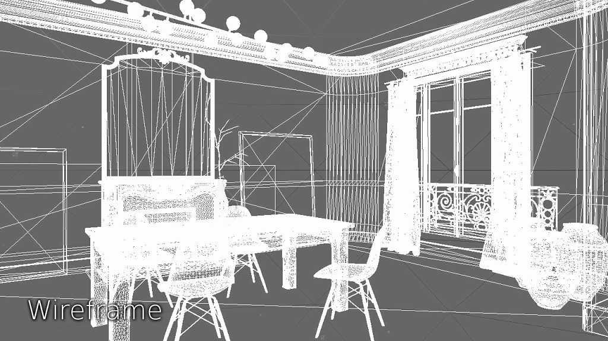
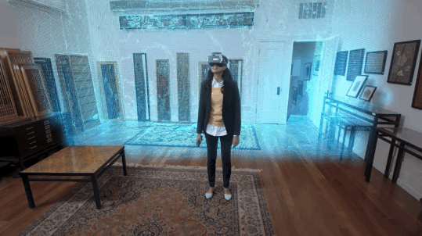
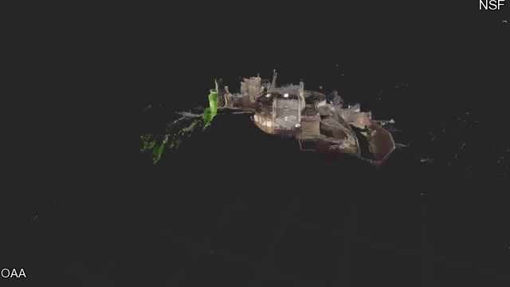
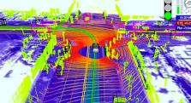
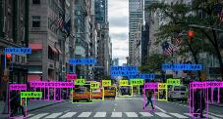
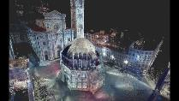
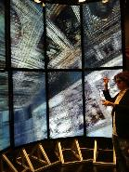
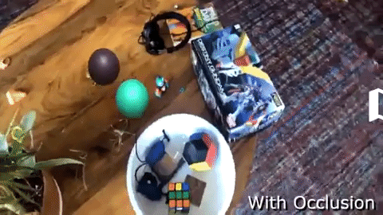
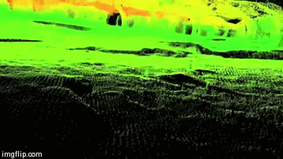
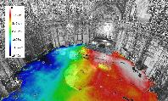
Mapping For Different Users
For Machine Mapping
For Human Visualization

Slide 8
Who is working on it?
Exploration/Mapping
Operations
Communication
Govt/Military/1st Responders (GEOINT💗)
AEC
(Architecture, Engineering, Construction)
[BIM (Building Information Modelling)]
[Smart Facilities,etc]
Hollywood/Music SfX
Cities
Autonomous Vehicles
Manufacturing
Gaming
Digital Heritage
[Archaeology]
Tourism*
Edtech
*Museums
Mining
*Themeparks
*Casinos
Hospitals/Medicine
Academic SciComm
Space Exploration
Retail
Notes:
Govt/Military Example: https://uploadvr.com/military-virtual-training-simulation-summit-arlington-virginia/
Autonomous Vehicles Example: https://news.voyage.auto/an-introduction-to-lidar-the-key-self-driving-car-sensor-a7e405590cff?gi=bbb5e7b87c27
Digital Heritage Example: https://blogs.nvidia.com/blog/2018/07/31/cyark-gpus-capture-world-heritage-sites/
Cities Example: https://techxplore.com/news/2019-02-ai-based-visual-tech-cctv-cameras.html
Gaming: https://discoversg.com/2018/07/13/vr-gaming-singapore/
Edtech: https://www.pcworld.com/article/2873657/hands-on-with-microsofts-hololens-the-3d-augmented-reality-future-is-now.html
Mining Example: https://www.eonreality.com/portfolio-items/virtual-reality-industrial-application/
Space exploration example: https://www.nasa.gov/vision/earth/technologies/vizsoftware_jb.html
AEC Example: https://www.convertbim.com/cjob_post/point-cloud-to-bim-conversion-in-14-days/
Maunfacturing Example: https://www.engineering.com/AdvancedManufacturing/ArticleID/14904/What-Can-Augmented-Reality-Do-for-Manufacturing.aspx
Academic Example: https://adventuresindigitalarchaeology.com/2014/05/07/cisa3-at-the-opening-of-the-ucsd-structural-materials-engineering-building/
Hospital https://www.imedicalapps.com/2013/08/augmented-reality-ipad-app/#
Retail: https://www.omnifi.co.uk/monitor/mport-full-body-scanning/
Casino: https://www.cmu.edu/news/stories/archives/2017/july/computer-reads-body-language.html
Hollywood: https://www.ign.com/articles/2014/07/11/a-brief-history-of-motion-capture-in-the-movies
Theme parks: https://d23.com/summoning-memories-of-the-haunted-mansions-opening-night/

Slide 9
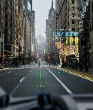
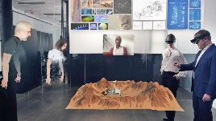
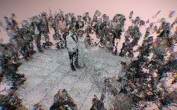
Spatial Computing Consumer Use Cases
Navigation
Communication
Shopping
Education
#FutureofWork
Household
Play
Memory
Notes:
People are using it for the expected use cases but also a few unexpected ones: ex. Memory: picture worth 1000 words vs a 3D replica of an ephemeral moment

Slide 10
The Spatial Computing Pipeline:
Data Capture
Data Processing
World Building
Machine Visualization Goal
Human Visualization
Mechanism
3D Capture:
a/m/t LiDAR
Radar/SAR
SLS
MRI/CT
Ultrasound/Sonar
GPR
Indoor Mapping
User Design Studios
Real World Annotations
Phones/Tablets/Computers
Heads Up Displays
Mapping/Localization
Real World
Operations
Object Identification
Software
Development
Toolkits
AR on 2D Interfaces
Glasses
Contacts
2D->3D Capture:
SLAM
SfM
RTI
Aerial Photogrammetry
GIS (etc)
Change Detection
Analysis
Automation
3D in 2D
Forced
Projection
Machine Readable
Asset Storage
& Querying
Data
Co-registration
Engines
CAVE/WAVE
* Security/Scale /Density/Resolution, Processing Time, Processing Skills Variables
Training Data
2D Capture:
Visible Photography
Video
Hyperspectral Imaging
Multispectral Imaging
Xray
IR
Traditional Mapping
Drawings
Human Readable
Agnostic ARCloud
“Spatial Net”
Brain-Computer Interfaces
Metadata/ Paradata
Tracking
Editing/
Cleaning
Synthetic Data
3D Haptics
3D Printing
Layer Access
Data
Geo-rectification
3D in 3D
Holography
Simulation/
Game
Artist Rendered 3D:
3D Assets
BIM
Version Control
Virtual Reality
Portable Devices
Authentication
Temporal Tracking (Version Control #2)
Interactive Game Build
Head Mounted Displays
Other:
Text
Audio
ABI
Social Media
Locational Light Projection
Proprietary Multimodal Content
Crowdsourced Multimodal Content
Open Source Multimodal Content
Pre-Built Game
Tables
Holodecks
Historical Focus
In Need of Development
Notes:
For more on baseline—old SC brief get in touch

Slide 11
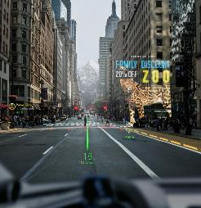
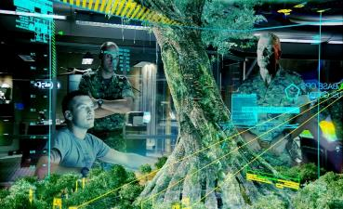
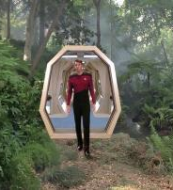
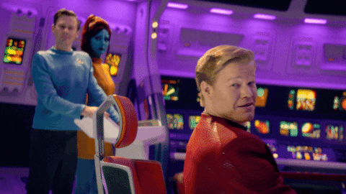
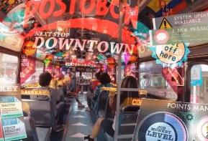
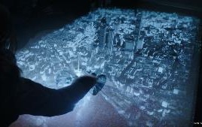
A Map Forward: Making Science Fiction Reality ( & Giving Order to the Information Overload)
Autonomous Systems
Virtual
Realms
Re-playable Digital Twin of Physical Landscape & Historic Archive of Human Activity
The World Mapped in 2D
Basic Augmented Reality
The World Mapped in 3D
The ARCloud
Self Sovereign Identity Based
Data Economy
Ambient Intelligence Landscapes
NOW
5 YRS
25 YRS+
Brain-
Computer Interfaces
Notes:
Expect Unexpected Players to Lead:
Entertainment
Gaming
Adult Industry
Tourism
Exploration
Mining
Digital Heritage
AgTech

Slide 12
The Next Level of Layers are already being mapped onto the 3D Scaffold
The Digital Worker
Smart Landscapes
Data Economy
Tracking
Human Mapping & Augmentation
Mapping &
Augmentation
Asset Digitization
Data Permissions & Ownership
Activity Based Intelligence
Real
/Avatar
Smart City
New Data Tradecraft
Synthetic
/NPC
Annotating
ARCloud
Public
Private
Data
Markets
Public
Engagement
Digitization of Identity & Skills
Analysis
Smart Facility
Pattern of Life
Edtech
HR Tools
Crowd-
sourced
Digital
Dust
Ambient Intelligence
Proprietary
Enterprise
Visualization
Cybernetics/
HCI/BCI
Spatial
Computing
Connectivity
Gamification
Smart Home
Future of Money
Remote
Collaboration
Social
Media
Applied Modelilng/
Cliodynamics
Storage
Individual
Commercial
Digital
Currencies
Fintech
Notes:
The mapping itself x 2D/3D computer vision/AI/ML
XR, ABI, and social media etc (= additional skill sets to mappers, esp re: game engines)
Preparation for an even greater exponential avalanche of incoming data than we’ve already been seeing….But at extreme, invasive scale

Slide 13
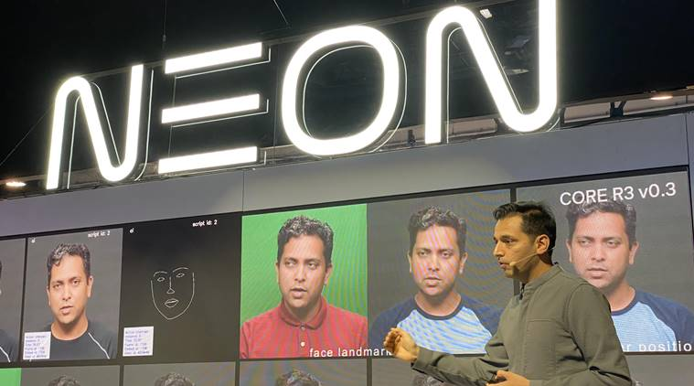
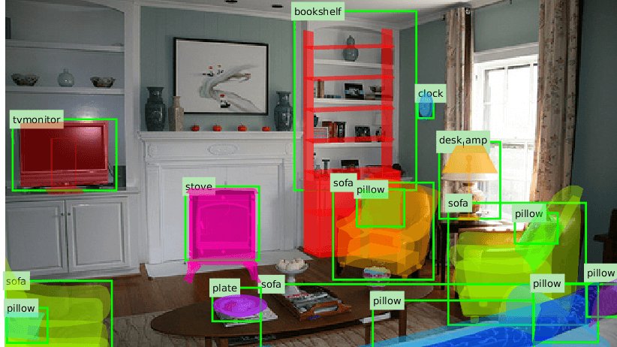
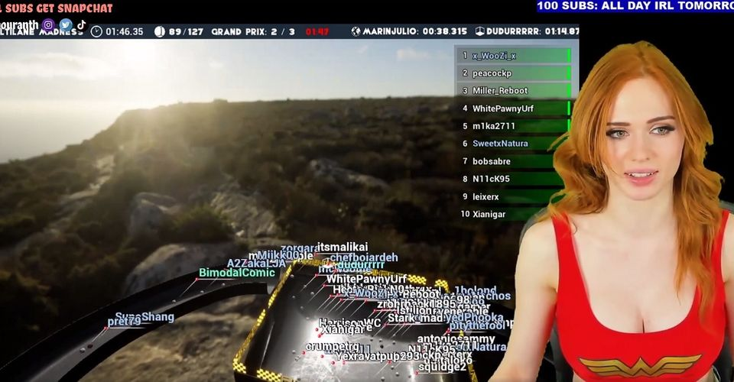
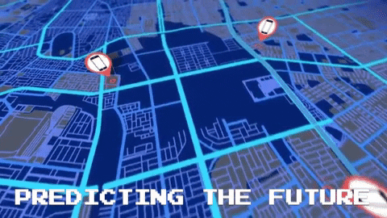
Emerging Trends (already)
Synthetic Humans Mapped In
Personal Space Indexing
Cyber-Physical Data Economy -> Physical-Cyber Data Economy
Pervasive Human Mapping
Predictive Activity Based Intelligence -> Cliodynamics
Notes:
https://neurohive.io/en/datasets/new-datasets-for-3d-object-recognition/
Image of ObjectNetLess3D

Slide 14
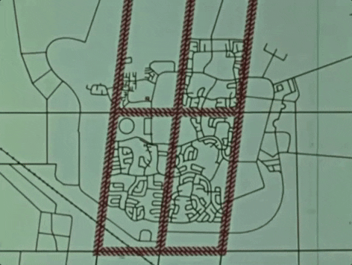
New Tech, New Tradecraft, New Challenges
Who Owns This Challenge?
And/or how do we divide it for best coverage?
Who Owns the Data?
How do standardize old/new workflows?
How do we handle data privacy?
How do we organize data/access?

Slide 15
Is anyone ready for a spatial computing driven paradigm?
Cambridge’s Centre for Digital Built Britain
High Scorers
Canada’s 3D Mapped Roads Project
Medium Scorers
The UK’s Open Source LiDAR Precedent
(more later)
The BIM Capital
Sydney Opera House UNESCO O &M Precedent
Scoring Factors:
Extant 3D Data Policies & Organizations
Applied Infrastructure Projects &/or Workflows Using 3D Data
Strength of 3D Heavy Industries like AEC, Mining,
Special Effects, Gaming Industries
Strength of Related Tech Communities of Interest like GEOINT/GIS, BIM, AI, CV, 3DCV, Game Engines
Strength of related Academic Communities
Notes:
Biggest Challenge of all—we may already be falling behind and losing the Extended Reality War

Slide 16
US and Canada produce the most English-speaking AR/VR research papers, but Western Europe, East Asia, and Australia have the most influential researchers and papers
France, Germany, UK, and Italy universities receive the most research funding
Canada #2 for number of VR papers
United States publishes the most papers
Japan and South Korea are Top 5 for number of AR researchers
Australia publishes the most papers with the most influential researchers
Large number of publications
Medium number of publications
Small number of publications
No or unknown number of publications
Sources: A Network of Cluster Analysis of Literature; Ecorys; Various research papers
Notes:
While the US has the most papers, other countries have the most influential papers (number of citations, most-cited researchers)
Canada also prolific
Europe has a lot of funding to back up its research
East Asia has the most researchers for AR
Australia (University of South Australia) has the most cited researchers
Where basic research to applied
Source of graphs: 2018: The past, present, and future of virtual and augmented reality research: a network and cluster analysis of literature. Frontiers in psychology: Human Media Interaction https://www.frontiersin.org/articles/10.3389/fpsyg.2018.02086/full (note: sampling focused on VR/AR only and emphasis on romance language texts), Spanish/Italian author collab
Additional graphics not included/combo-ed in from” https://medium.com/@marknb00/where-in-the-world-is-ar-vr-research-happening-ddebbdc6436b , South Australian author
Plus hand-trolling latest conference hosts/keynotes/papers/projects/impact
University logos are an accumulation of 1) number of published research; 2) number of citations; 3) strength of commercial partnerships. Sources:
https://www.frontiersin.org/articles/10.3389/fpsyg.2018.02086/full
https://medium.com/@marknb00/where-in-the-world-is-ar-vr-research-happening-ddebbdc6436b
https://ec.europa.eu/futurium/en/system/files/ged/vr_ecosystem_eu_report_0.pdf
Country shading is based on number of VR articles published. Source:
https://ec.europa.eu/futurium/en/system/files/ged/vr_ecosystem_eu_report_0.pdf

Slide 17
The bulk of VC funding for spatial computing goes to US, China, and UK startups
Jiangxi Province: $460M in AR/VR funding
Guangdong: $160M in AR/VR funding
32 UK investments
Improbable ($789M)
Blippar ($137M)*
Wave Optics ($55M)
Blue Vision ($17M)*
Scape ($8M)*
* Acquired
166 US investments
Magic Leap ($2.6B)
Matterport ($114M)
Mojo Vision ($108M)
Leap Motion ($94M)
Fyusion ($57M)
76 China investments
Baofeng Mojing ($166M)
3vjia ($118M)
Sandbox VR ($83M)
HiScene ($67M)
Insta360 ($39M)
KEY:
Total Investments (2018 – 2020)
Top 5 Funded Startups ($Total VC investment, to-date)
30+ total company investments
11 – 30 total company investments
1 – 10 total company investments
No or unknown company investments
Data: Traxcn
Notes:
But the VC spending and commercialization goes to the US (and China)
Most investments in the US
Biggest check sizes in the US
China: different dynamic: centrally planned where direction is set at the top and then provinces figure out how to allocate money in line with the direction

Slide 18
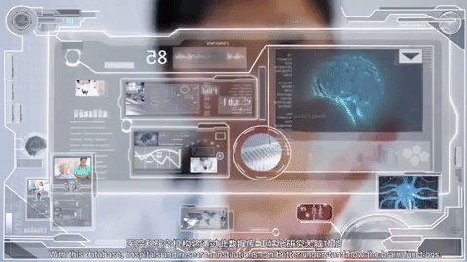
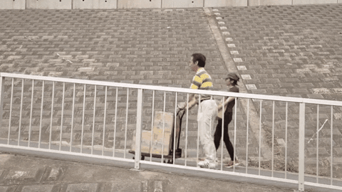
China plans to become a VR* leader by 2025
3D scanners
Visualization
Light field
Headsets
Human computer interfaces
Haptics
Eye tracking
Brain-computer
3D data processing
Graphics processors
3D stitching
National policy
Financial support for local government efforts
Construct local VR demonstration centers
Promote VR companies and brands
Plan to increase VR skills training
Create standards
Core Technologies
Key Industries
Infrastructure
Security
Government Promotion
Manufacturing
Education
Tourism
Entertainment
Health
Retail
Architecture
Education
Universities
Research labs
Patents and IP
Startups incubators
Industry associations
Cybersecurity
Protect user information
Source: Guiding Opinion of the Ministry of Industry and Information Technology on Accelerating the Development of the Virtual Reality Industry, Dec 2018.
Notes:
China is a making a big push into spatial computing
Dispel the myth that China is not focused on this space
Every five years, China puts out its economic plan
Virtual reality called out in China’s 14th 5-year plan (2016 – 2020): https://cset.georgetown.edu/wp-content/uploads/t0076_innovation_driven_development_strategy_EN.pdf
In 2018:
“Guiding Opinion of the Ministry of Industry and Information Technology on Accelerating the Development of the Virtual Reality Industry” (released December 2018): http://www.miit.gov.cn/n1146285/n1146352/n3054355/n3057643/n3057649/c6559691/content.html
China creates a government sanctioned VR standards body (Industry of Virtual Reality Alliance): https://www.opengovasia.com/chinese-industry-alliance-issues-virtual-reality-standards-under-guidance-of-ministry-of-industry-and-information-technology/
Chinese VR subsidies
https://www.mckinsey.com/industries/technology-media-and-telecommunications/our-insights/augmented-and-virtual-reality-the-promise-and-peril-of-immersive-technologies
https://www.vrfocus.com/2018/10/chinas-jiangxi-province-pledges-substantial-investment-in-vr-and-ar/
China accounts for 82% of VR global shipments: https://foreignpolicy.com/2019/06/21/chinas-communist-party-is-making-its-own-virtual-reality/

Slide 19
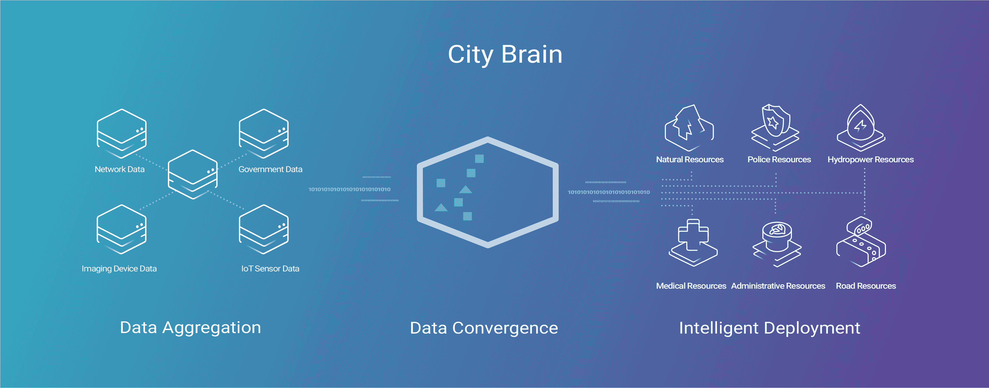
It’s not just policy in China..
It’s Applied Organization
& Use of 2D-> 3D Data into a working Panopticon
It’s Money
Notes:
But things like CityBrain = something else super important—they’re already getting their 2D organized
We’re not--, our companies and our agencies struggling w large scale digital transformation and basic AI/ML implementation, pulling together data streams, etc

Slide 20
General Recommendations in preparation for the “Extended Reality War” (“XRWar”)
USG Needs to get Organized
Organize US-Led International Coalitions
Then we iteratively adjust to living in a 3D+ World
Step 1:
Step 2:
Step 3:
Step 4:
Address & scale current (2D) tech policy & regulation challenges
Decide What Government Entities Take Ownership
Establish How They’re Going to Work Together/With Everyone Else
Organize our 2D and 3D data and connectivity pathways
Establish scalable pathways through uproars over AI, Data Privacy, 5G, etc
Do so keeping the in-bound spatial computing confluence in mind so component pieces don’t conflict with the confluence
Build off the FVEY’s GEOINT coalition
Coordinate across democracies to keep the information flow democratic and individual privacy protected
Encourage Basic & Applied Work in Academia & Industry
Appropriately engage with new tech sub-cultures
Parallel Internet Development
Greater authentication/3D watermarking (unhistory)
Expand Data Economy
Facilitate #futureofwork in an ambient intelligent landscape of autonomous helpers
Notes:
Work w partners (FVEY), global orgs leadership---US wont be able to do this alone, but could and should be a leader among leaders in this space Sort 2d and 3d data management issues –centralize archives stop re-doing 3d data make it accessible—get familiar with it—recruit gamers and mappers and encourage cross-collaboration between them and field survey groups

