Slide 1
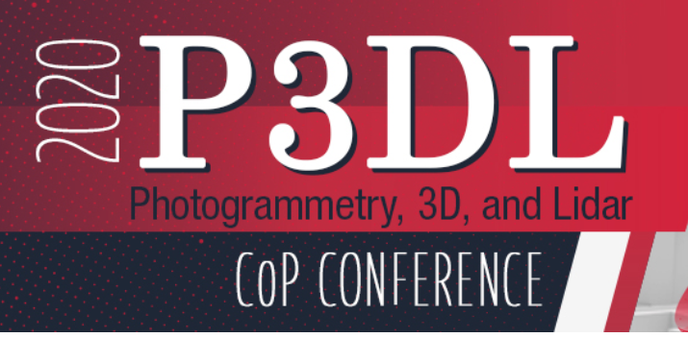
Got a Drone… Now what? Mapping with your UAV.
August 12, 2020
Kris Berglund
Vice-President, Sales

Slide 3
Agenda
Lidar point clouds vs photogrammetric point clouds & output derivatives
Flight paths & Loading UAV photos – what’s important to know
Reconstruction of a 3D environment from 2D
Analysis
PC thinning & classification
‘Best Fit’ PC vertical adjustment

Slide 4
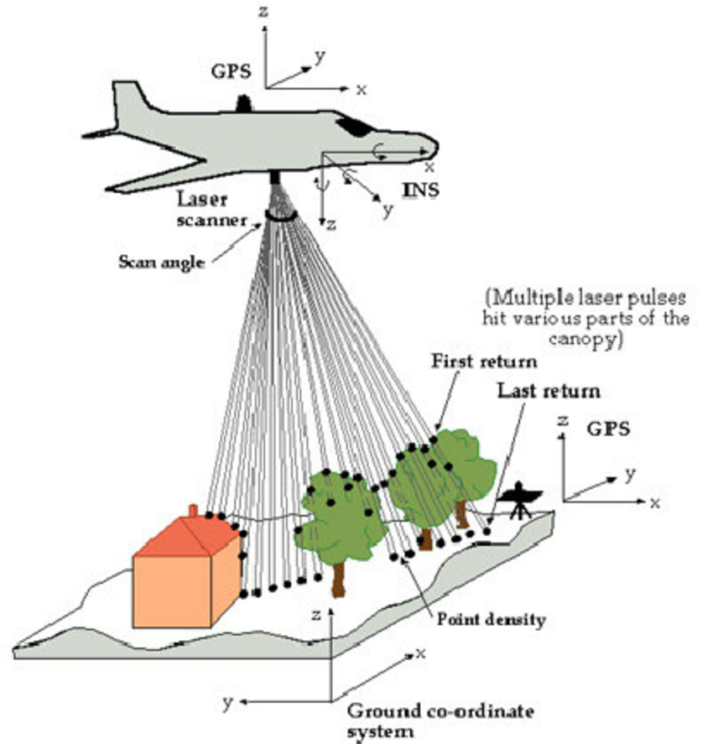
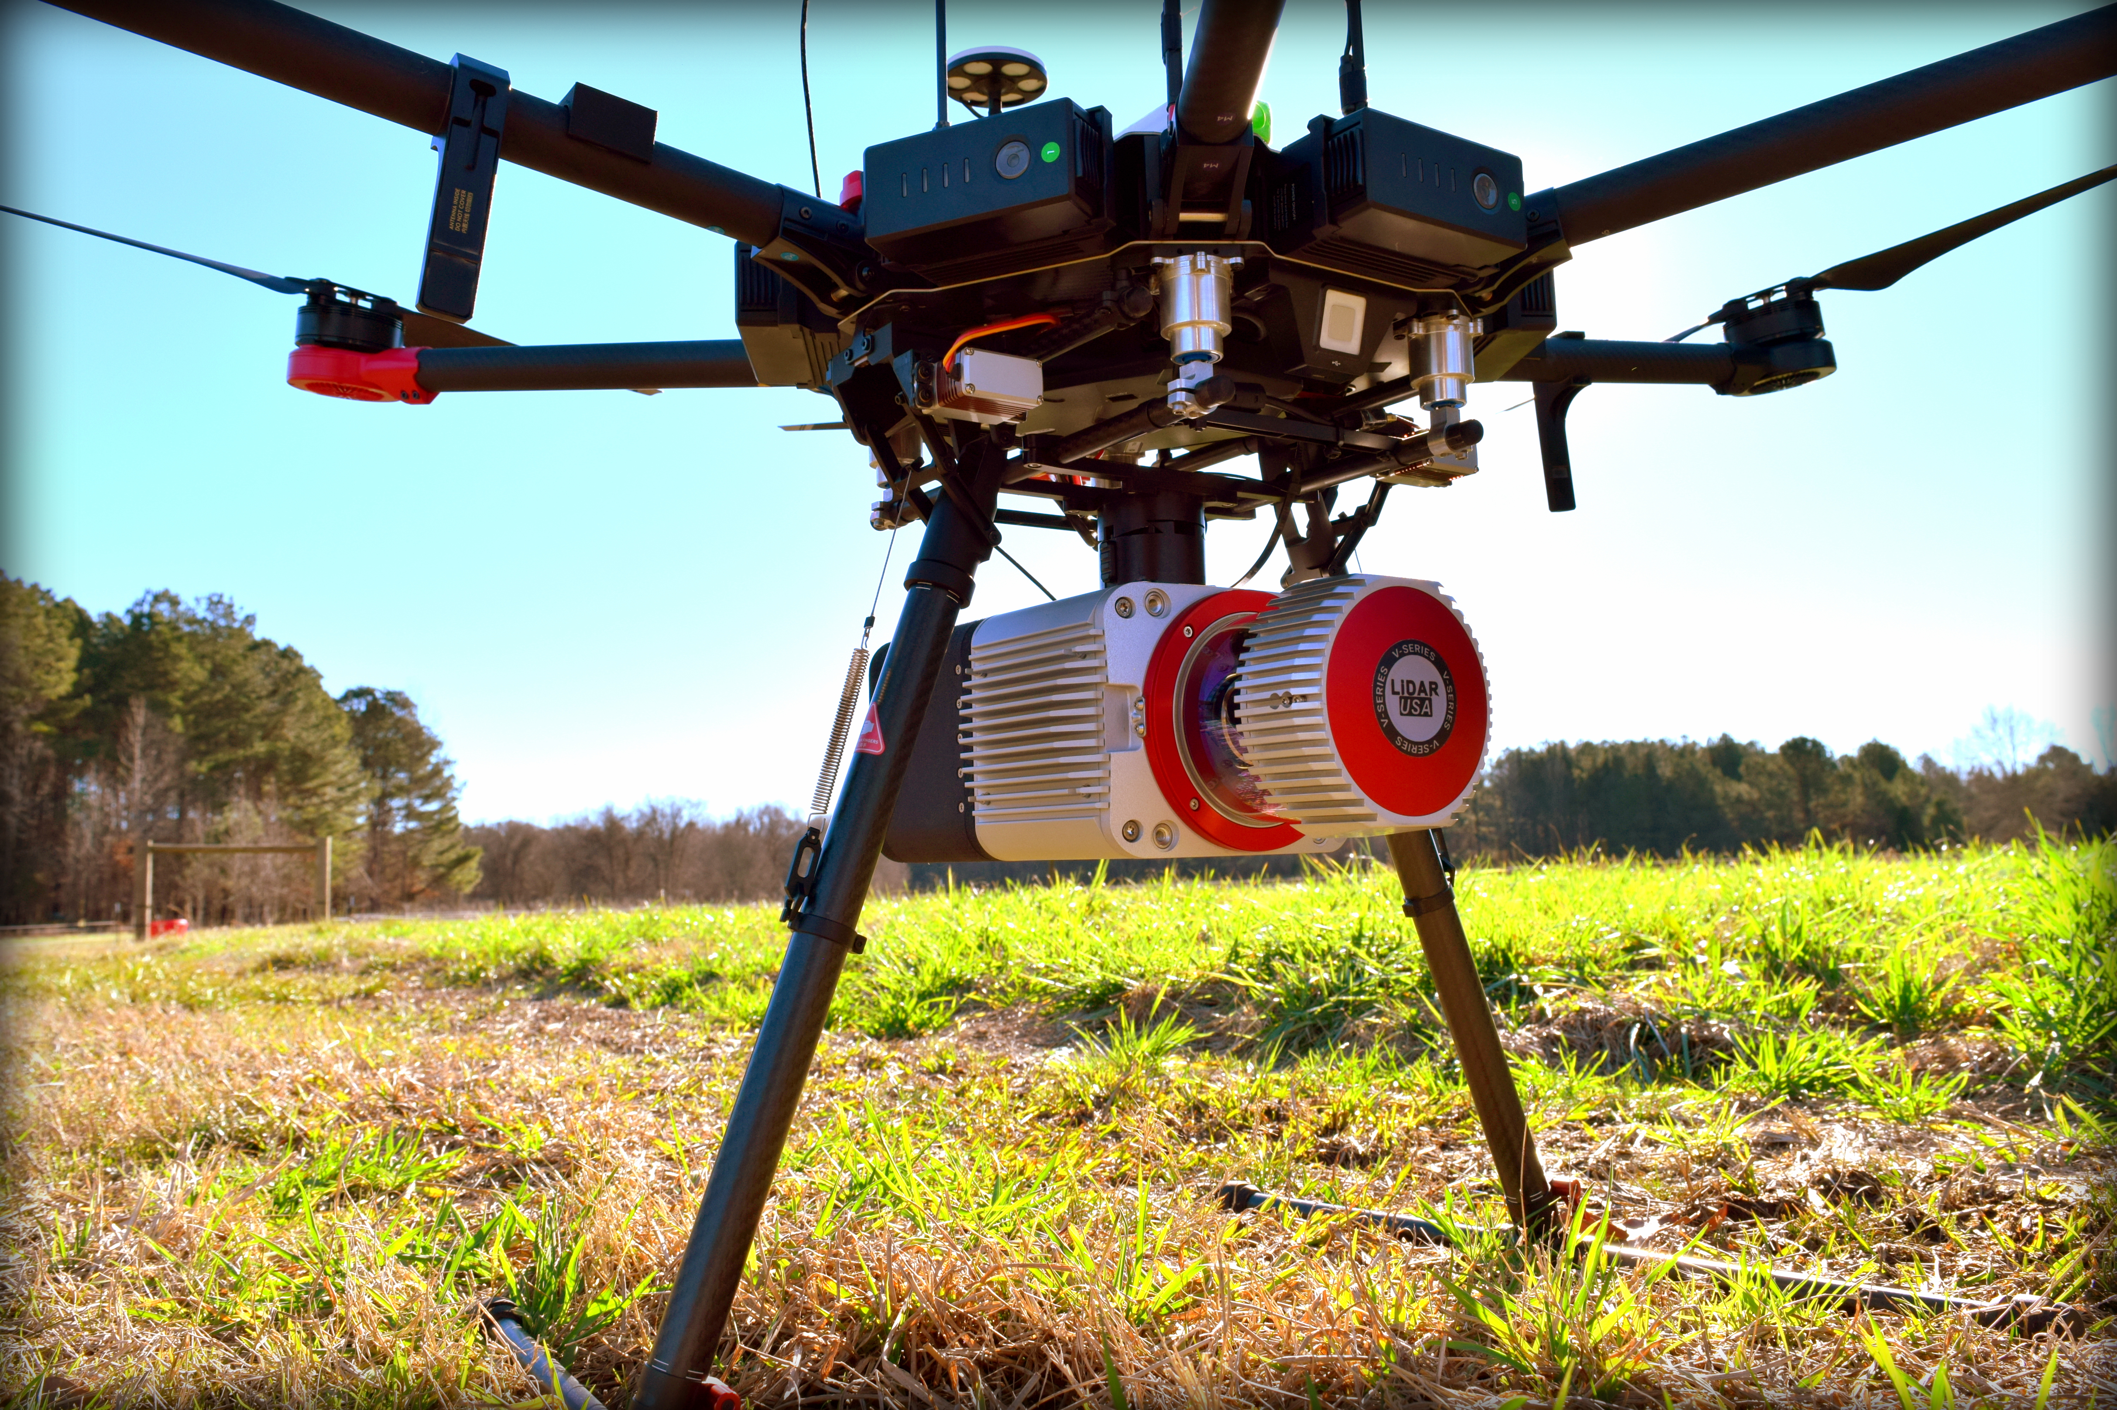
LiDAR Light Detection and Ranging
Aerial Sensors- Aircraft, Helicopter, UAV
Output Topographic or Bathymetric data
Terrestrial Sensors- Stations, Vehicles, Backpacks
Hi-res scans, used more for 3D meshes
Credit LiDARUSA/Fagerman Tech.
Credit Ian Dowman
Notes:
Lidar diagram Image: Dowman, Ian. (2004). Integration of LiDAR and IFSAR for mapping. International Archives of Photogrammetry and Remote Sensing. 35.

Slide 5
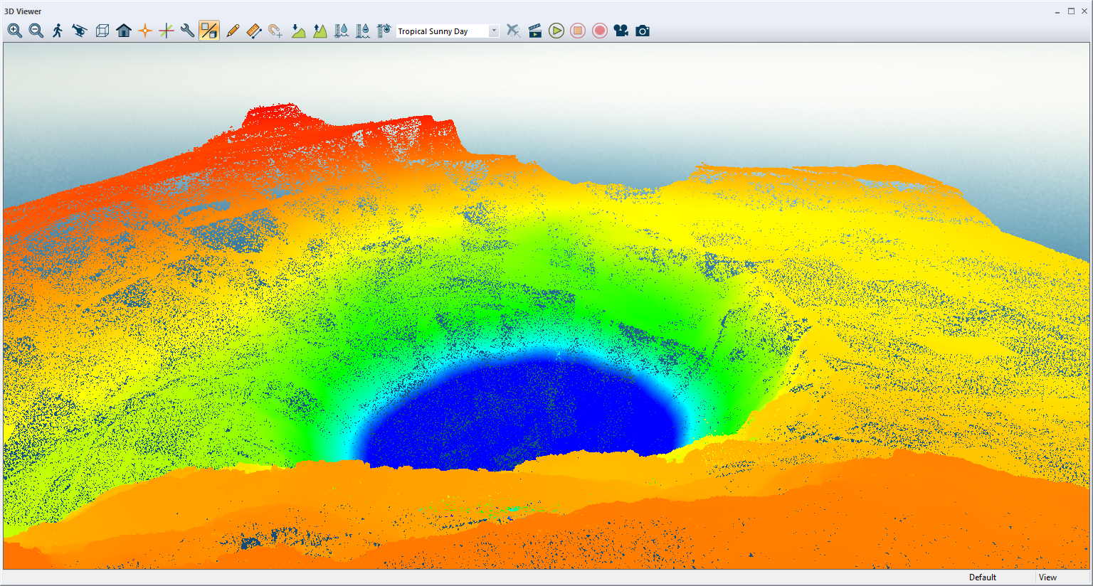
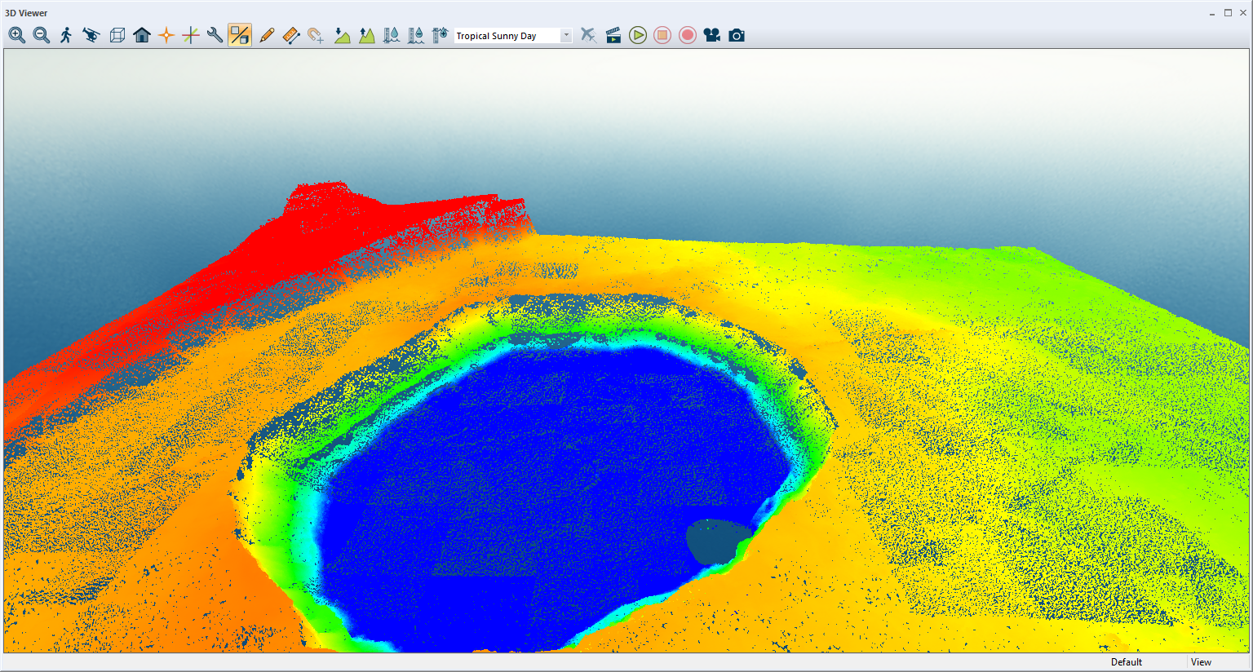
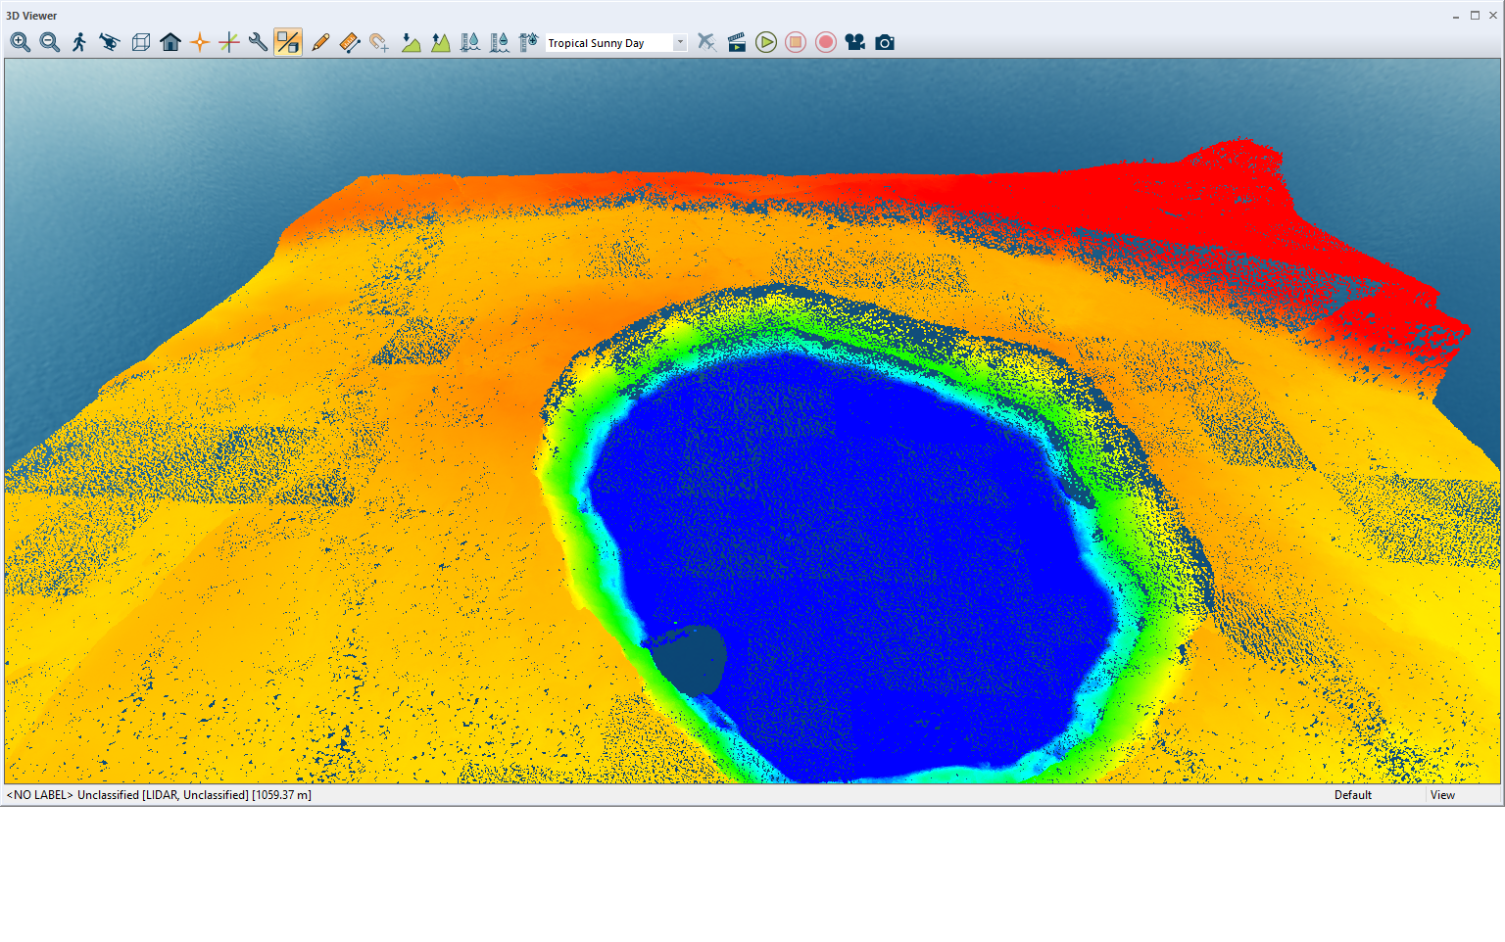
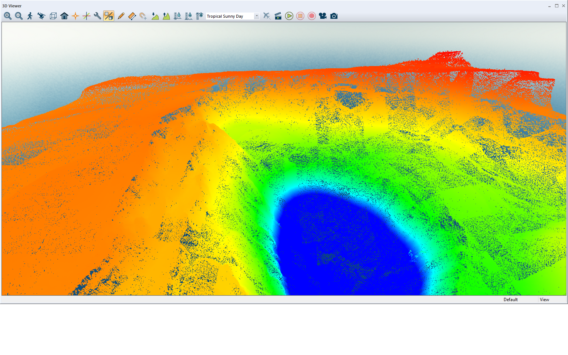

Slide 6
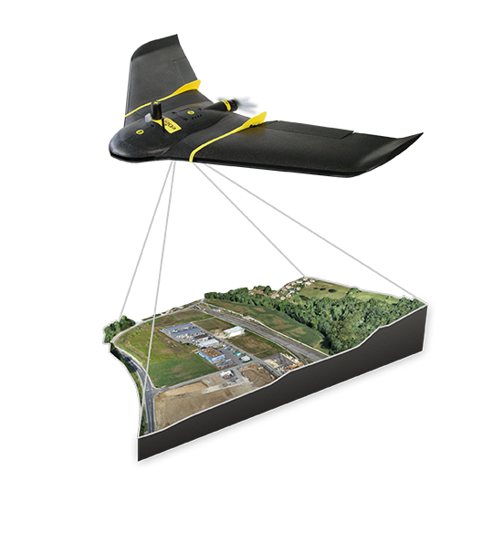
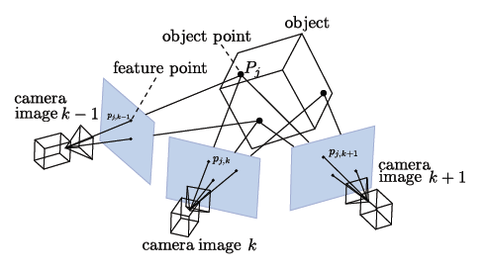
Photogrammetry Structure from Motion
Measuring distance of the same “objects” using multiple overlapping photographs
Better results are achieved with photos that have good texture, contrast, RGB color definition
Figure: From point observation and intrinsic camera parameters, the 3D structure of the scene is computed from the estimated motion of the camera.
© Copyright 2013-2017, OpenMVG
Notes:
Find distinct features, try to match them, then triangulate their position
When the images don’t have the same color, exposure, camera properties, etc. this get more difficult (separate project in CS usually termed Big SFM to deal with these unorganized images, i.e. VGI)
- Flickr, google etc.
http://www.cs.cornell.edu/projects/bigsfm/

Slide 7
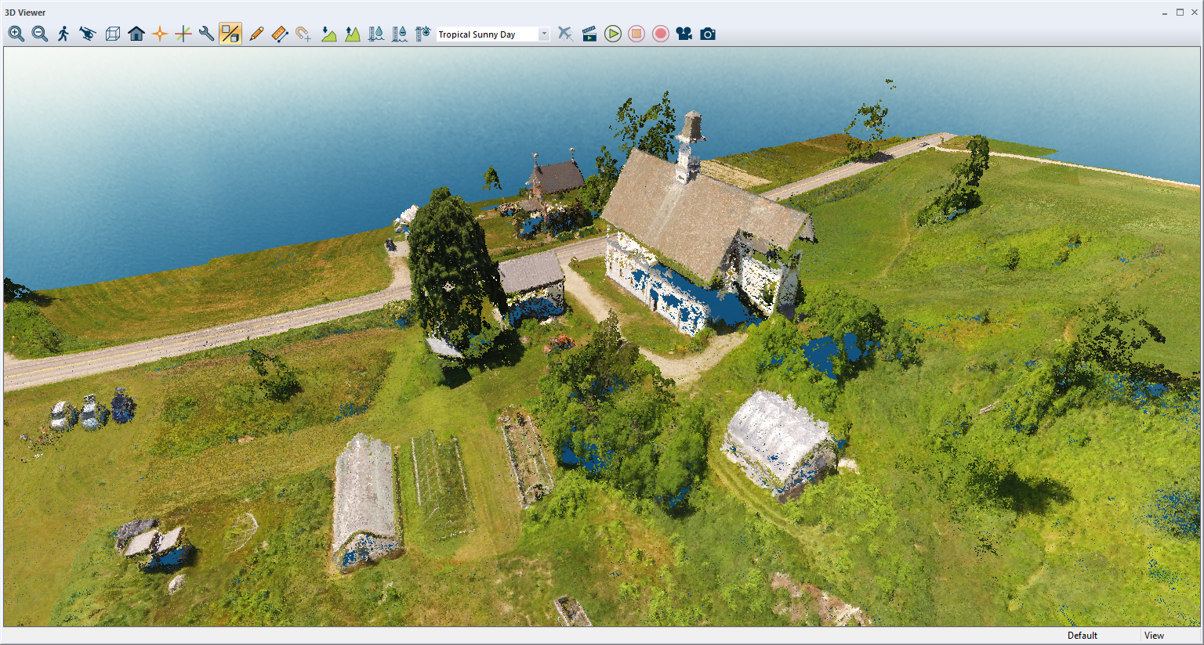

Slide 8
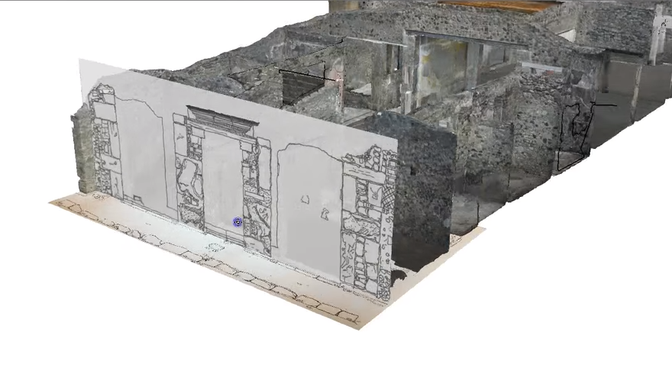
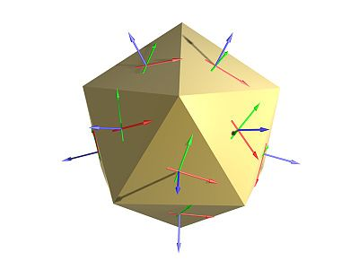
3D Modeling
Measuring distance of the same “objects” using multiple overlapping photographs
Better results are achieved with photos that have good texture, contrast, RGB color definition
Credit https://blenderartists.org/
Notes:
Using historic information
Possibly adding on to or starting from remotely sensed data

Slide 9
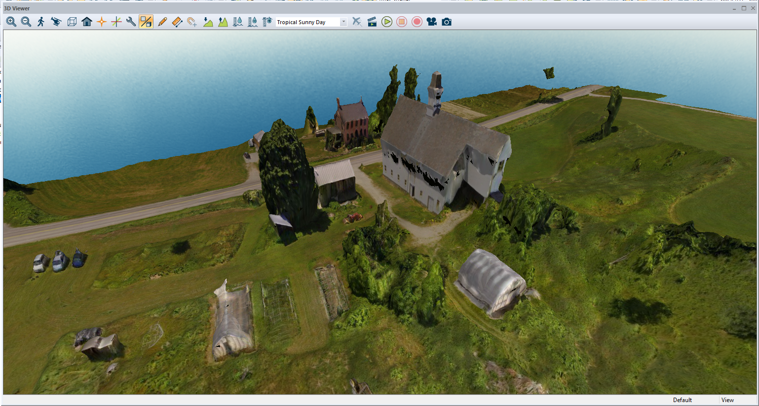

Slide 10
Data Analysis
Defining Flight Path & Loading UAV Photos
Photogrammetric Point Cloud Generation
Manipulation - 3D Modeling – DSM/DTM
Visualization – cross section profiles, cross profiles, best fit adjustment

Slide 11
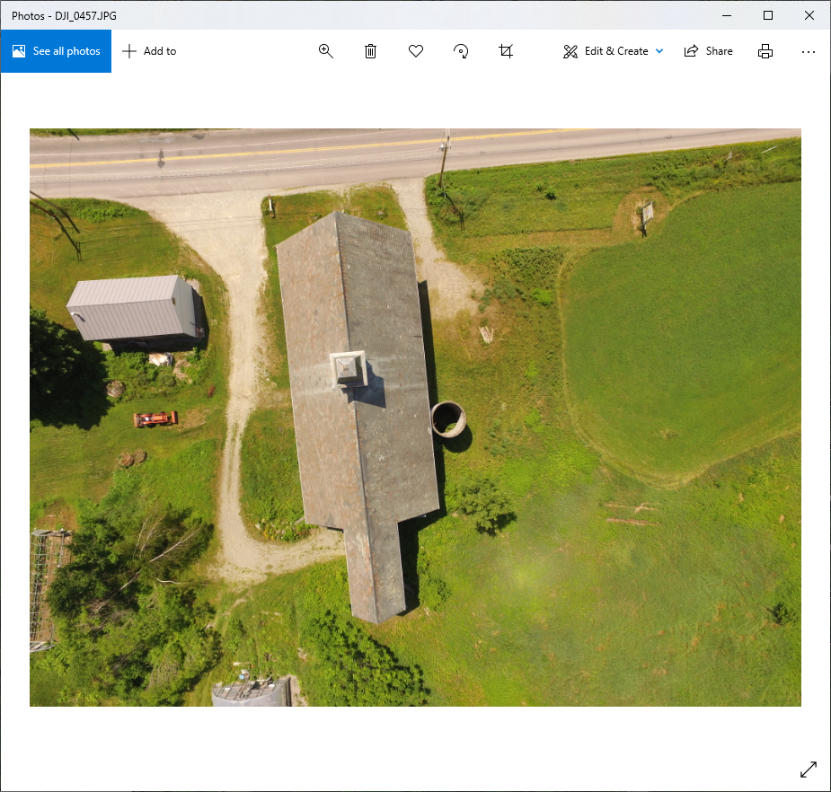
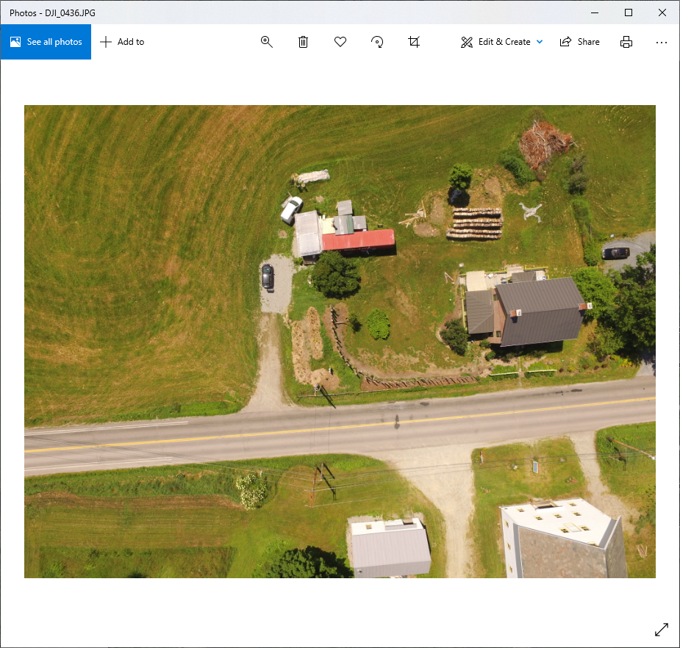
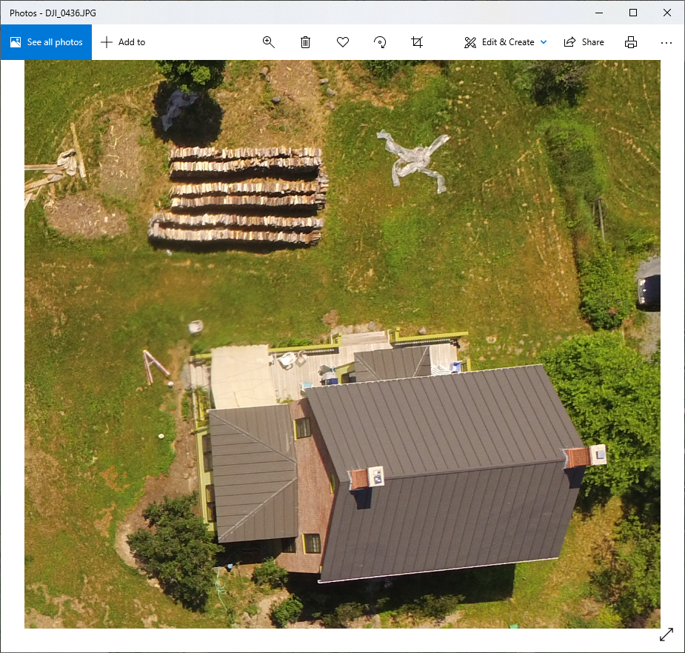
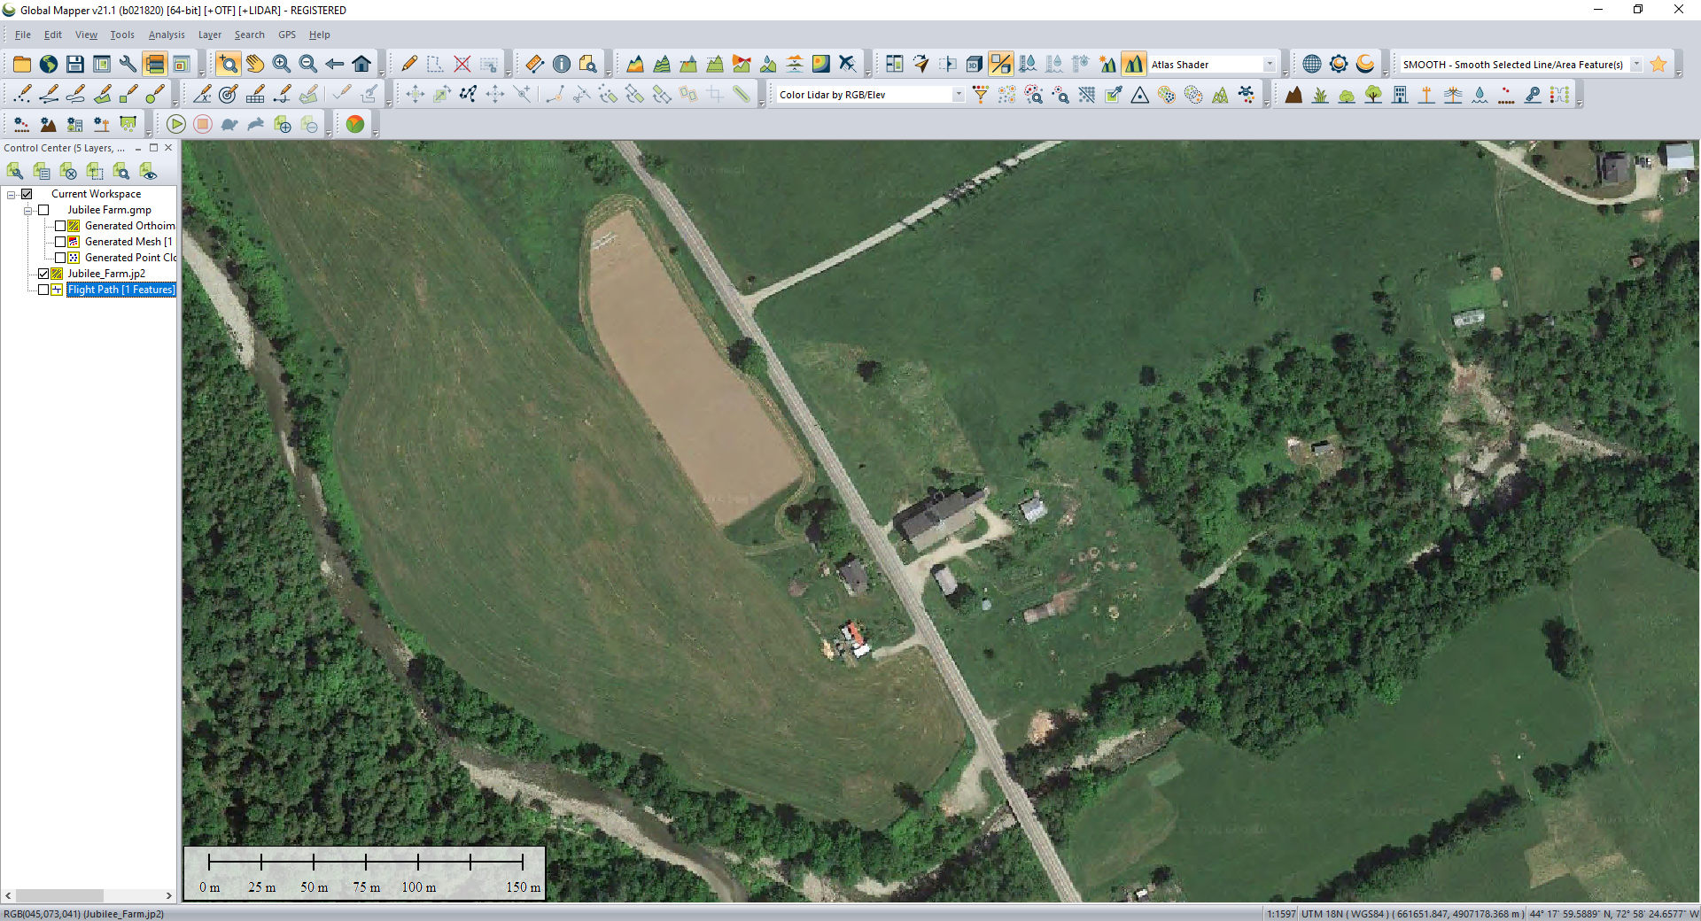
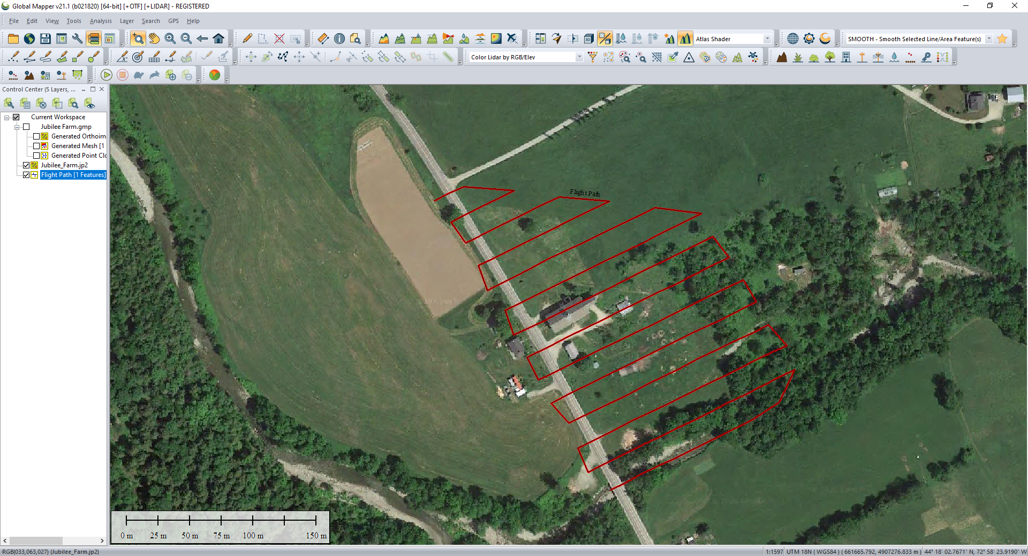
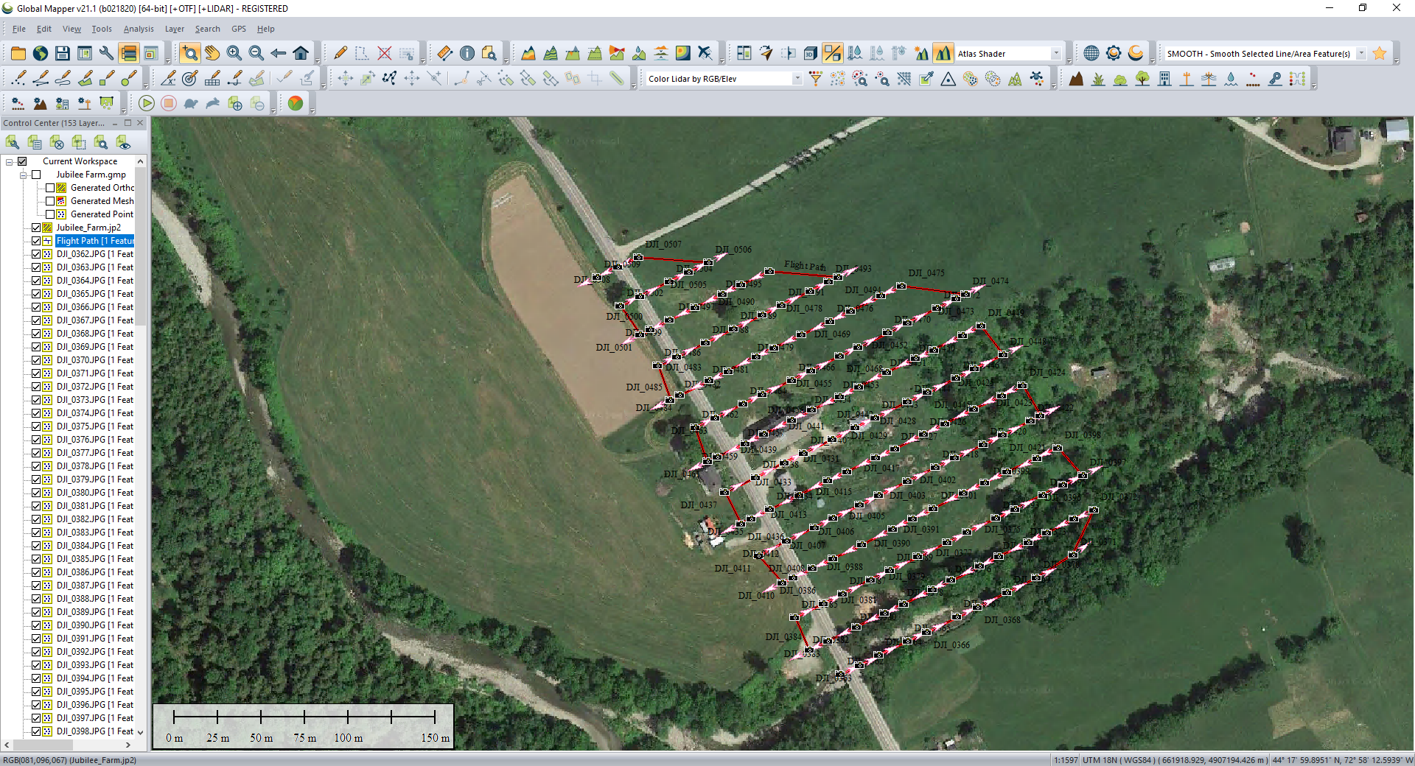
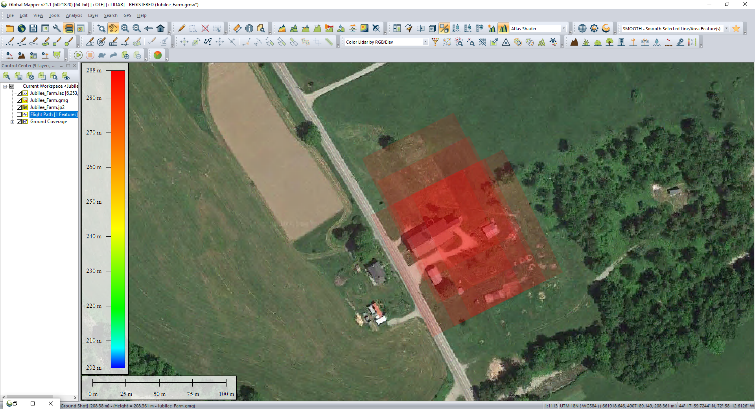

Slide 12
Data Analysis
Defining Flight Path & Loading UAV Photos
Photogrammetric Point Cloud Generation
Manipulation - 3D Modeling – DSM/DTM
Visualization – cross section profiles, cross profiles, best fit adjustment

Slide 13
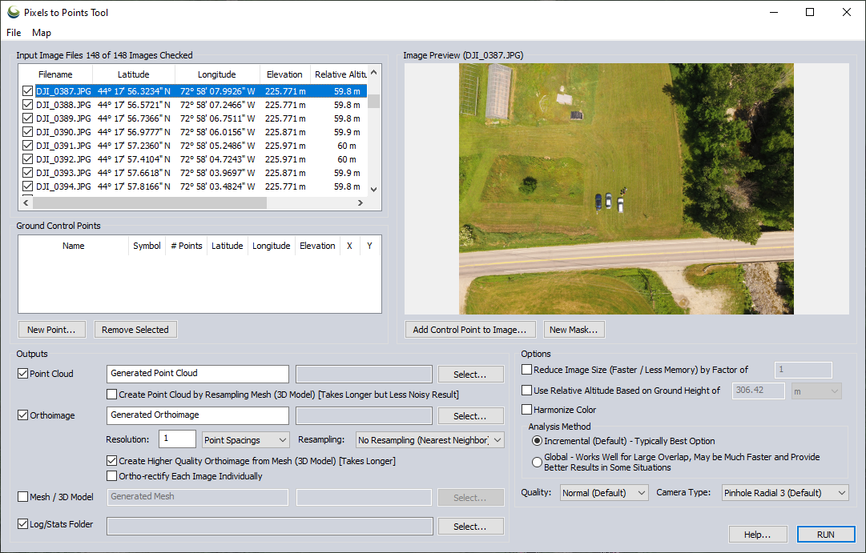
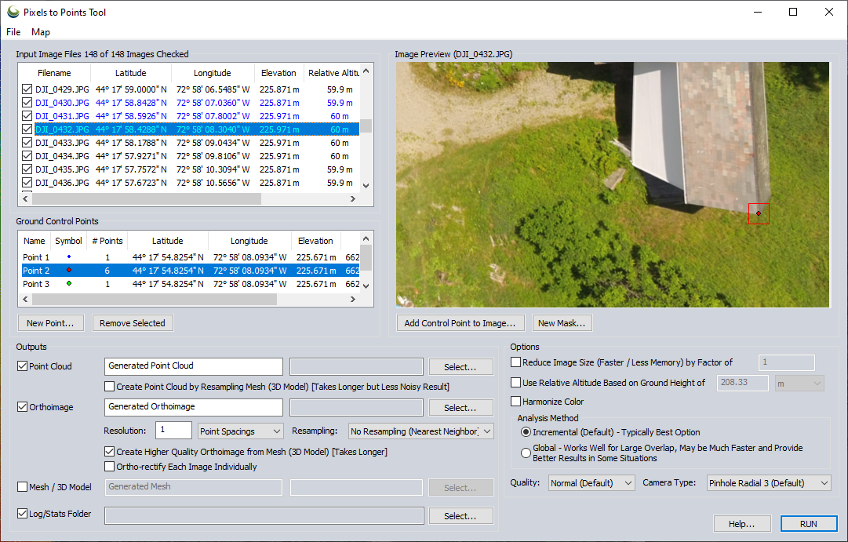
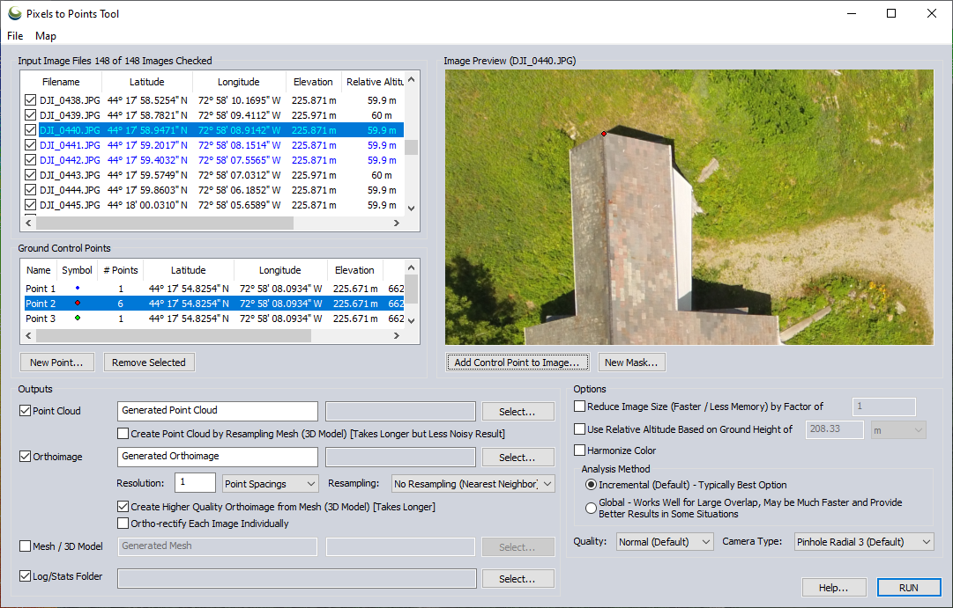
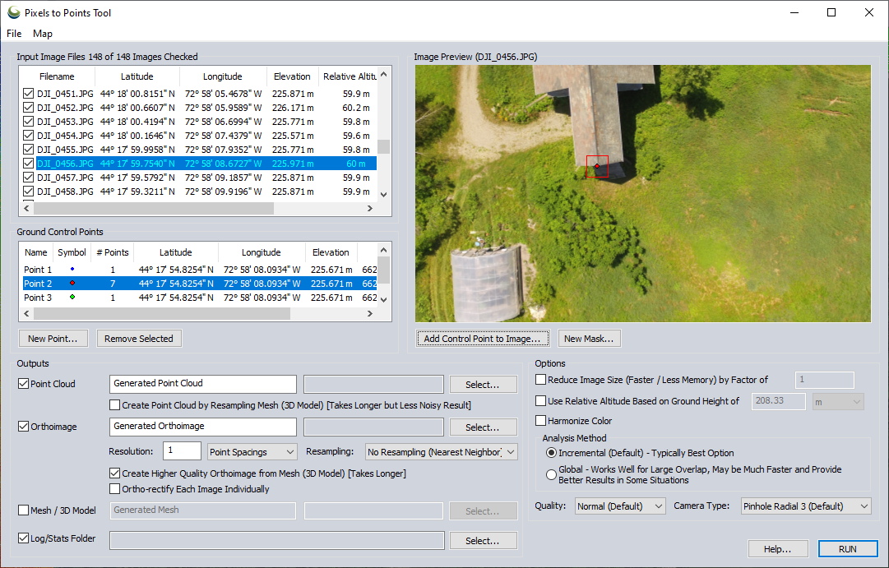
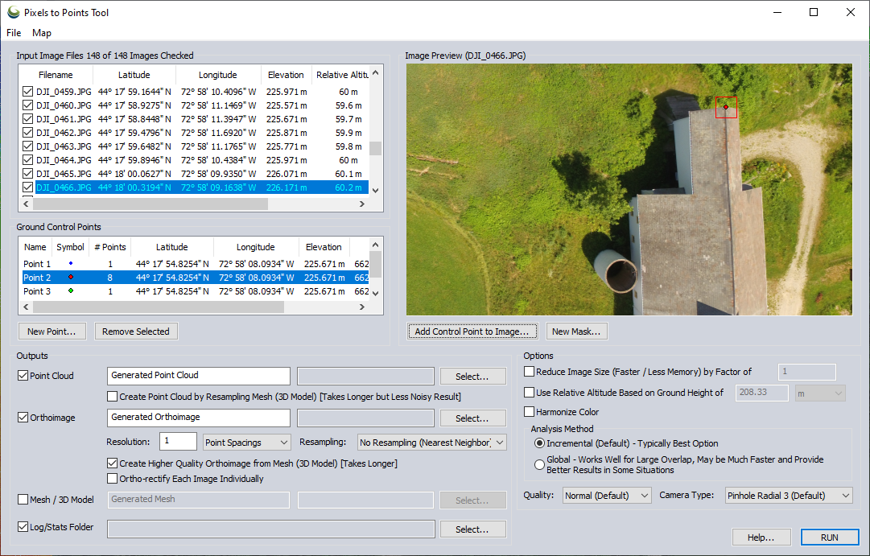

Slide 14
Data Analysis
Defining Flight Path & Loading UAV Photos
Photogrammetric Point Cloud Generation
Manipulation - 3D Modeling – DSM/DTM
Visualization – cross section profiles, cross profiles, best fit adjustment

Slide 15
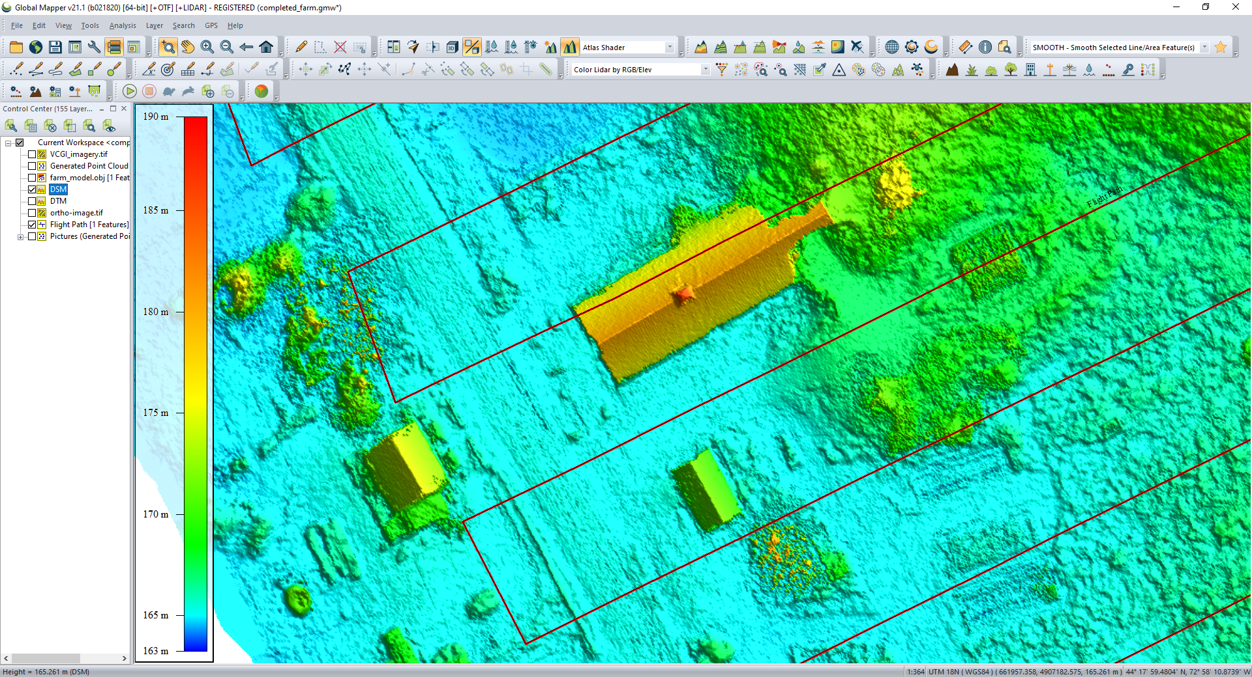
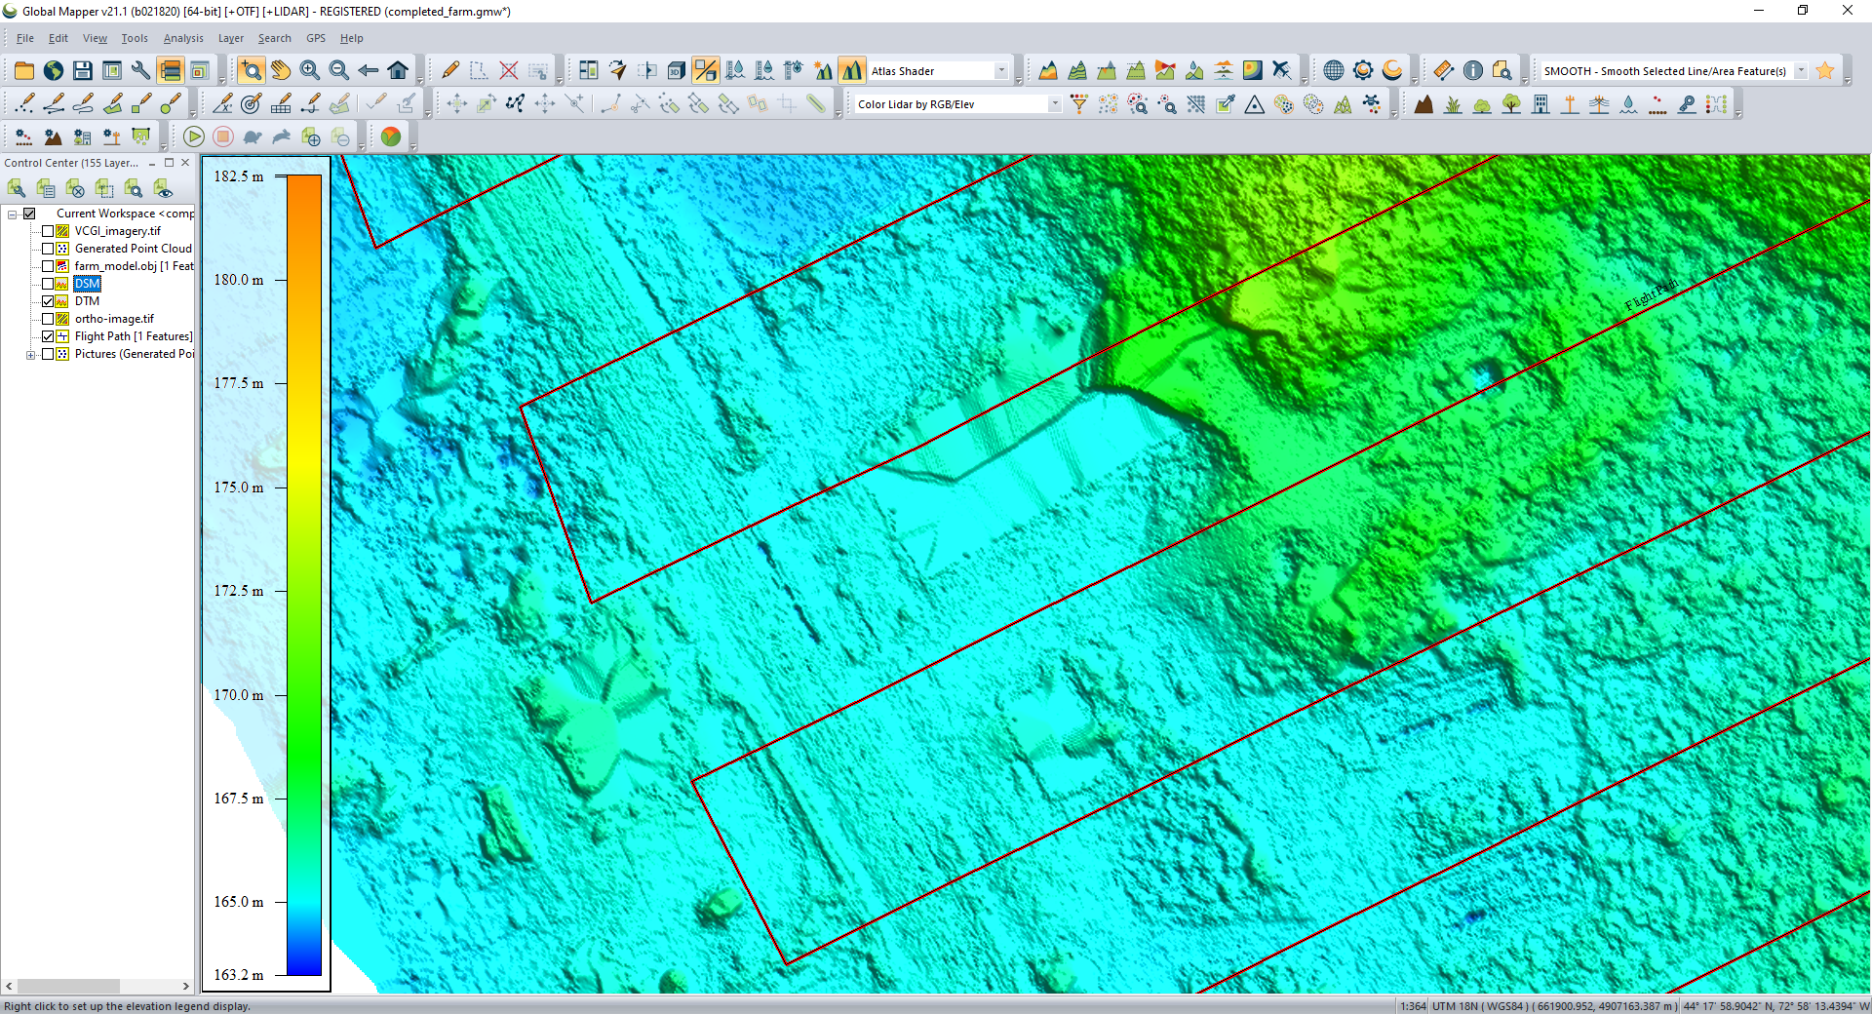

Slide 16
Data Analysis
Defining Flight Path & Loading UAV Photos
Photogrammetric Point Cloud Generation
Manipulation - 3D Modeling – DSM/DTM
Visualization – cross section profiles, cross profiles, best fit adjustment

Slide 17
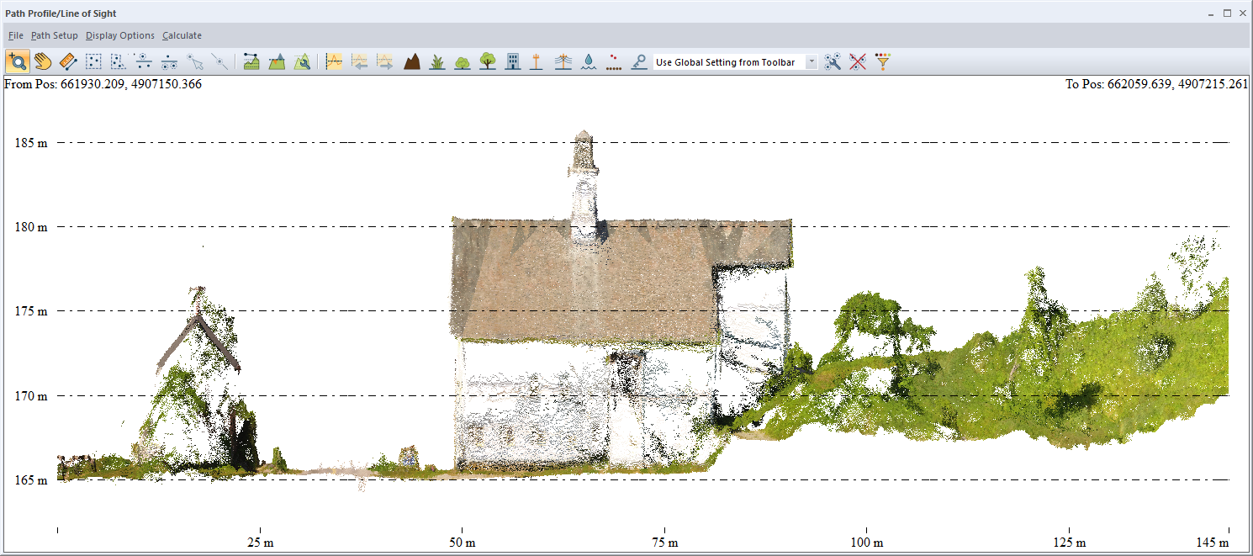
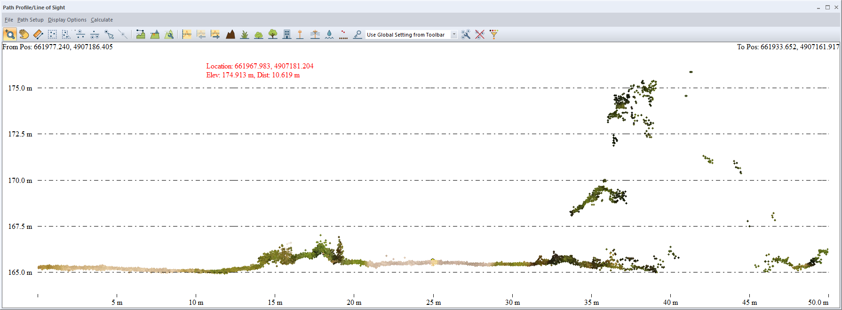

Slide 18
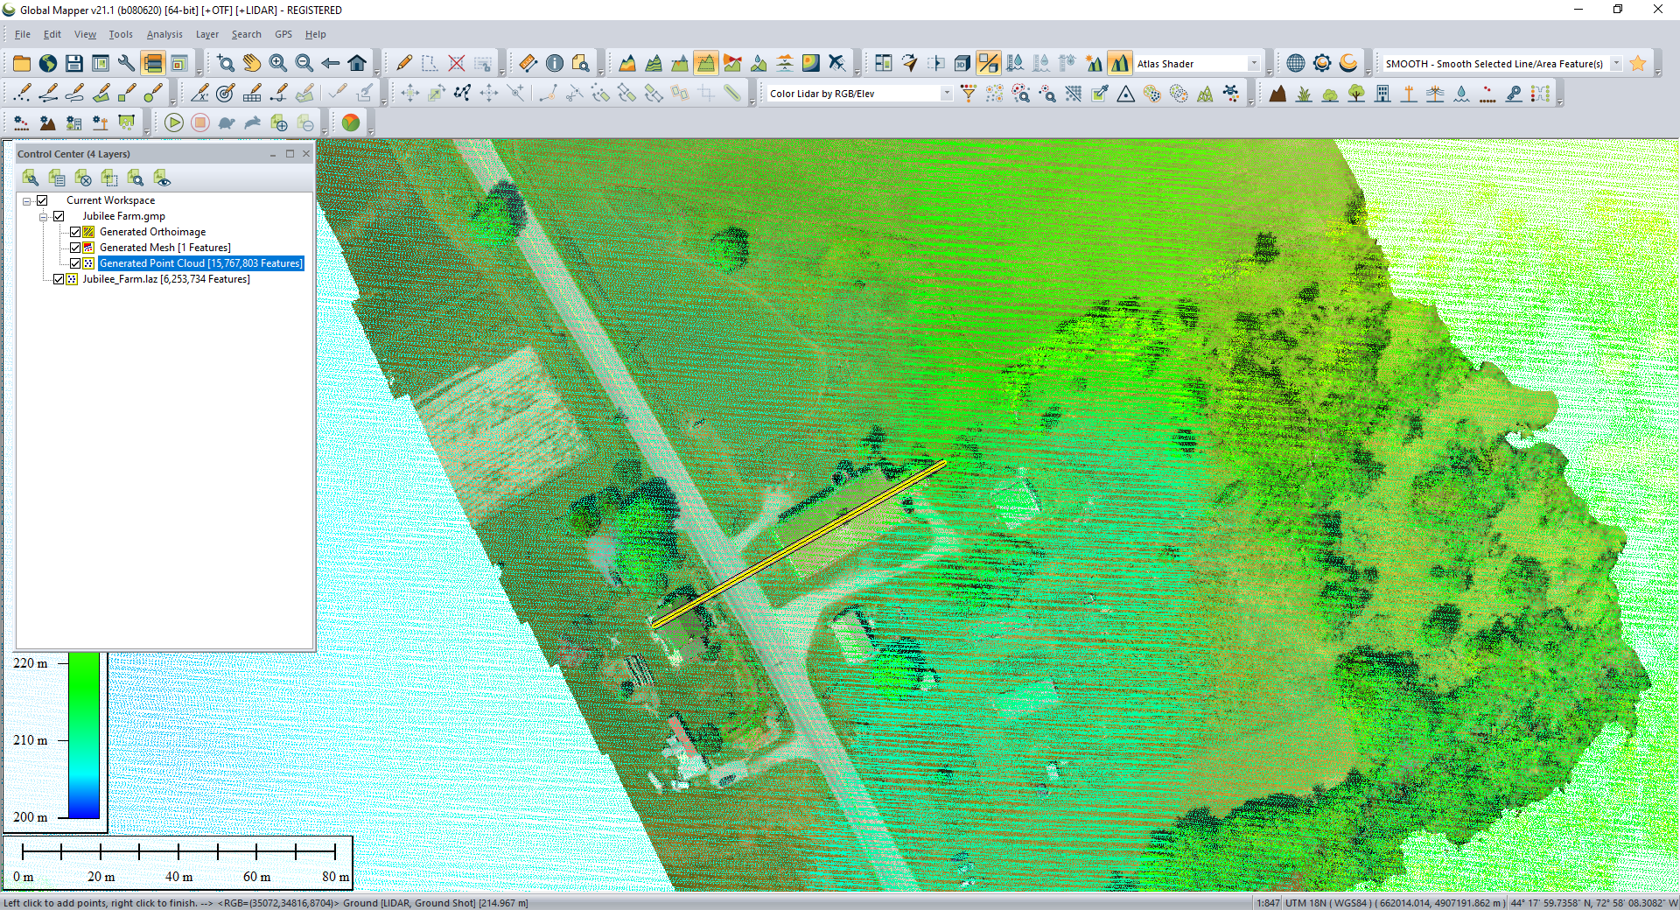
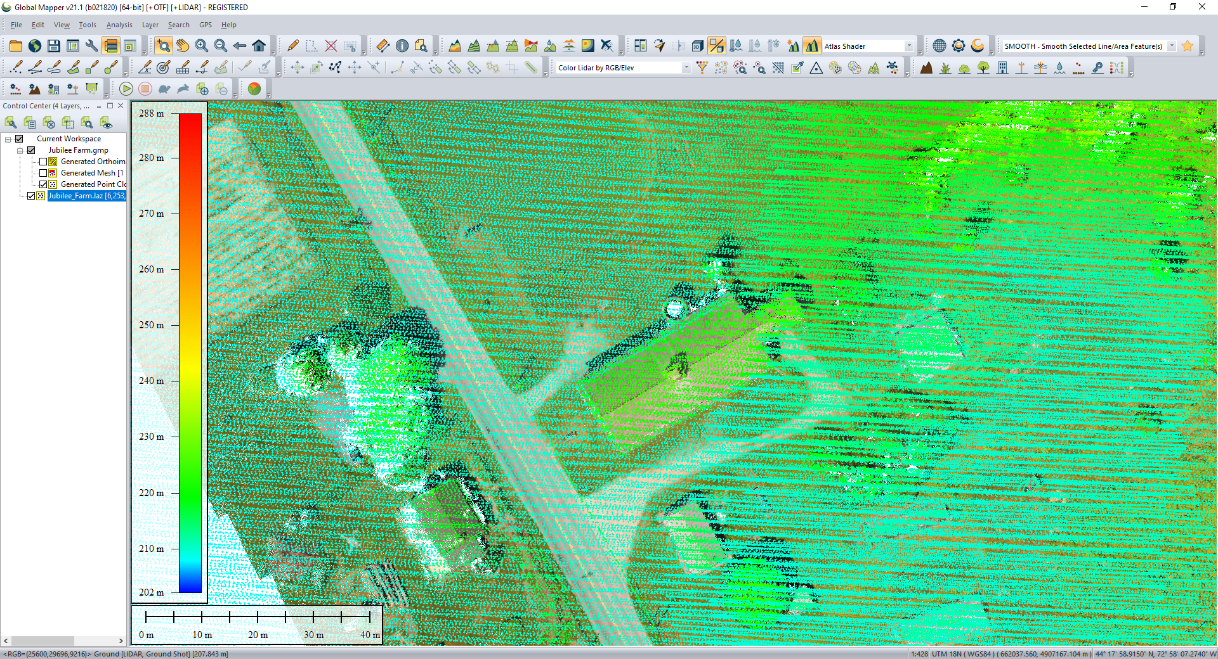
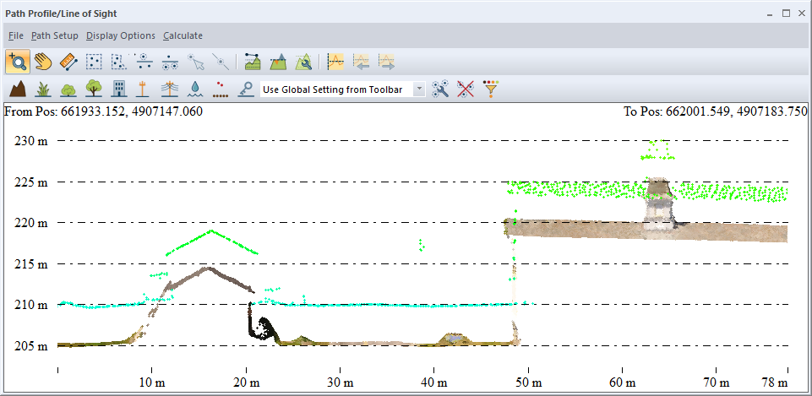
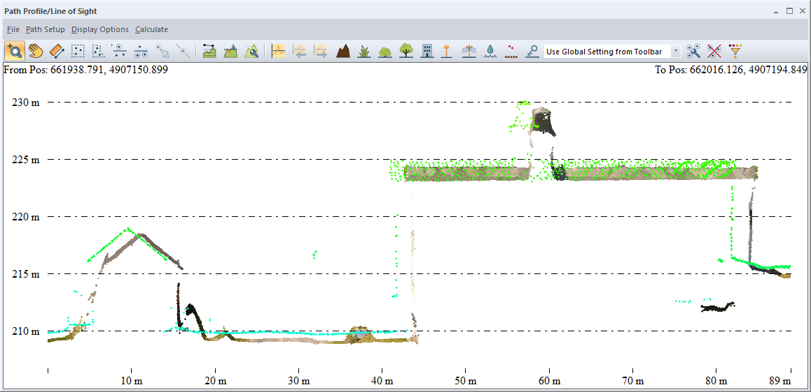
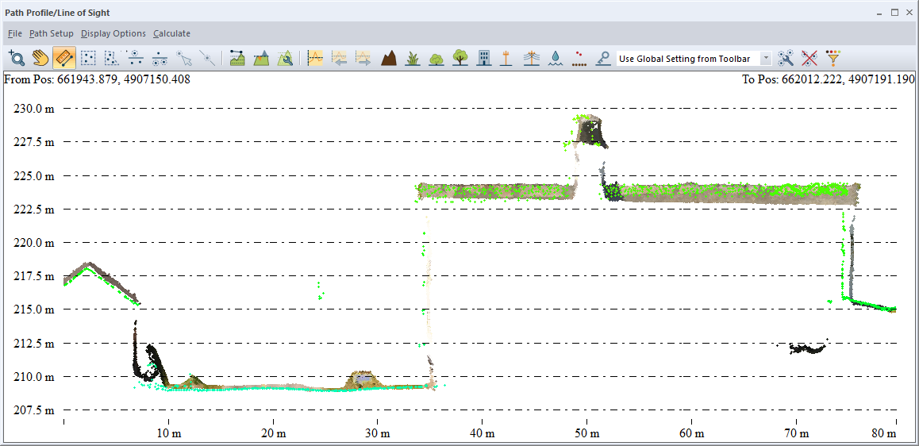
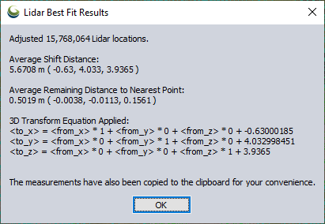

Slide 19
Dissemination
3D Web Viewers (Sketchfab, 3DHOP)
Virtual Reality / Augmented Reality / Mixed Reality
Google 360 video, Google Cardboard
Unity
Microsoft HoloLens
Replicas and reproductions
3D printing
Simulate repairs or reconstruction after damage
Notes:
http://vcg.isti.cnr.it/3dhop/demo.php#external
https://archaeologydataservice.ac.uk/archives/view/lascuevas_uchn_2016/viewer.html

Slide 20
BGC Engineering Case Study Integrated Mine Planning – 2018
Notes:
Discovery / Pre-excavated sites
El Mirador (Example 1)
Damaged or lost sites
Project Mosul / Rekrei (Example 2)
Pompeii (Example 3)
Reconstruction from volunteered photos
General Access and Education
CyArk (Example 4)
Zamani Project (Example 5)
VR / AR
Replicas
Accurate maps
Historical reconstruction

Slide 21
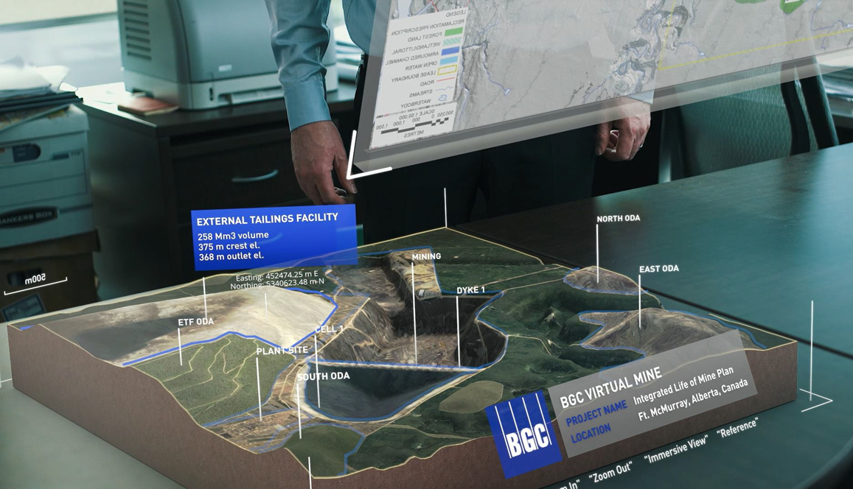

Slide 22
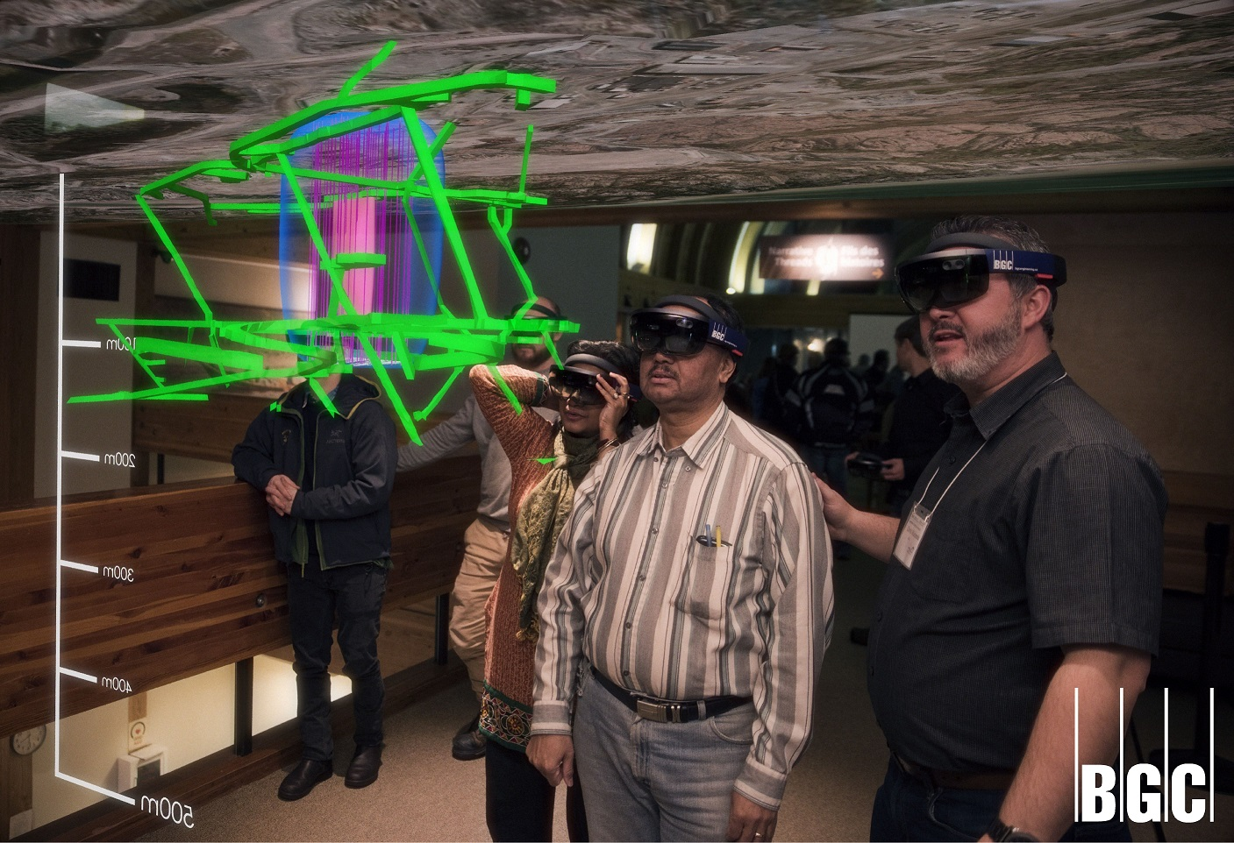

Slide 23
Thanks and Be Safe!
August 12, 2020
Kris Berglund
Vice-President, Sales

