Slide 1
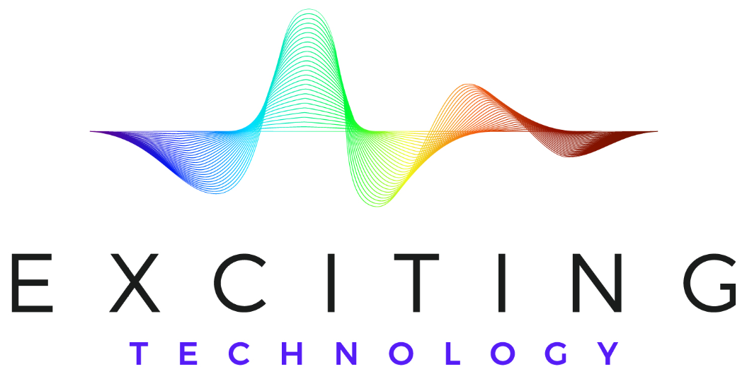
New Optical Beam Steering Technologies

Slide 2
Two Main Topics
A new Mechanical Approach
  Uses existing Components, so can be easily built
  Patent pending
  Can steer ±45 degrees, from an arbitrarily large aperture, > 200 hertz
New non-mechanical approaches
  Will further develop one of them during a phase 2 SBIR
    ±30 degrees
    2.5 cm aperture
    < 5 µsec steering time
  Second Approach ±60 degrees, < 20 µsec steering time

Slide 3
Background
Steering using decentered lenses has been around for years.
  Below shows 2 lens steering and 3 lens steering

Slide 4
Significant aspects of decenter lens based Steering
A piezo plate or a pair of piezo plates move a lens
  A smaller lens creates a larger angle for the same displacement
  Piezos are limited in the amount of displacement
  Higher frequency means piezos move a smaller distance
Magnification reduces steering angles
Usually to steer 2 dimensions a single lens is moved in 2 dimensions
  This limits the total movement
Traditionally steer small angles and small apertures

Slide 5
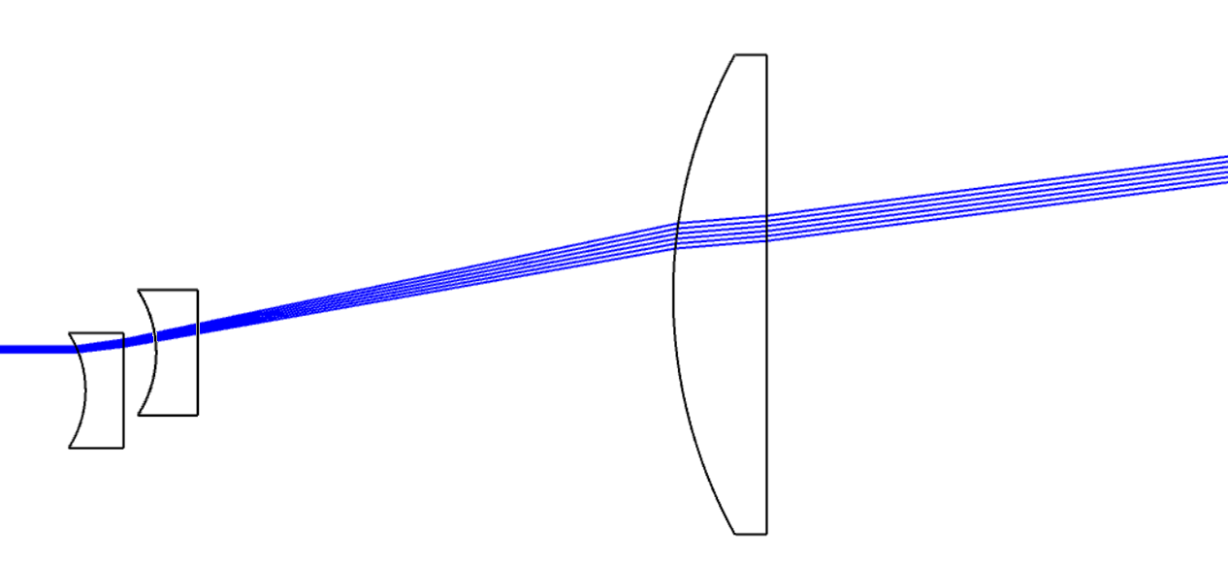
1st Major Improvements in Our Design*
Steer and magnify at the same time
  Allows larger angle steering with larger aperture
Move two lenses, one in azimuth and one in elevation
  Increases allowed movement by a factor of 10 or even more
* Patent pending

Slide 6
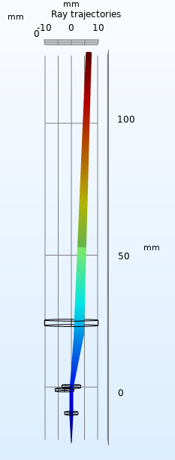
Stage 1 Steering
The steerer consists of at least three lenses; two small moving negative lenses and one fixed larger positive lens
No focus. Can steer plus of minus 10 degrees

Slide 7
Stage 2 - Decenter Lens Steering with Virtual Beam Displacement
The major limitation of decentered lens beam steering is the available motion
  From Piezo-electric devices, or electro-magnetic motion.
  This is rapid, but small motion.
In this approach we use a version of stage 1 to create larger virtual motion at the field lens.
  This allows steering to larger angles

Slide 8
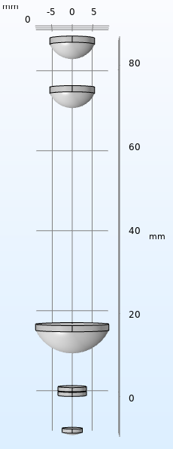
Second Major Breakthrough
( Stage 1 and 2 Steering)
The steerer consists of at least five lenses, two small moving negative lenses, one fixed positive magnifying lens, one fixed positive field lens, and one fixed positive re-collimator lens
Can steer to > ±50 degrees.
Moving negative lens 1
Moving negative lens 2
magnifying lens
field lens
Final Aperture
Fiber collimator lens

Slide 9
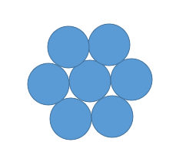
It is possible to independently steer more than 1 laser beam
One beam will be directly down the center of the lens system
  We can have 6 more around the center beam, each one tilted so the center of their beam system passes through the field lens, but at an angle.
  The center beam will steer ± 50 deg. The 6 around center will steer ~ ±40 degree around their center line
Field lens

Slide 10
Revolutionary Non-Mechanical Beam Steering

Slide 11
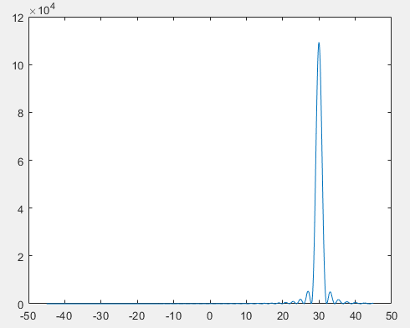
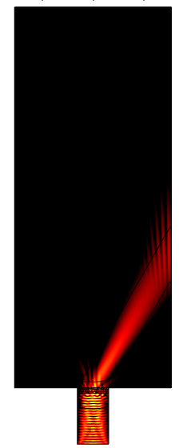
Far Field Pattern
For 30 degrees steering, and 1,06 um

Slide 12
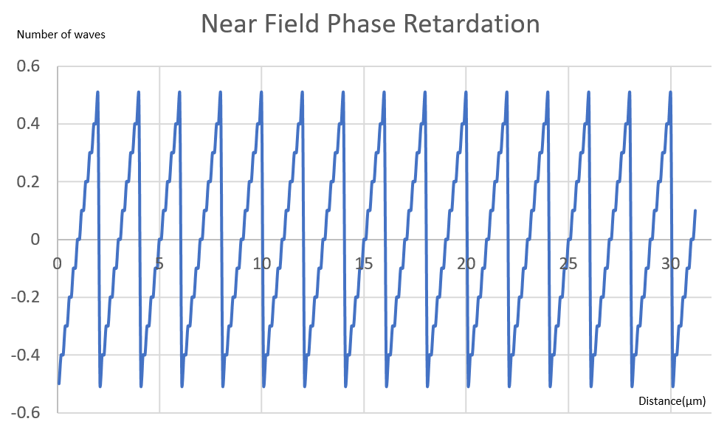
Near Field for this case
Sawtooth, with steps

Slide 13
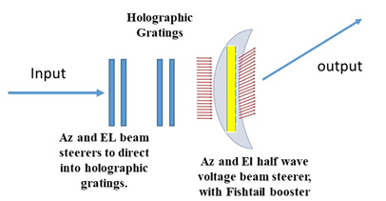
Wide Angle beam steering ( > +, or – 60 degrees)
Use a couple Volume Holograms before steering
  Can use polarization birefringent gratings to steer into each volume hologram
  Use new, simple to fab, steering after volume holograms

Slide 14
Wide Angle beam steering ( > +, or – 60 degrees)
Can use +10 deg, and -10 degree into VHGs
VHGs can Steer another 20 deg, or 30 deg
Continuous beam steering using half wave voltage approach
  Up to plus or minus 20 degrees, without fishtail
  + or – 30 degrees with fishtail
10 degree, PBG, 20 deg VHG, 20 deg half wave =50 degree
  Conservative. VHG can be large, can use fishtail
Can get high efficiency, continuous, steering at + or – 60 deg

Slide 15
Active Media
KTN is baseline
  Working on thin, single crystal, layers
  Can use ceramics, but need 3x the voltage
Looking at MWIR materials as well
Investigating Quantum Dots
  Need to learn more
  Steers both polarizations
  Can get > 1 index change.

Slide 16
Summary
Have invented a revolutionary >±45 degree mechanical steering approach
  Arbitrarily large apertures (e.g. 15 cm, 20 cm, 50 cm, or more)
  200 Hz
  Available components. No development required
Non- Mechanical ±30 to ±60 degree steering
  > 20 Khz
  No moving parts
  Available in 24 months at 2.5 cm aperture size.

