Slide 1
Auto Lidar Benchmarking

Slide 2
Auto Lidar benchmarking
Goal: Develop standard benchmarking tests for auto lidar performance
There are no testing standards now
How does an auto company or a tier 1 supplier evaluate auto lidars?
Test originally Planned for SPIE Defense and Commercial Sensing (DCS) Symposium in Anaheim.
At a baseball stadium parking lot
Current plan is to test at DCS in Orlando, 11 - 15 April 2021
May do some preliminary tests, depending on the virus

Slide 3
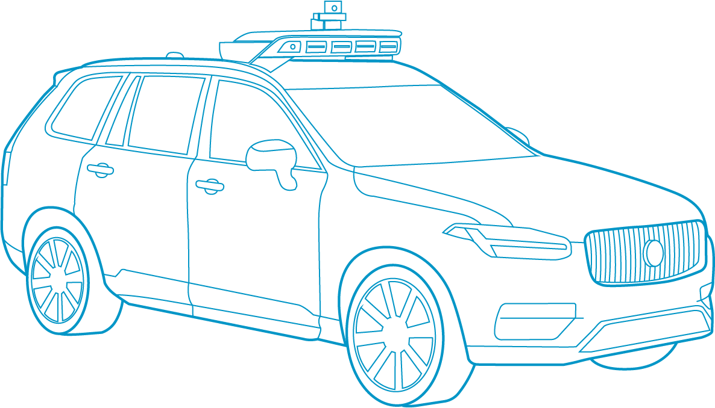
Autonomous Vehicles
Lidar will be a critical Sensor, but not the only one
Radar, and visible Sensors, and maybe acoustic sensors, will be used
360° LiDAR
Rear and
Side cameras
Front-facing
cameras
360° Radar Coverage
Custom Software
Onboard Computers
Accelerometers / Gyroscopes

Slide 4
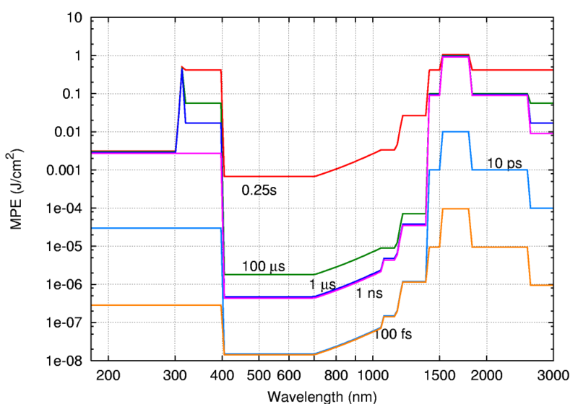
Eye Safety Considerations
Chart shows relative Eye safety threshold
1 j/cm² @ 1.5 µm, and 1E-6 j/cm² @ .9 µm for nsec to µsec pulse width
This is for nanosec pulse widths, and a 10 second exposure time. Scanning will increase allowed power, to reach threshold energy in 10 seconds

Slide 5
Coherent vs Direct Detection
Coherent detection requires an LO, so more complexity
Much can be “borrowed” from radar
Coherent Detection can use high duty cycle waveforms, but will need narrow line width lasers
High duty cycle makes it easier to use laser diodes
Coherent detection can measure velocity
Could be an edge sometimes, e.g when someone is stepping off the curb
Coherent detection will have speckle issues
Have to average out speckle, so likely will have lower sample rate
Coherent Lidar has GREAT discrimination against other lidars
The case of 6 lanes of traffic each way is made for coherent lidar

Slide 6
Laser Options
~905 nm laser diodes are popular
Laser diodes are peak power limited, because you cannot Q switch a laser diode
Coherent lidars do not need pulsed lasers
Most designers will match one laser diode to one detector
Laser diodes can be made on wafers, so require very little touch labor
At 905 nm they will have a low eye safety threshold (1E-6 j/cm² )
~1550 nm
Eye safer wavelength (1 j/cm² )
Usually will use a fiber laser
Fiber lasers can cover many detectors.
Fiber lasers require more touch labor
Most auto lidars will be pulsed, direct detection, but can use coherent LFM, with high duty cycle

Slide 7
Team
Paul McManamon, Chair:
Jeremy Bos, Vice Chair: Michigan Tech
Hamzeh Alzubi: Senior controls engineer at FEV North America
Joe Buck: Lockheed Martin Senior Fellow
Christy Cull: Head of Sensors at Lyft, Level 5 Self-Driving Division; leads AV-sensors at L5 encompassing camera, lidar, and radar.
Zack Jeffri: Michigan tech grad student.
Charles Kershner: Project scientist at NGA.
Dennis Killinger: Has 50 years of lidar experience.
Greg McKee: Labsphere chief technologist;
Prem Rachakonda: NIST. familiar with measurement precision and standards.
Dan Sawyer: NIST. familiar with measurement precision and standards.
Joe Shaw: Professor of electrical and computer engineering, Montana State University
Vasanthi Sivaprakasam: NRL lidar employee .
Andri Van Rynbach: AFRL lidar researcher.
Ed Watson: 35 years of lidar experience.

Slide 8
Team
Test Execution Panel:
Cullen Bradley: Lead test engineer
Eddie Ruff: Assistant test engineer
Definition and Analysis panel:
Jeremy Bos: Assistant professor of electrical and computer engineering, Michigan Tech.
Zack Jeffri: Michigan Tech grad student.

Slide 9
Initial Test Range
250 meters long
Initially 2 lanes
Lane 1 – basic tests
Lane 2 – add confusers
Stop signs
Large corner cubes to simulate other lidars.
2nd year may add 3rd lane for weather
Range finder to measure range to targets
Ground truth Lidar
Thank you Charlies

Slide 10
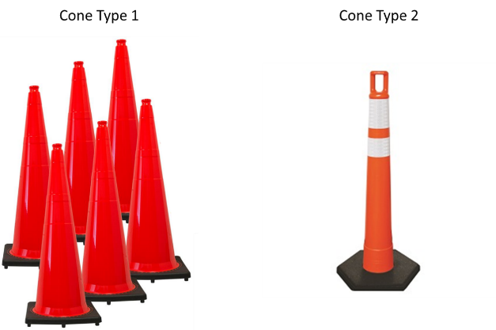
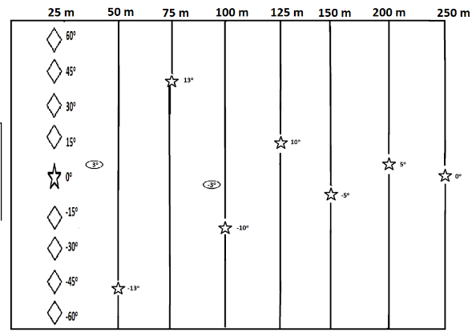
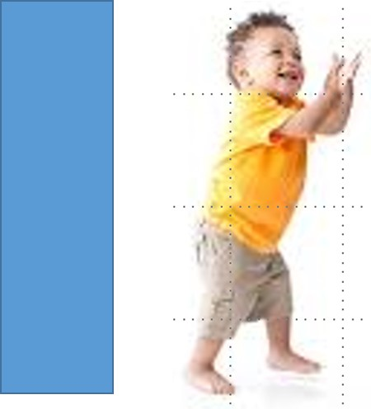
Lane 1
Toddler corner case
25 meters out to 250 meters, 10% reflective
Toddler case 80 cm tall, by 24 cm wide
Elevation and azimuth FOV tests targets spread out)
Eye safety

Slide 11
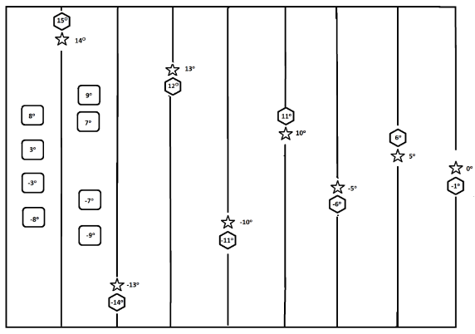
Lane 2 tests
Many tests from 1st lane
Stop signs
Large corner cubes to simulate other approaching lidars
Close range

Slide 12
Working on processing
Dr Andre VanRynbach at AFRL in charge of processing
Can we do real time automatic capture, and processing, of data?
We would like
10 seconds of lidar measurements, at about a 10 hertz frame rate
Range and deviation in range from ground truth
Position horizontally and deviation in horizontal position from ground truth
Position vertically and deviation in vertical position from ground truth

Slide 13
Conference Interaction
Brief results in the exhibit hall
Discussion
What should be change?
Path to a standard
Team will publish an article in Optical Engineering

Slide 14
Moving Toward Standards
Goal of auto lidar testing standards within 3-4 years
Hope to get the Society of Automotive Engineers, SAE, involved after 1st year
Revise testing each year

