Slide 1
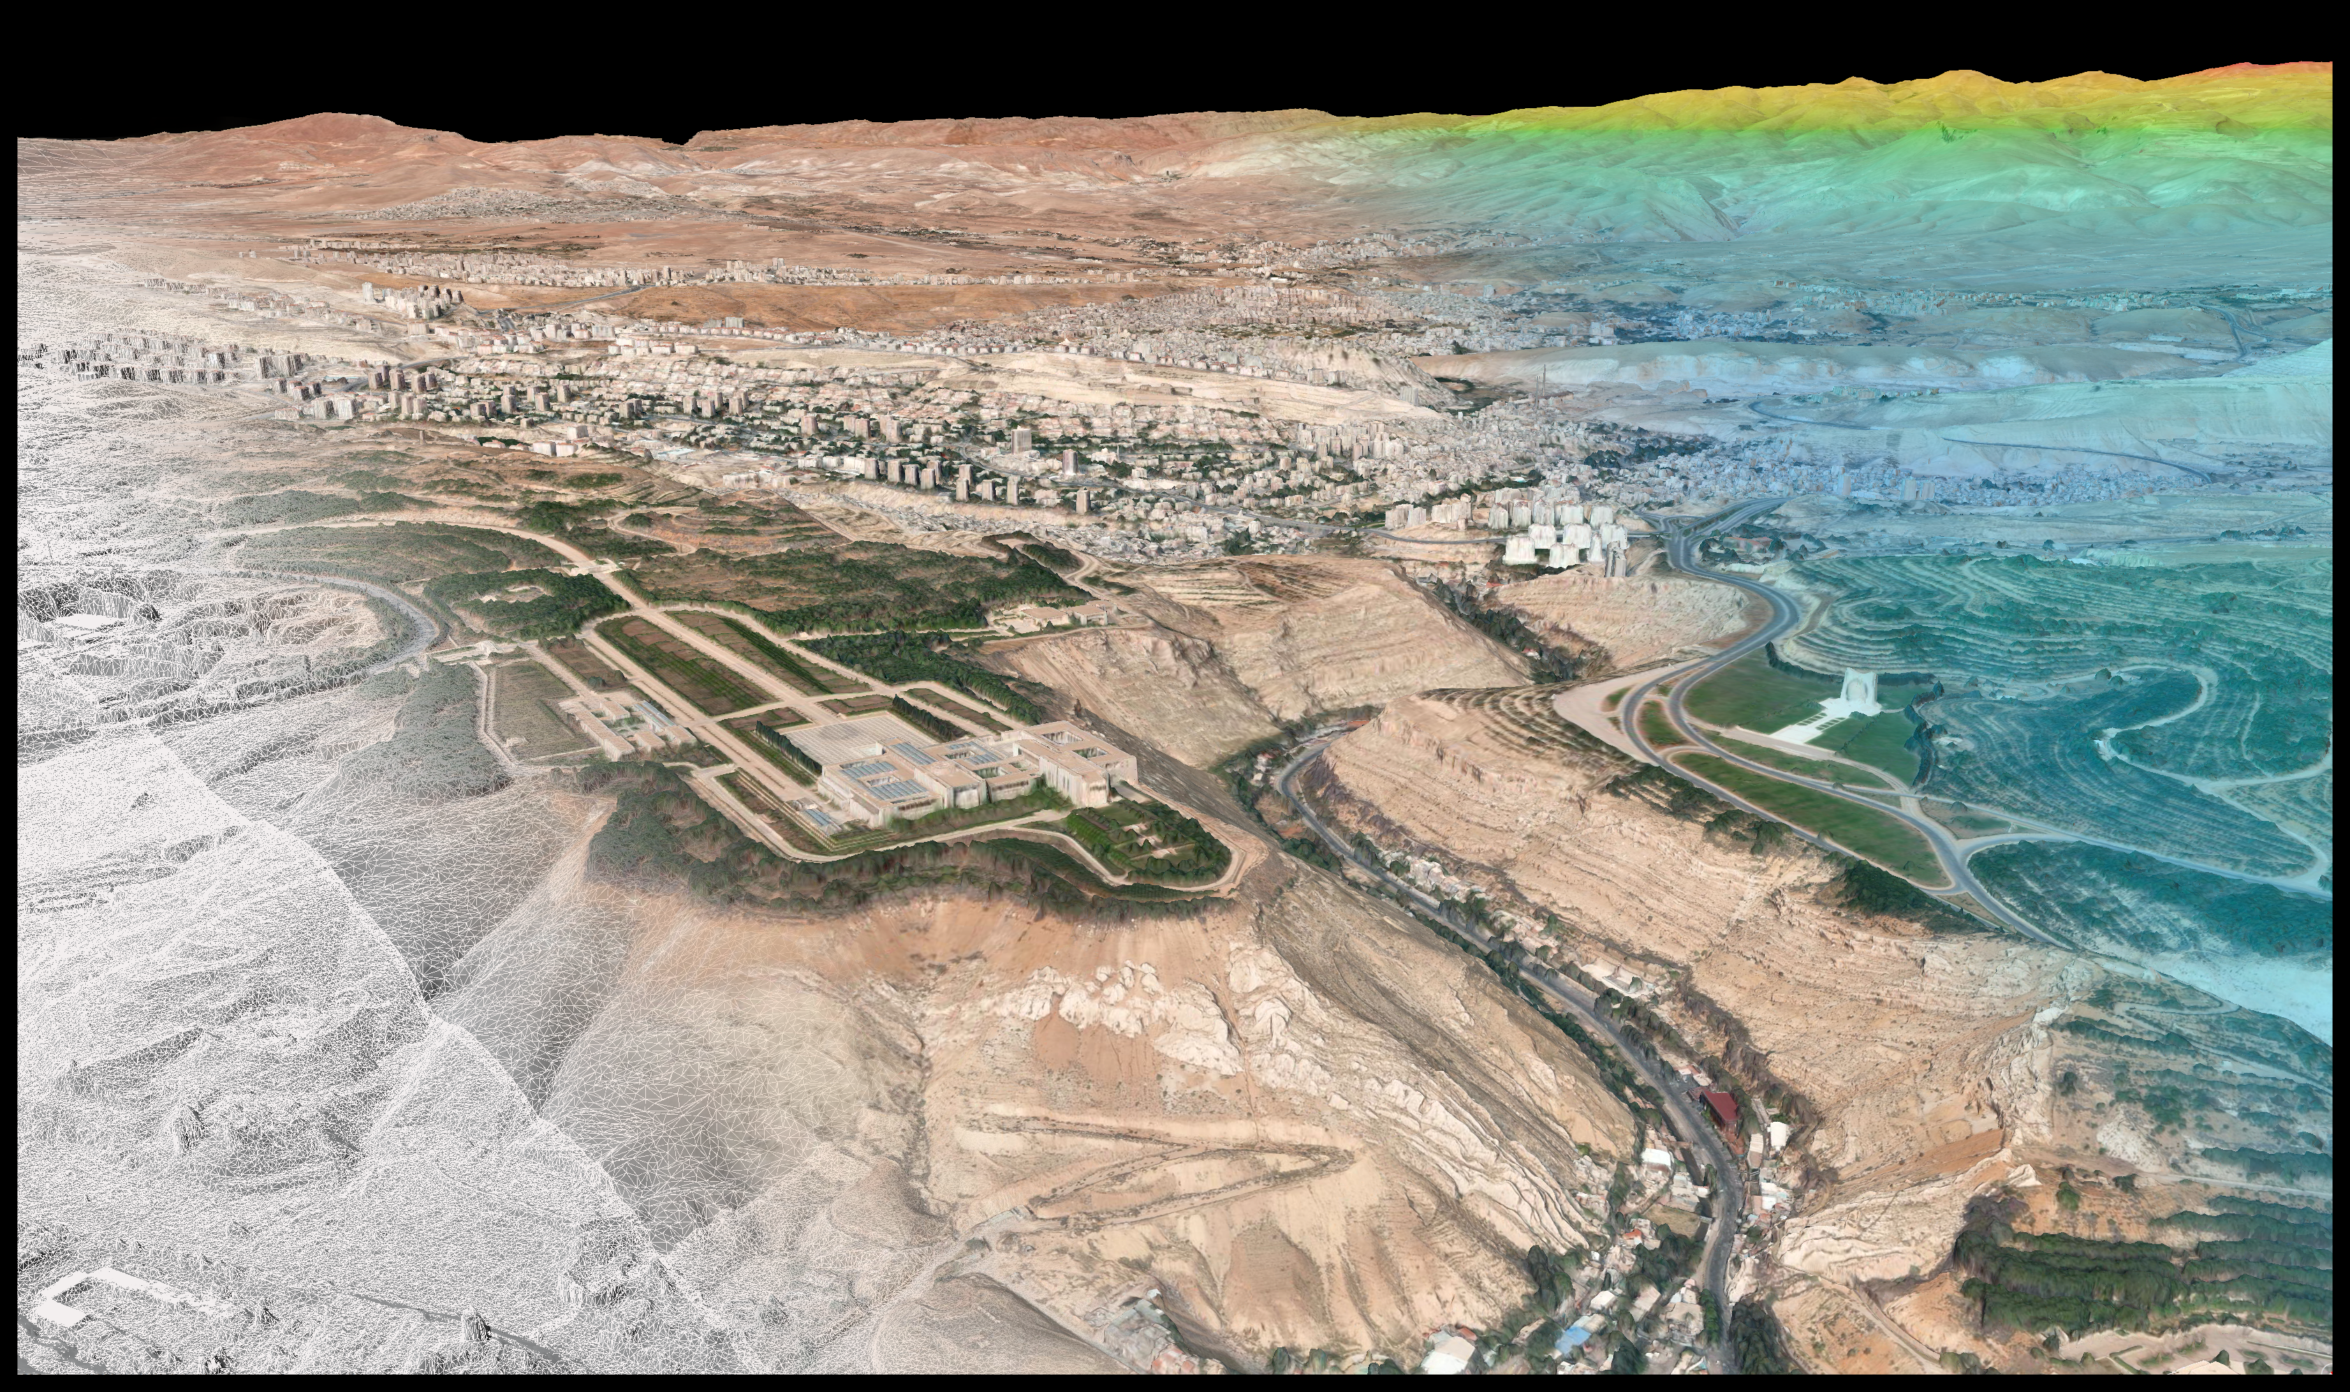
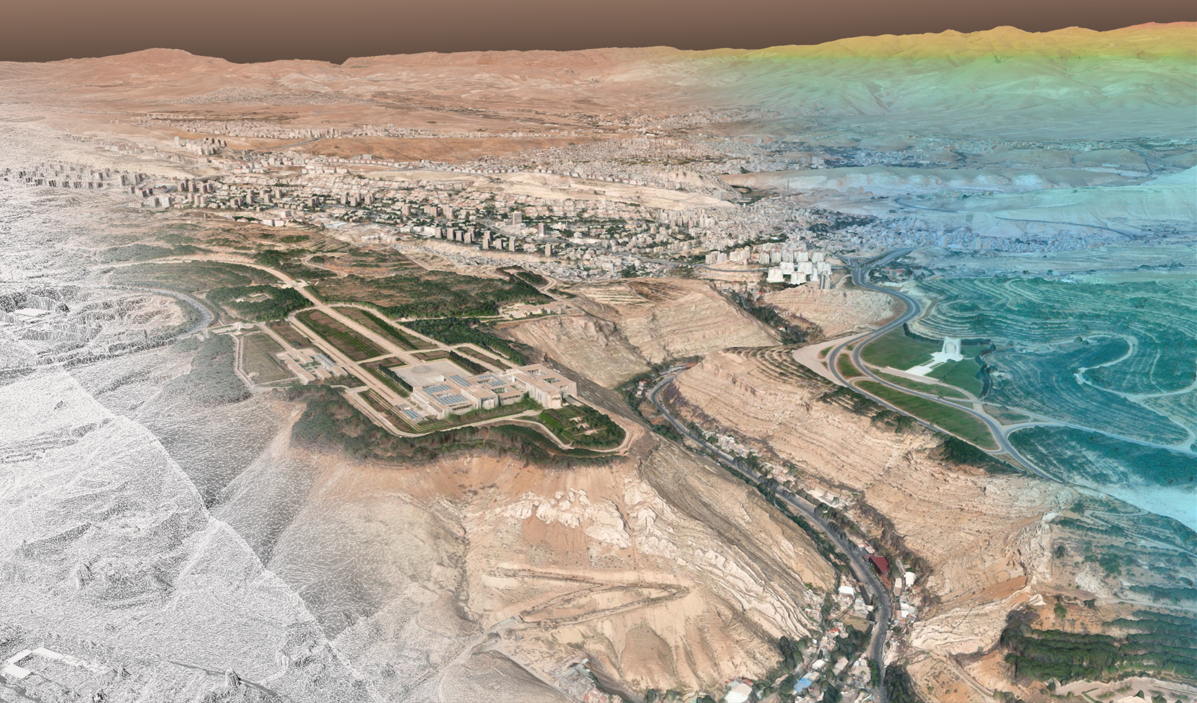


VRICON THE GLOBE IN 3D
2020-08-06

Slide 2
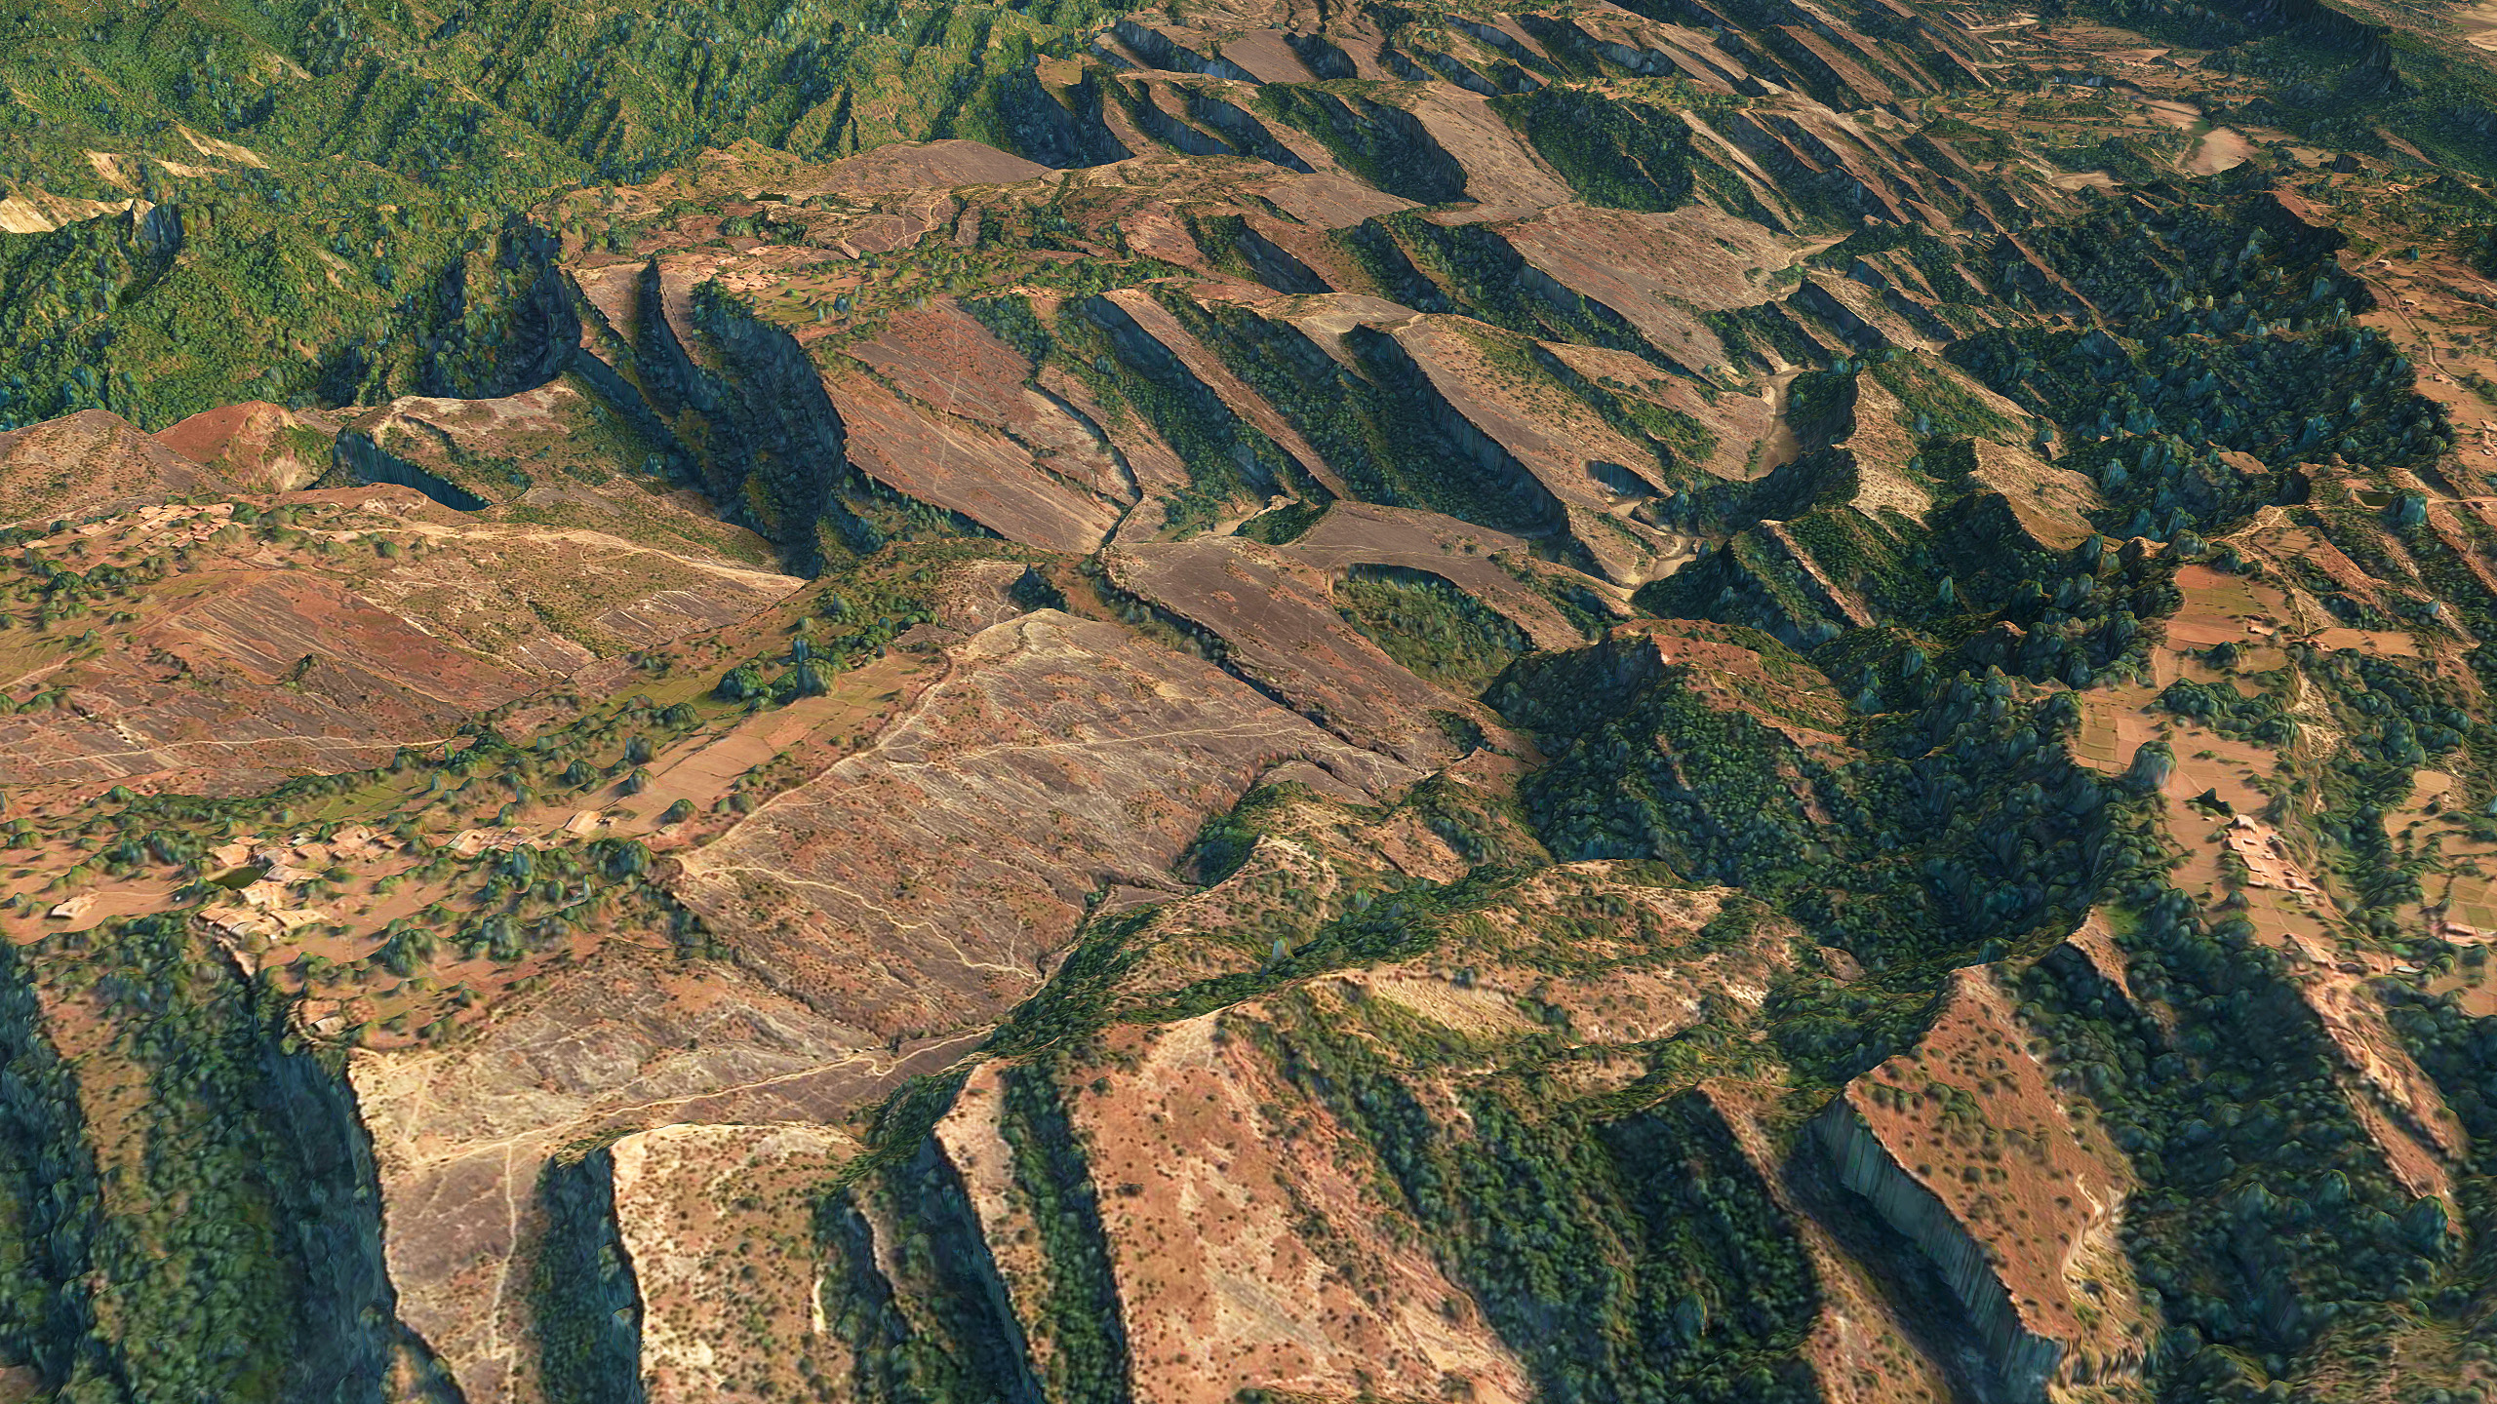

Introduction – What are accuracy and precision?
Precision in a scene
Accuracy assessment
How do we convey accuracy and confidence in data
GPM and the NGA way forward
Questions
Vricon (Maxar) / NGA CRADA Overview
VRICON THE GLOBE IN 3D
Slide 2

Slide 3
In measurement of a set…
Accuracy is closeness of the measurements to a specific value
Precision is the closeness of the measurements to each other.
In other words, Accuracy symbolizes the extent of conformity, whereas Precision indicates the extent of reproducibility.
Definitions - What ARE ”Accuracy” and Precision
VRICON THE GLOBE IN 3D
Slide 3

Slide 4
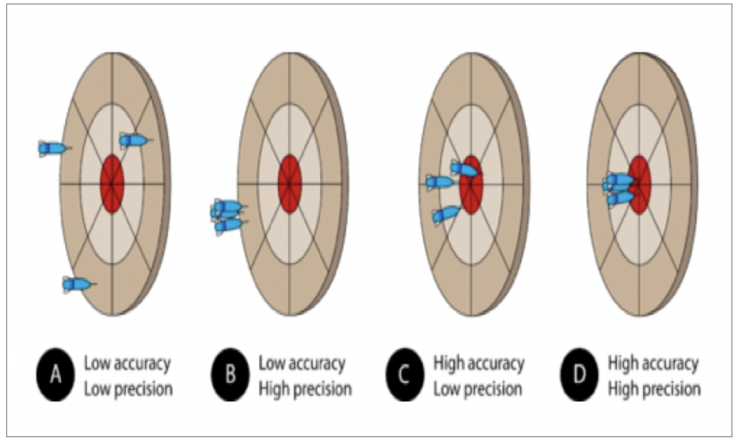
Precision versus Accuracy
In darts where the objective is to hit a single zone of the board repeatedly, both accuracy and precision are important – using drones and automated custom software terrain imagery is captured
Accuracy – Hitting the specified point on the board (bullseye, 20, tripple 2, etc.)
Precision – Repeated contact of the same location on the board with each dart

Slide 5

Does the distinction make a difference?
Yes - Let’s look at a football situation…
When the Referee places the ball on the field, he is able to use his (and the Wing Officials) judgement as to where the ball was at the instant the carrier’s knee or elbow touches the ground. The issue is one of accuracy, and it can be a game changer.
When a measurement is called for, the chains are marked within one link, and then moved to the ball site. Migrating from the sideline by this method is an issue of precision (i.e. repeatability) irrespective of whether the ball was placed correctly in the first place
The result can occasionally be comical as a placement which is off by several feet is measured to ½ inch.

Slide 6
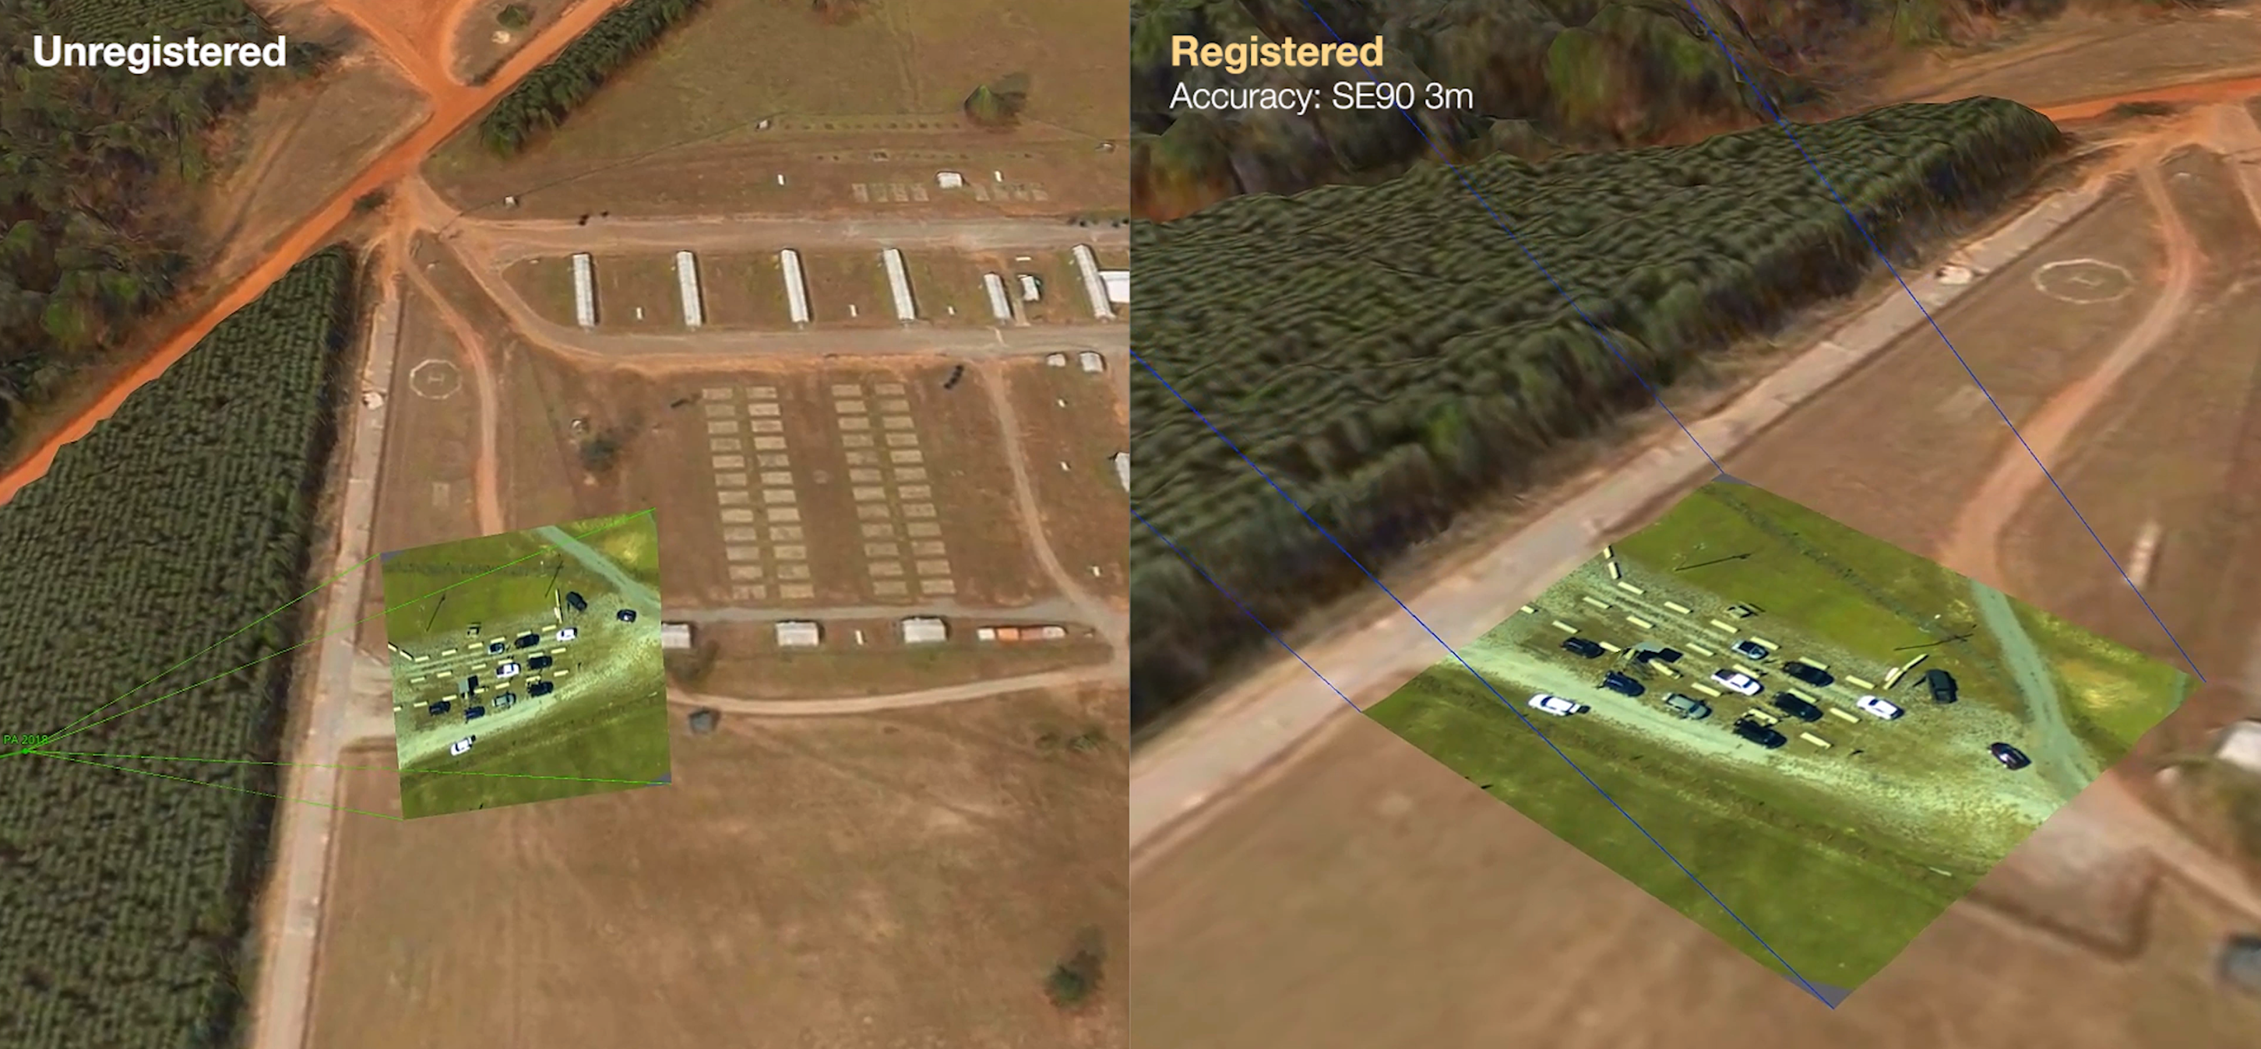
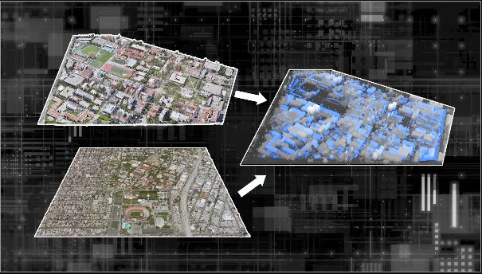
Implications of Accuracy for Foundation Data Applications
The situation is less comical when the issue is delivery of a payload
  the process of assigning real-world coordinates to each point of an image map.
Control Points
  Specific point locations that have been geolocated and their coordinates verified geospatially so that they can be used to correlate different image maps accurately
The original uploader was Rchoetzlein at English Wikipedia. derivative work: Lobsterbake (talk) - Mesh_overview.jpg
Georeferencing Examples
VRICON THE GLOBE IN 3D
Slide 6

Slide 7
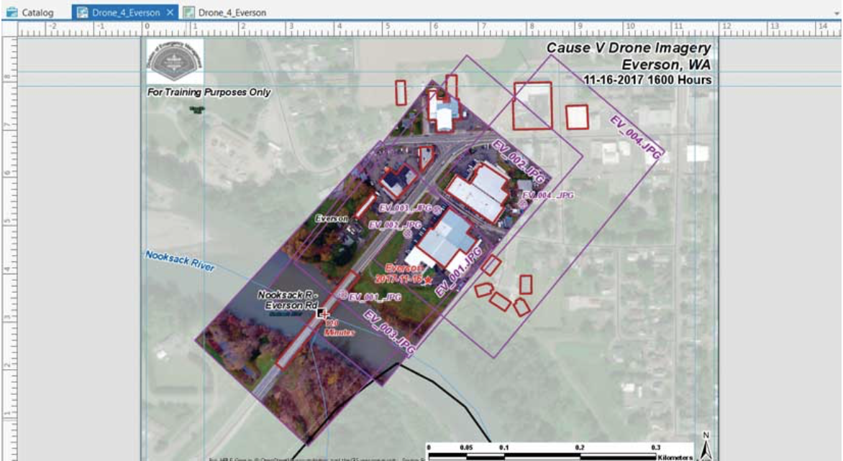
Georeferencing
Georeferencing
  the process of assigning real-world coordinates to each point of an image, map or mesh.
Control Points
  Specific point locations that have been geolocated and their coordinates verified geospatially so that they can be used to correlate different image maps accurately
The original uploader was Rchoetzlein at English Wikipedia. derivative work: Lobsterbake (talk) - Mesh_overview.jpg
Georeferencing Examples
VRICON THE GLOBE IN 3D
Slide 7
Notes:
Vricon has developed and implemented means to calculate predicted error information as a metadata layer inside of the 3D surface model
Predicted Error: A user can click on any point to instantly return error metadata
CE90/LE90 as well as full error covariance available
3D visualization of full error ellipses
Other Metadata: Examples shown on the right show error metadata visualized, however other metadata can be included as well (Date range used for 3D production, FOM for P3DR’d image, etc.)

Slide 8
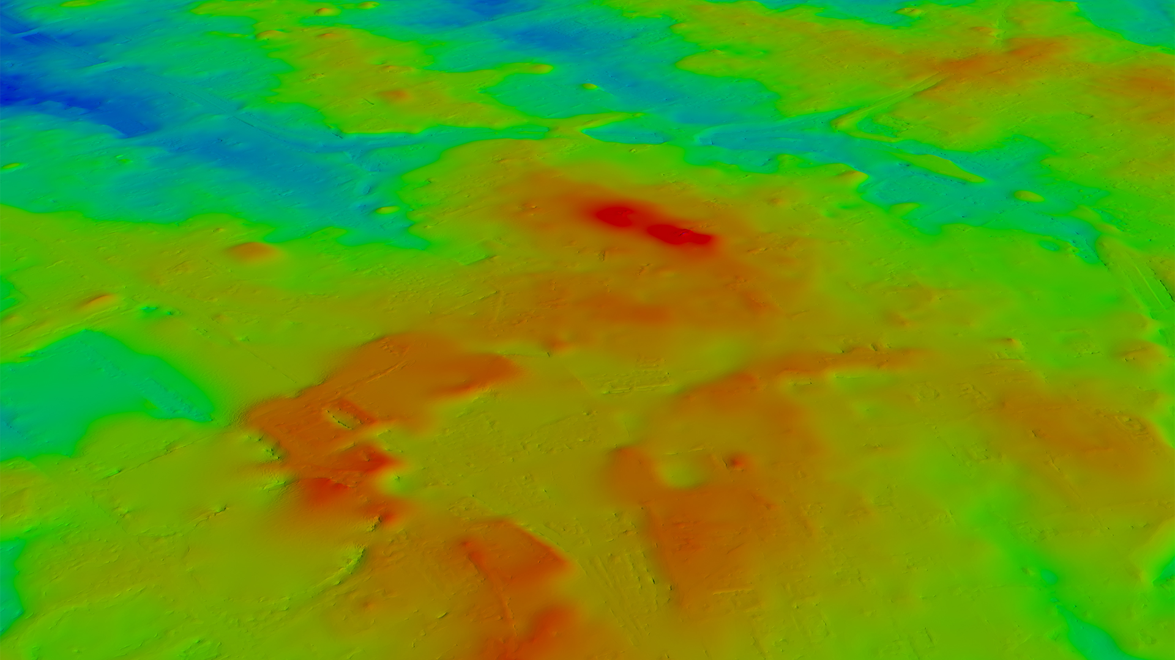
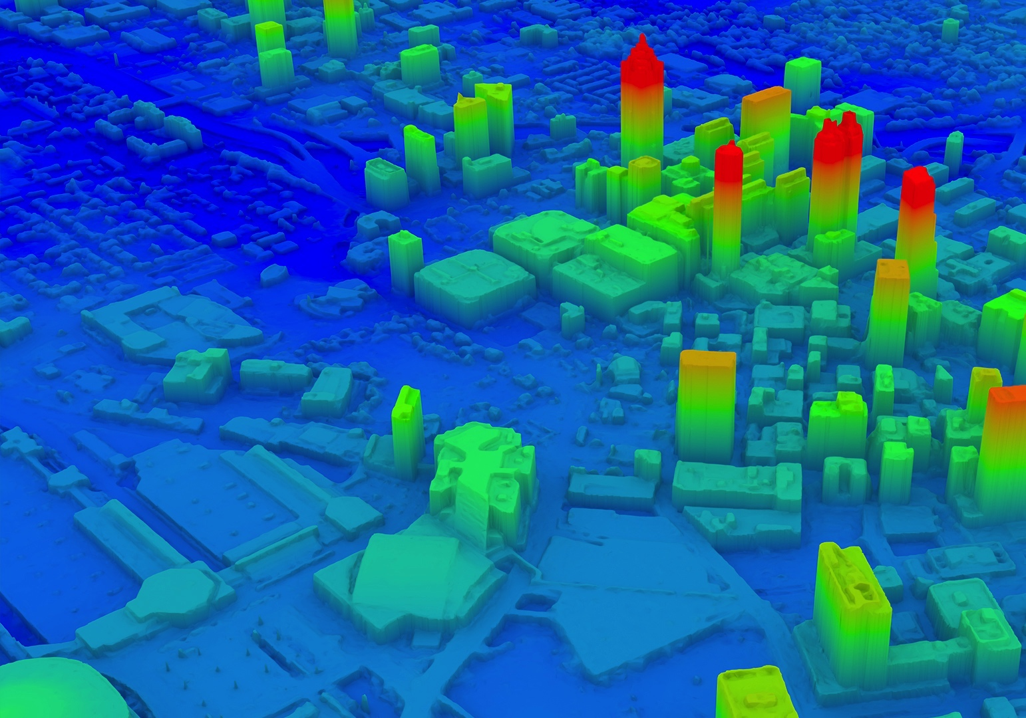
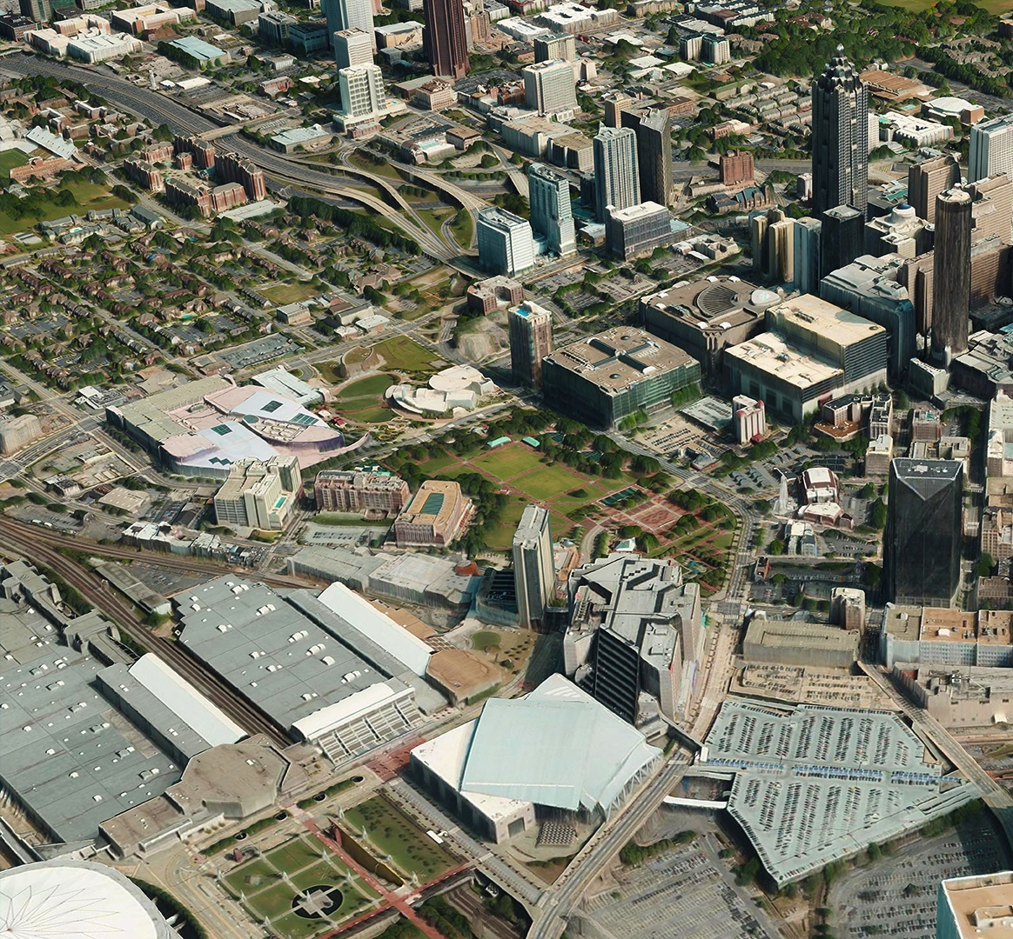
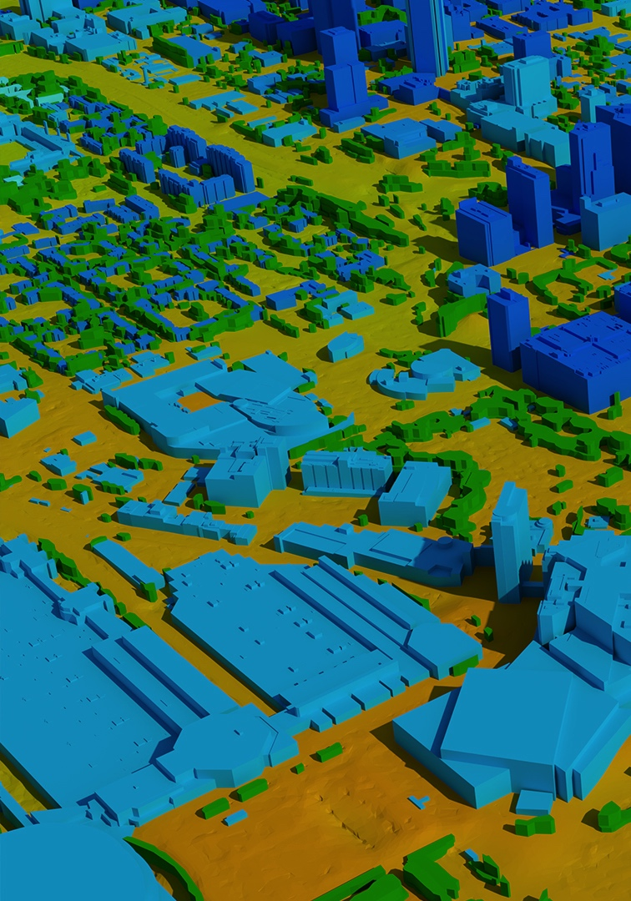
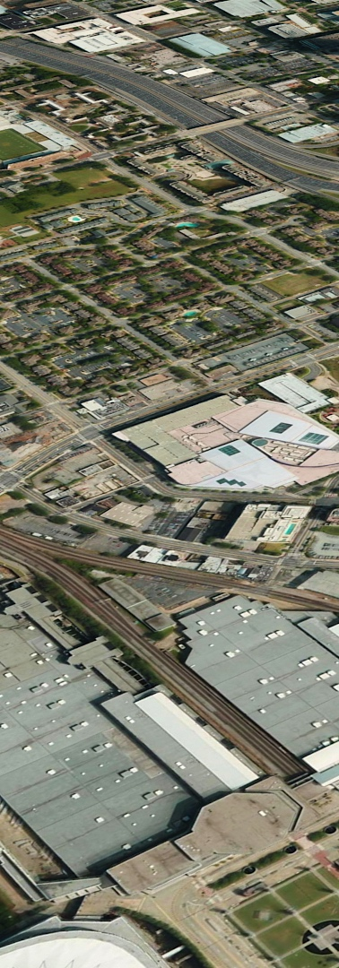
TRUE ORTHO
3D VECTORS
3D SURFACE MODEL
DIGITAL SURFACE MODEL
DIGITAL TERRAIN MODEL
VRICON THE GLOBE IN 3D
Slide 8

Slide 9
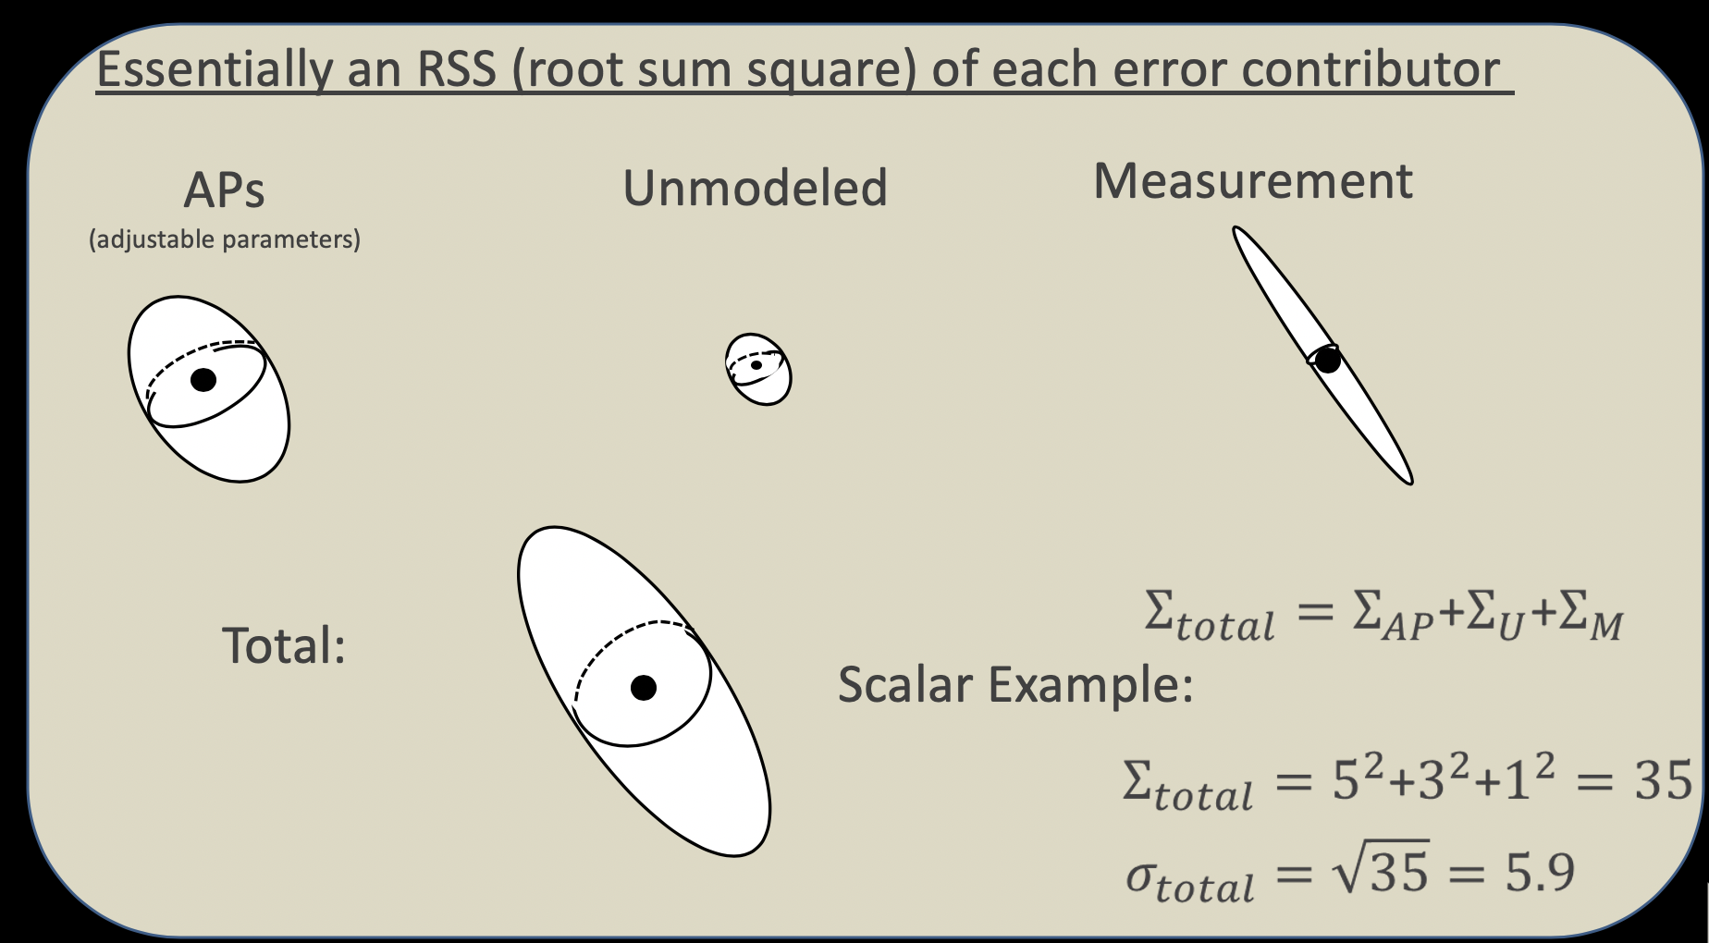
Absolute Geolocation Error Propagation
Each of several components of position error contribute independently to the total error
  These can be aggregated into the groups, and then spatially averaged to create a total error per location
Separate or Aggregate?
  Different tools for error characterization choose to join the terms or leave them as separate for clarity

Slide 10
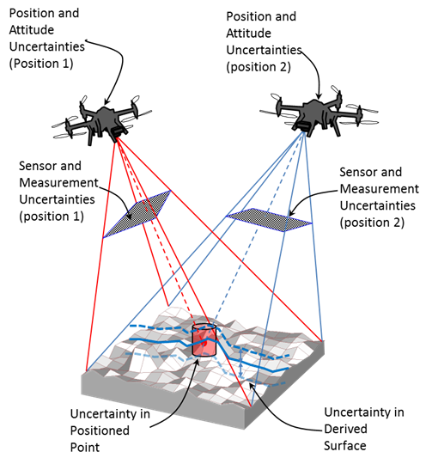
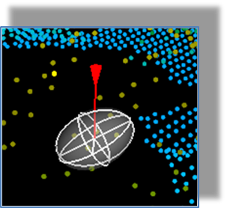
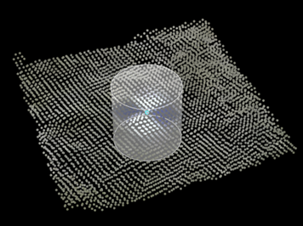
Benefits of Error Propagation
Uncertainty estimates of final 3D products:
  Provide a more complete understanding of the quality of the products
  Allows user to determine applicability of the product for a given use.
  Provides a method to weight datasets by accuracy during registration and fusion.
Uncertainty estimates mandated for certain applications.
Error Cylinder representing CE90 / LE90
Error Ellipsoid

Slide 11
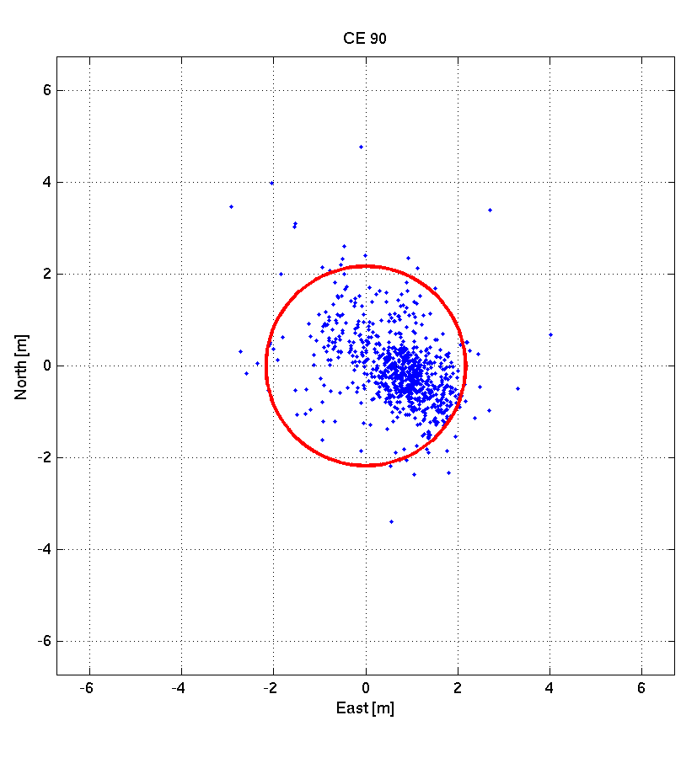
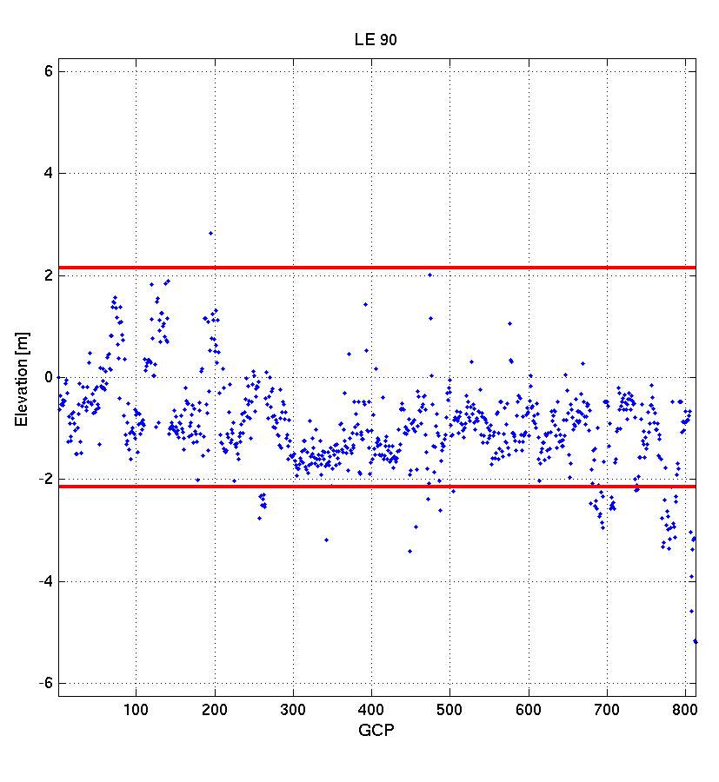
Sample comparison of point localization

Slide 12
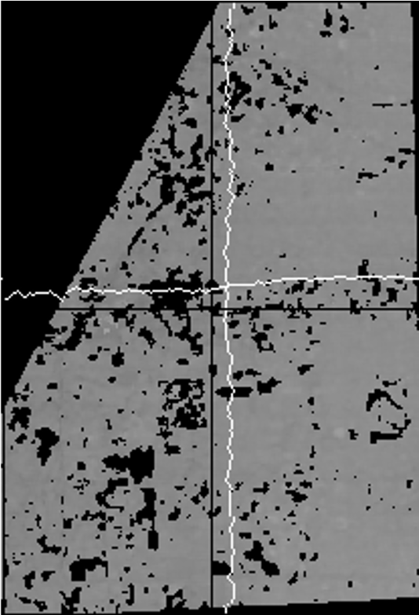
Error comparison between satellite and MIDAS
North-South error comparison
East-West error comparison

Slide 13
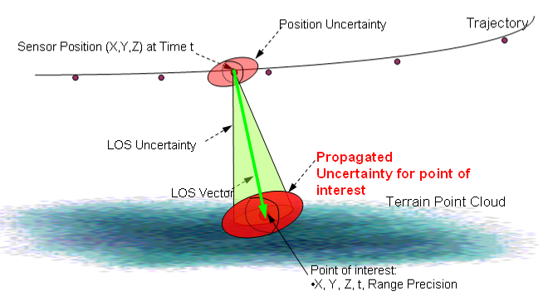
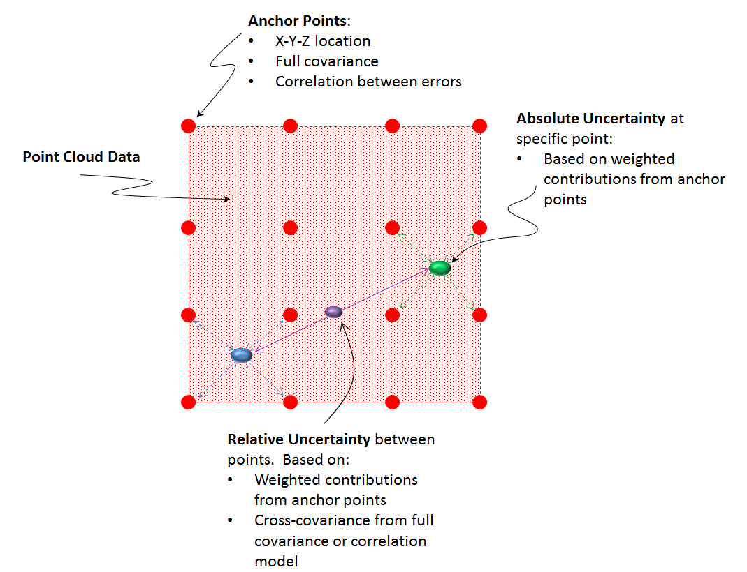
Generic Point-cloud Model (GPM)
Goals of GPM
  Propagation of sensor / data uncertainties
  Support rigorous data adjustment
Two Implementations
  Sensor Space
    Based on adjustable parameters (and covariance) associated with sensor location, pointing, and ranging.
  Ground Space
    Model based on adjustable parameters (and covariance) in ground space.
      Association with original data collection geometries is lost.
      For Anchor Points (AP), the adjustable parameters are translations at the anchor points.
Sensor Space
Ground Space
Notes:
13

Slide 14
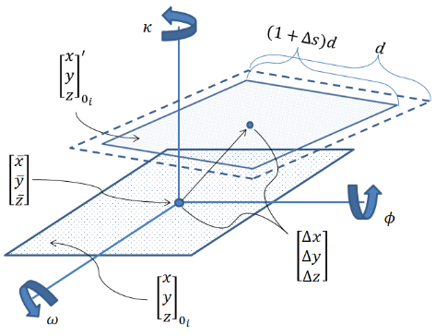
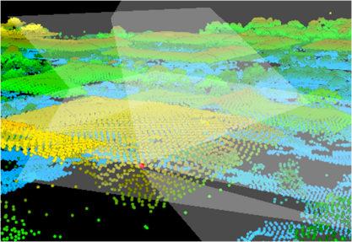
GPM Error Model Components (Ground Space)
Dataset wide 3D Conformal Transformation Parameters
Anchor Points (AP) – Parameters are translations (Δx, Δy, Δz) at a series of specified location throughout the dataset.
Unmodeled Error– Errors that can be correlated, but can not be accounted for in data adjustments (due to model limitations, etc.)
Per Point Error– Errors per point that are uncorrelated between points
Mensuration Error– Uncorrelated error based on ability to measure points in datasets during exploitation.

Slide 15

Questions:
Barry Tilton, P.E., PMP
Barry.tilton@vricon.us
(703) 298-3371
Stephen Hanna
Stephen.hanna@vricon.us
VRICON THE GLOBE IN 3D
2020-08-05

Slide 16
GPM Error Model Components
The wide spectrum of overall contributing errors
Low Frequency
High Frequency
Bias
(shift/offset)
Random
(white noise)
3D Conformal (3DC) Transformation
(3 offsets, 2 tilts,
1 rotation, 1 scale)
Unmodeled Errors (high frequency:
Can be highly correlated for nearby points
Cannot be “removed” from dataset via registration)
Anchor Points (localized systematic effects)
Data Provider Measurement error
Human (“point-picking”) Measurement error
Adjustable Parameter (AP) Errors (“removed”, stored, and applied to subsequent exploitation)
Input to Sensor Model
by Tool
(uncorrelated, even between nearby points)
Managed by Sensor Model

Slide 17
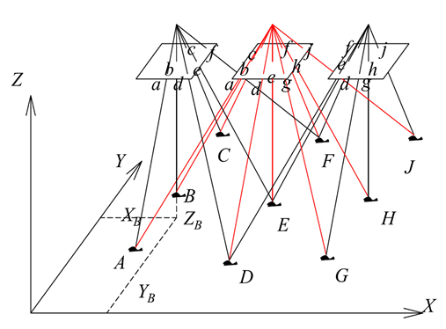
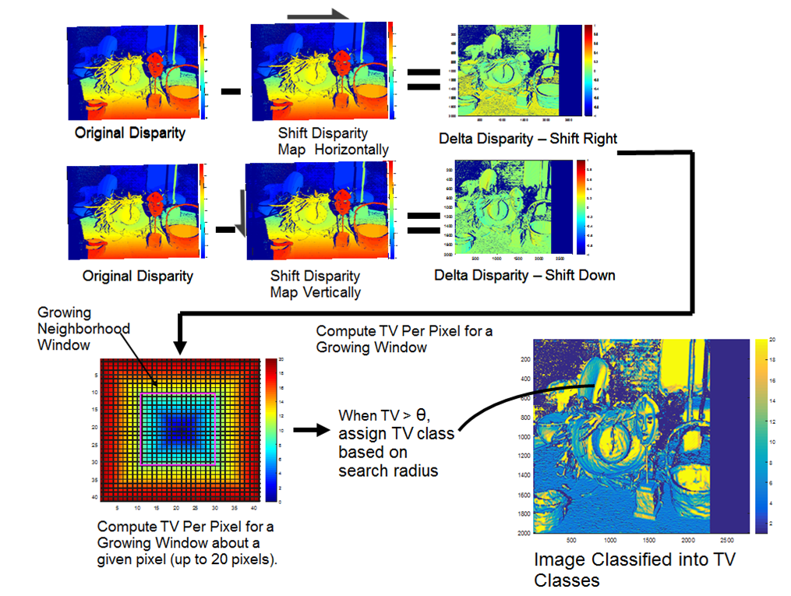
Populating GPM Error Model Components (EO derived Data)
Dataset wide 3D Conformal Transformation Parameters
  Derived from triangulation / data adjustment – low frequency
Anchor Points (AP) – Parameters are translations (Δx, Δy, Δz) at a series of specified locations throughout the dataset.
  Derived from data adjustment – low frequency
  In prototypes, used multi-point MIG to get the APs and full error covariance among them.
Unmodeled Error– Errors that can be correlated, but can not be accounted for in data adjustments (due to model limitations, etc.)
  Depends on knowledge of end-to-end system and process
  Typically low to medium frequency.
Per Point Error– Errors per point that are uncorrelated between points
  Derived from dense matching, correlation, and 3D extraction methods.
  High-Frequency
From disparity maps to an error metric
Note: Original Images (Scharstein, 2014)

