Slide 1
Geospatial 3D Model Conversion and Transmission A Comparison of Open Standards and Software
P3DL - August 12th, 2020
Presented by: Dr. Matt Leotta
Work supported by SBIR topic NGA183-002
Notes:
Abstract: There is an ongoing need to support the efficient transmission and web-based visualization of large textured 3D geospatial mesh models. The Open Geospatial Consortium (OGC) provides competing standards for the representation of tiled 3D geospatial data, most notably CDB (Common Database) and 3D Tiles. This talk presents a comparison of these two standards, highlighting the advantages and disadvantages of each. It also describes experiments comparing the performance of storage and transmission of these standards after converting the same city-scale 3D models into both formats and transmitting to the same web client. While the CDB and 3D Tiles standards are open, the tools to convert data into these file formats are typically proprietary. Open source software tools to convert 3D data into these standard formats would be enormously beneficial to the community. This talk also describes some of the existing relevant open source tools and their limitations. Lastly, the talk will cover plans for development of future open source tools both to convert geospatial mesh file formats, but also to generate 3D mesh surfaces from other sources including LiDAR and multi-view imagery.

Slide 2
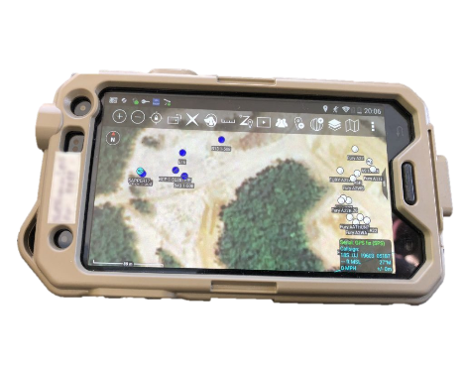
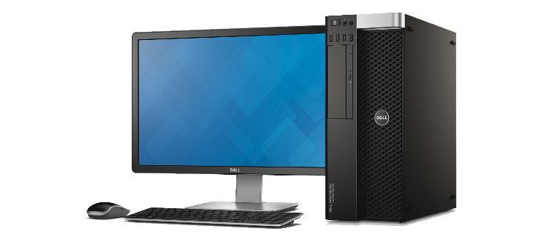
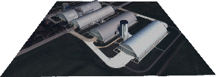
Motivation
Support 3D geospatial data transmission for web visualization over low bandwidth
Point clouds require high bandwidth, procedural mesh models are more efficient
How do we transform point clouds into geospatial meshes?
Which standards are best for storage, transmission, and visualization of these meshes?
Can we do this with open standards and open source software?
Focus of this talk
Point Cloud
Requires
High Bandwidth
Procedural Mesh
Requires
Low Bandwidth
3D Point Cloud (P3D) - 100MB
CORE3D Buildings - 260KB
CORE3D with Texture - 5MB

Slide 3
Agenda
Open Standards and Open Source for 3D Geospatial Meshes
Experimental Comparison of Standards
Data Sets
Data Conversion
Data Transmission
Results
Conclusions
Point Cloud to Mesh Conversion and Future Work

Slide 4
Open Standard ≠ Open Source Software
Documentation describing how data is to be stored or transmitted
Shared software source code that implements algorithms

Slide 5
Open Standards for 3D Geospatial Meshes
Storage
Transmission
Tiling
For representation on disk
CityGML (XML)
OBJ (text)
Collada (XML)
X3D (XML, JSON, binary)
OpenFlight (binary)
For sending data over the wire
glTF – OpenGL Transmission Format
I3S - Indexed 3D Scene Layer
For subdividing data into manable geospatial chunks
3D Tiles
I3S SLPK - Scene Layer Package
CDB – Common Database

Slide 6
Open Source Software (OSS) Availablity
Focus on these
Tiling format | 3D Tiles | I3S / SLPK | CDB
Transmission format | glTF | I3S | OpenFlight (FLT)
Primary Developer | Cesium | Esri | CAE
OGC Standard type | Community Standard | Community Standard | Full Standard
OSS Transmission format tools | Yes – glTF supported in many libraries | No – ArcGIS Pro | Yes – FLT is uncommon but some tools exist
OSS Tile Viewer | Yes – Cesium.JS | No – ArcGIS | No
OSS Tile Generator | No – Cesium Ion, Cesium 3D Tiling Pipeline | No – ArcGIS Pro | No – EPIC Builder, etc.

Slide 7
Standards Comparison
 | CDB | 3D Tiles
Advantages | - Broad data support - 2D and 3D tiled data - Raster and vector data - Extensive metadata | - Optimized for web transmission - Adaptive quadtree tiling - Replacement and additive refinement - Draco mesh compression - Textures scaling - Optimized for WebGL rendering
Disadvantages | - No 3D transmission optimizations - No WebGL optimization - Few open source tools | - Only geospatial 3D models - No 2D data in the standard - No semantic layers in the standard

Slide 8
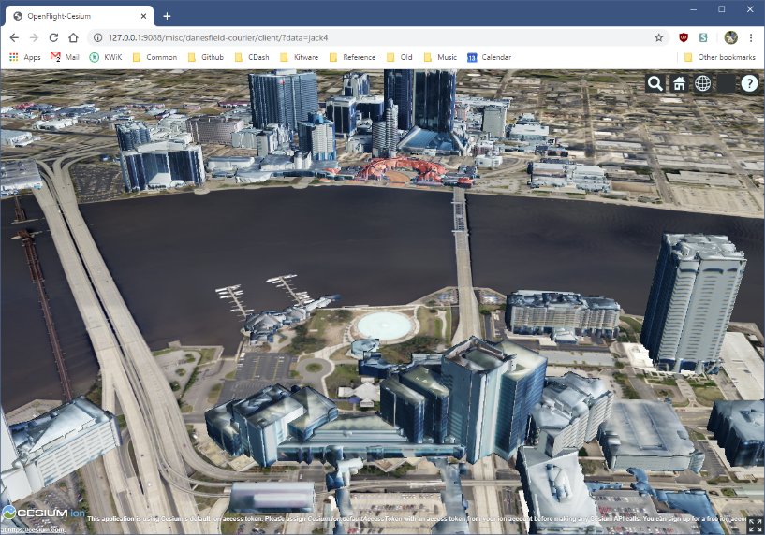
Experimental Plan: Comparison of CDB to 3D Tiles
Converted city-scale meshes into both formats
Input data came in OBJ or CityGML formats
Mix of open source and commercial tools were required
Used Cesium for 3D web visualization
3D Tiles is natively supported in Cesium
Extended Cesium to support CDB
Evaluated performance of CDB and 3D Tiles
Compared using several metrics
vs.

Slide 9
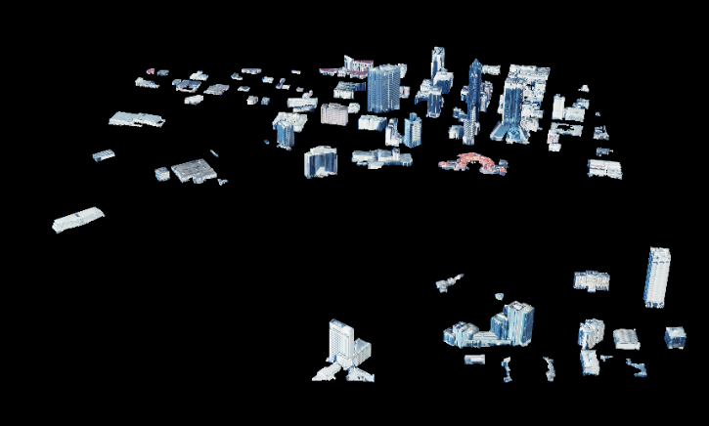
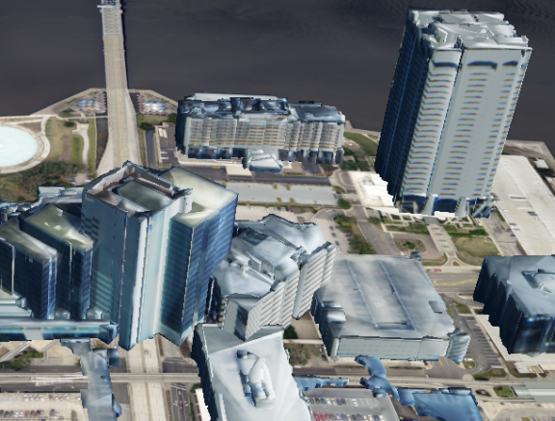
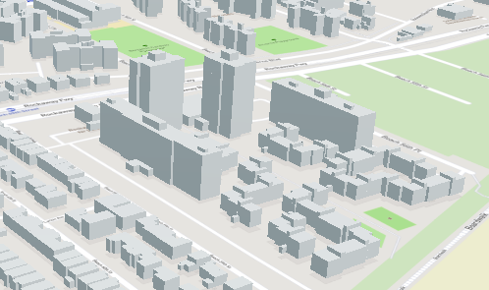
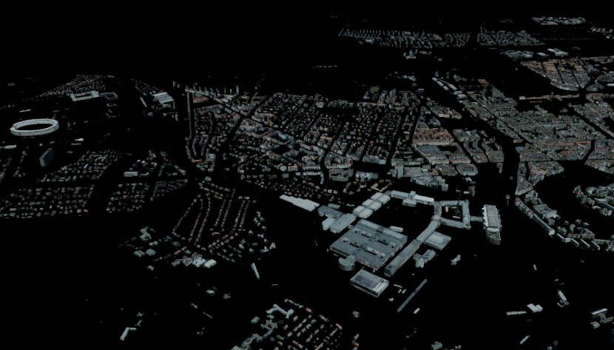
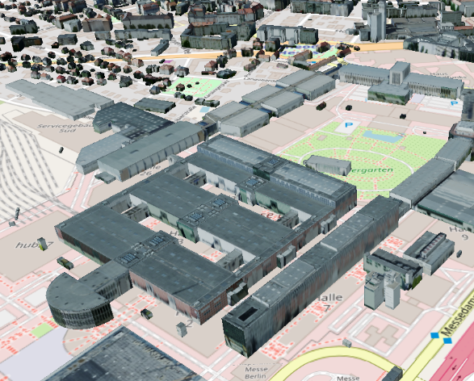
Data Sets
Jacksonville
Jacksonville, FL (from CORE3D)
Produced by Kitware on IARPA CORE3D
82 buildings in OBJ format
Contains texture (in PNG format)
82MB
New York City
NYC 3-D Building Model
19404 buildings in CityGML format
No texture
267 MB
Berlin
Berlin-3D
22805 buildings in CityGML format with
Contains texture (in JPG format)
891 MB for geometry and 4.4 GB for texture
New York City
Berlin

Slide 10
Data Conversion
Convert all data sets to both CDB and 3D Tiles for comparison
No complete open source solution for CDB or 3D Tiles
Used some open source tools for each
open source solution for OBJ to 3D Tiles
Obtained trial licenses from vendors
EPIC Builder
Cesium 3D Tiling Pipeline
Collaborated with Cesium and EPIC to understand their software and fix bugs
Data
Conversion
Jacksonville
(OBJ)
CDB
Transmit
New York City
(CityGML)
Compare
3D Tiles
Transmit
Berlin
(CityGML)

Slide 11
Conversion to 3D Tiles
CityGML to 3D Tiles
Used Cesium 3D Tiling Pipeline
OBJ to 3D Tiles
Used open source script obj23dtiles to generate a 3D tiles dataset for each building
Provides one-to-one mapping of single OBJ to a 3D tile, no tile hierarchy
Wrote a script to parent all 3D tiles under a single root tile

Slide 12
Conversion to CDB
CityGML to CDB
Converted the CityGML file to a list of OBJ files, one for each building
Used Kitware’s open source tools VTK & Paraview.
Proceeded with OBJ to CDB steps below
OBJ to CDB
Converted OBJs to FLTs using OpenSceneGraph osgconv tool.
Used EPIC Builder to build the CDB dataset
Additional manipulation needed to handle coordinate systems for OBJ
CityGML
OBJ
OBJ
OBJ
FLT
FLT
FLT
CDB

Slide 13
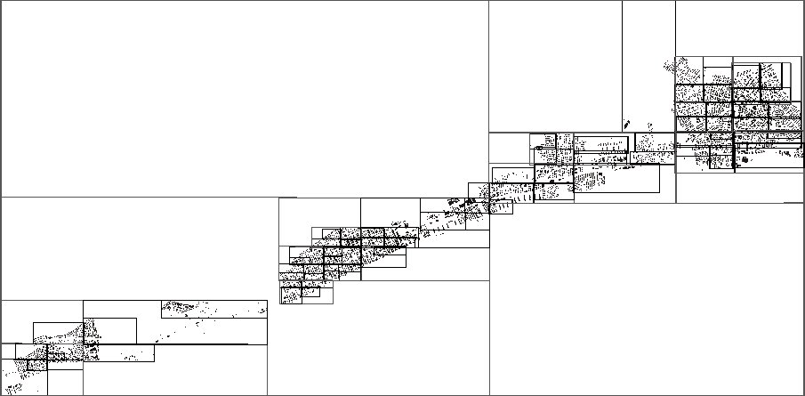
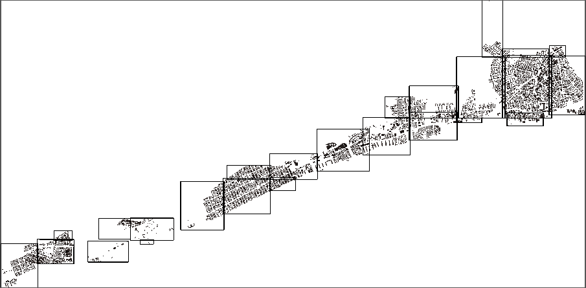
Tiling Strategies
3D Tiles
Adjustable partitioning
Intended to balance number of tiles and complexity of each tile
CDB
Quad tree per geocell (degree of lat/long)
Generator used made all tiles at same tree depth (default behavior)

Slide 14
3D Streaming to a Web Client
Cesium is the obvious choice for a 3D geospatial web client
Open source (mostly) and extensible
Provides 3D geospatial context (virtual 3D globe)
Supports 3D Tiles and glTF out of the box
How can we interface CDB with the Cesium client?
Need to parse FLT, textures, etc. into WebGL
Option 1: preprocess FLT file on the server into a supported format
Option 2: serve CDB directly and read FLT on the client

Slide 15
Sending CDB to the Client
CDB with Preprocessing
CDB Data set
- many Openflight files
- many Shapefiles
- texture files
Preprocessing
- read all tiles
- convert to json and binary
- unzip+aggregate textures
Processed CDB
- 2 or 3 files per tile
File Server
a few files
Cesium
- direct reader
CDB with Client Reader
CDB Data set
- many Openflight files
- many Shapefiles
- texture files
Tile Reader / Parser
- many Openflight files
- one Shapefile per tile
- zipped texture file
File Server
Cesium
- CDB tile reader
many files

Slide 16
Evaluation Metrics
Quantitative Measures
Size on the disk (bytes)
Number of files (count)
Texture size (bytes)
Conversion time (seconds)
Time to download (seconds)
Download size (bytes)
Download number of requests (count)

Slide 17
Evaluation Results
 | Jacksonville |  |  | New York (no texture) |  |  | Berlin (center view)
 | Processed CDB | Client CDB (no texture) | 3D Tiles | Processed CDB | Client CDB | 3D Tiles | Processed CDB | Client CDB (no texture) | 3D Tiles
Size for 3D data (texture + rest) | 125 MB (64 + 61) | 61 MB (no texture) | 53 MB | 395 MB (0 + 395) | 395 MB | 4.4 MB | 4.6 GB (3.6 + 1.0) | 1.6 GB (no texture) | 8.3 GB
Number of files for 3D data (texture + rest) | 261 (3 + 258) | 258 (0 + 258) | 2 | 19618 (0 + 19618) | 19618 (0 + 19618) | 126 | 45932 (29+45903) | 45903 (0 + 45903) | 6967
Conversion (hh:mm:ss) | 00:01:16 | 00:01:16 | 00:03:00 | 00:25:00 | 00:25:00 | 00:01:08 | 4:15:24 | 4:15:24 | 01:51:13
Download Time | 4.27 s | 4.66 s | 2.62 s | 1.79 s | 211 s | 1.38 s | 109 s | 339 s | 111 s
Download Size | 65.5 MB | 30.4 MB | 51.6 MB | 27.9 MB | 178 MB | 4.6 MB | 126 MB | 272 MB | 110 MB
Download Requests | 3 | 132 | 3 | 52 | 19515 | 95 | 60 | 14251 | 1127

Slide 18
Conclusions
Best practices are more important than choice of standard
3D Tiles is more efficient than CDB given best practices
Either CDB or 3D Tiles are significantly slower if not tuned for
optimal tile size, minimizing server requests, compact textures, etc.
Texture size has much bigger impact on render time than geometry
Existing tools for creating CDB and 3D Tiles are very limited
Open source tools only address fragments of the problem
Even proprietary tools (especially for CDB) do not optimize output, resulting in inefficiencies
CDB is not optimized for the web
Serving CDB directly results in a large number of file requests, which is slow
Preprocessing (e.g. into glTF) can help, but needs to be kept in sync with source CDB

Slide 19
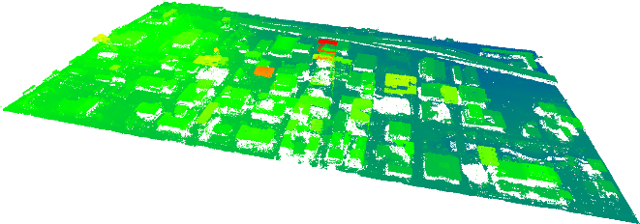
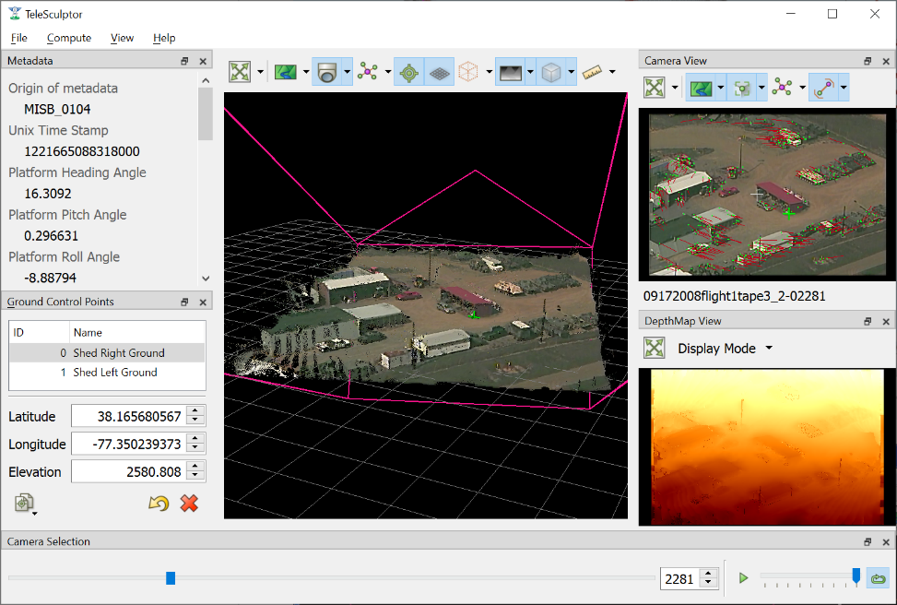
Point Clouds to Mesh Related Open Source Projects
Photogrammetric Point Cloud
Semantic 3D Meshes
We will extend our past open source work for point cloud to mesh conversion in Phase II.
Danesfield – Satellite Imagery to 3D
Funded by IARPA CORE3D
EarthVision 2019 - Best Paper
TeleSculptor – FMV to 3D
Funded by ARFL, DARPA, SOCOM, and NVESD
Presented at P3DL 2019
Textured 3D Meshes
Danesfield
https://github.com/Kitware/Danesfield-App
TeleSculptor
https://github.com/Kitware/TeleSculptor

Slide 20
Future Work - Proposed Phase II Plan
Create open source 3D Tiles generation tools
Make fully open source end-to-end conversion tools
Optimize output to take advantage of the standards (optimal tiling, LOD, etc.)
Extend to other OGC Standards (e.g. CDB, I3S, etc)
Generalize and improve point cloud to mesh tools (started on CORE3D)
Adapt tools for UAV-derived point clouds (TeleSculptor) or other sources (e.g. lidar)
Tools include: structure/terrain separation, meshing, mesh simplification, texture mapping
Revisit Phase I experiments with ATAK as a client
3D Tiles support on the roadmap for next ATAK release

Slide 21
Thank You

Slide 22
Backup Material

Slide 23
Open Geospatial Consortium Standards
Both OGC Full and Community Standards are considered to be normative standards by OGC membership and are part of the OGC Standards Baseline.
Full Standard
A standard developed by the OGC
No requirement of implementation
OGC membership has committed to support and maintain the standard through its lifecycle
Community Standard
A “snapshot” of a mature, de facto standard developed outside of the OGC
Requires a strong evidence of implementation
OGC does not take over the maintenance of the standard

