Slide 1
Seamless Merging of Topographic and Bathymetric Point Clouds
Presenter: John Morgan
PSU/ARL Geospatial Intelligence Department
NGA PI: Tom Creel
Tech GPOC: Emanuelle Feliciano
August 12, 2020

Slide 2
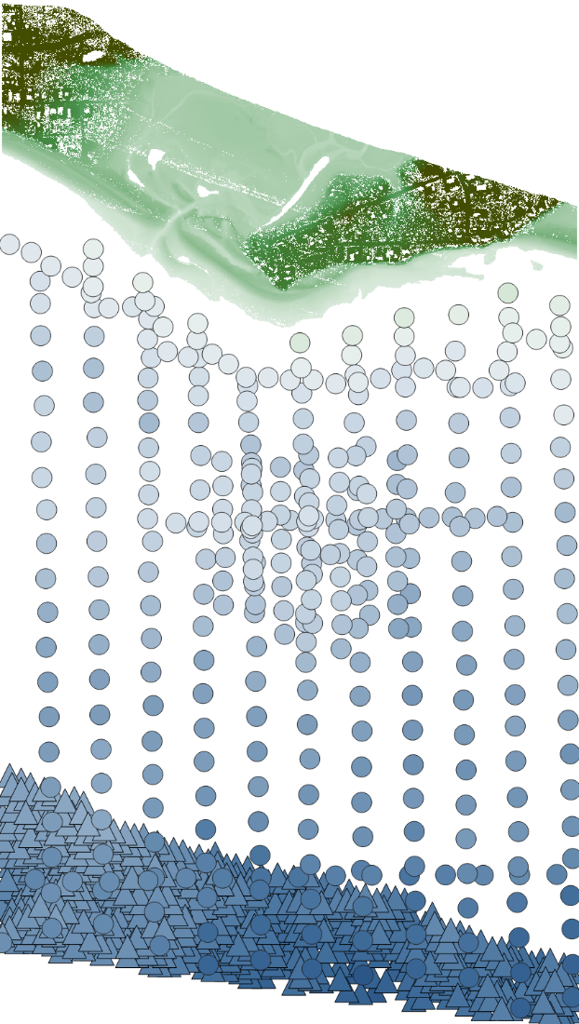
The goal is to merge point clouds from multiple sources into a seamless digital elevation model (DEM) that has no holes
2019 topographic
lidar¹ (NAVD88)
Voids need to be filled
Commonly occur between topography and bathymetry because it is difficult to get measurements in shallow, turbid water
Varying point density can lead to seams in the DEM
Sonar is referenced to MLLW, and the necessary tide measurements to convert to NAVD88 are not available
1980 sonar²
(MLLW)
2008 sonar³
(MLLW)

Slide 3
DEM heights are optimized by jointly (1) minimizing distance to data and (2) maximizing smoothness
Smoothness multiplier
$$\min_{D}{E\left(p,W;D\right)=\sum_{i}{m_{i}\left(p;D\right)}+λ_{s}\sum_{j}{s_{j}\left(W;D\right)}}$$
Measurement
error
Smoothness
error
$D$: grid of raster values
$p$: set of one or more point clouds
$W$: set of one or more convolution kernels
$λ_{s}$: smoothness multiplier that controls relative importance of smoothing to fitting
$λ_{s}>1$ yields a smoother surface
$λ_{s}<1$ yields a closer fit to the data

Slide 4
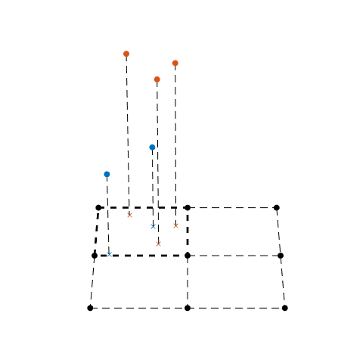
Measurement error notation
$B^{\left(2\right)}\left(i\right)$:
points from dataset k=2 in bin i
$p_{j}^{\left(1\right)}=\left(x_{j}^{\left(1\right)},y_{j}^{\left(1\right)},z_{j}^{\left(1\right)}\right)$:
point j in dataset k=1
$B^{\left(1\right)}\left(i\right)$:
points from dataset k=1 in bin i
Bin i
$D$:
DEM
$D\left(x_{j}^{\left(1\right)},y_{j}^{\left(1\right)}\right)$:
interpolated DEM value
for point j in dataset k=1

Slide 5
The measurement error is the distance from the points to the bilinearly interpolated DEM value at the same XY location
Per-dataset weight
Normalize by total weight
$$m_{i}\left(p;D\right)={\sum_{k}{\sum_{j∈B^{\left(k\right)}\left(i\right)}{w^{\left(k\right)}{\left(z_{j}^{\left(k\right)}−D\left(x_{j}^{\left(k\right)},y_{j}^{\left(k\right)}\right)\right)}^{2}}}}/{\sum_{k}{\sum_{j∈B^{\left(k\right)}\left(i\right)}{w^{\left(k\right)}}}}$$
Bilinearly interpolated DEM value
Bilinear interpolation utilizes sub-pixel information
Per-dataset weight can be used to prioritize more accurate or more recent data
Normalization preserves relative importance of fitting and smoothing
Normalization prevents seams due to point density

Slide 6
The smoothness error is implemented as a convolution with one or more smoothing kernels
Normalize by total weight
$$s_{i}\left(W;D\right)={\sum_{j}{{\left(\left(D∗W\right)\left(x_{i},y_{i}\right)\right)}^{2}}}/{\sum_{j}{trace\left(W_{j}^{T}W_{j}\right)}}$$
Independent of points, thus voids are filled so as to maximize smoothness
Normalization preserves relative importance of fitting and smoothing
Common measures of smoothness are the first and second order derivate:
1st order: $W_{1}=\left[\begin{matrix}−1 \\ 1\end{matrix}\right]$, $W_{2}=\left[\begin{matrix}−1 & 1\end{matrix}\right]$
2nd order: $W_{1}=\left[\begin{matrix}1 \\ −2 \\ 1\end{matrix}\right]$, $W_{2}=\left[\begin{matrix}1 & −2 & 1\end{matrix}\right]$, $W_{3}=\frac{\sqrt{2}}{4}\left[\begin{matrix}1 & 0 & −1 \\ 0 & 0 & 0 \\ −1 & 0 & 1\end{matrix}\right]$
Notes:
1st order minimized by horizontal plane
2nd order minimized by plane

Slide 7
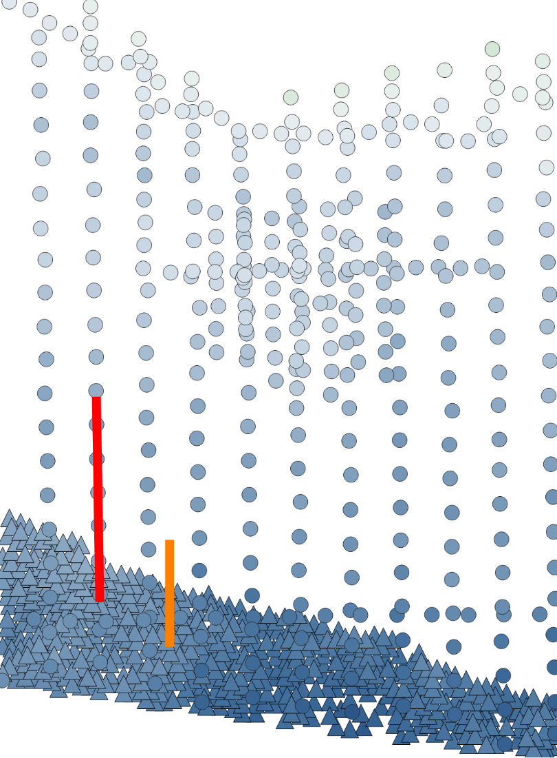
Example: seamless merge of sonar with varying density
Potential for seams in the DEM where point density changes
1980 sonar: 70 pts / km²
2008 sonar: 650 pts / km²
Risk of overfitting when the DEM resolution is much lower than the point density
DEM resolution: 5 m
1980 sonar²
(MLLW)
2008 sonar³
(MLLW)

Slide 8
Example: seamless merge of sonar with varying density
ArcGIS Empirical Bayesian Kriging⁴
ArcGIS Topo to Raster⁵
PSU, $λ_{s}=100$

Slide 9
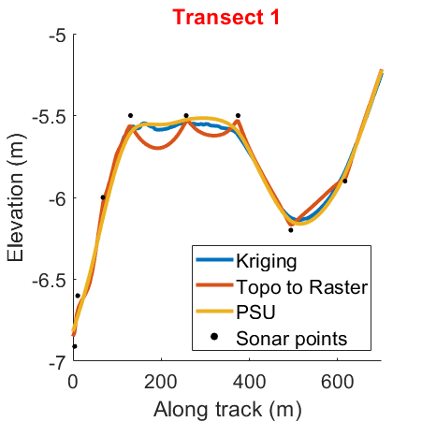
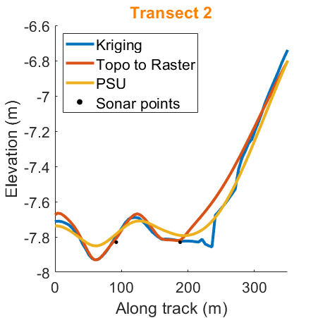
Example: seamless merge of sonar with varying density
Overfitting
Seam

Slide 10
Bathymetry measured as water depth will have a vertical misalignment because the water depth changes with the tide
1 Tidal Day
Water Level
NAVD88
MLLW
Vertical misalignment

Slide 11
To correct for vertical misalignment, a vertical translation is added to the measurement error
$$m_{i}\left(p;D,t\right)={\sum_{k}{\sum_{j∈B^{\left(k\right)}\left(i\right)}{w^{\left(k\right)}{\left(z_{j}^{\left(k\right)}+t_{z}^{\left(k\right)}−D\left(x_{j}^{\left(k\right)},y_{j}^{\left(k\right)}\right)\right)}^{2}}}}/{\sum_{k}{\sum_{j∈B^{\left(k\right)}\left(i\right)}{w^{\left(k\right)}}}}$$
$t$: vertical translation for each point cloud
Translation is optional; if disabled for dataset k then $t_{z}^{\left(k\right)}=0$

Slide 12
Datasets that do not overlap are aligned by shifting up or down so as to fill the gap as smoothly as possible
$$t_{z}= ?$$
1st order:
Minimizes distance
between datasets
2nd order:
Maintains linear trends

Slide 13
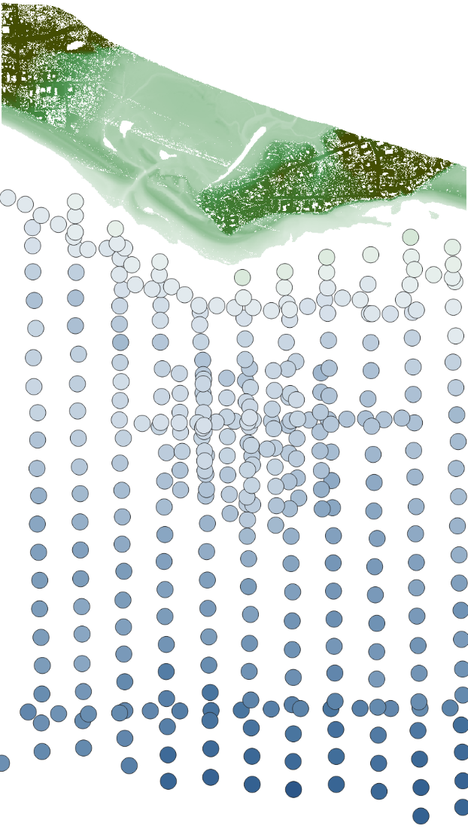
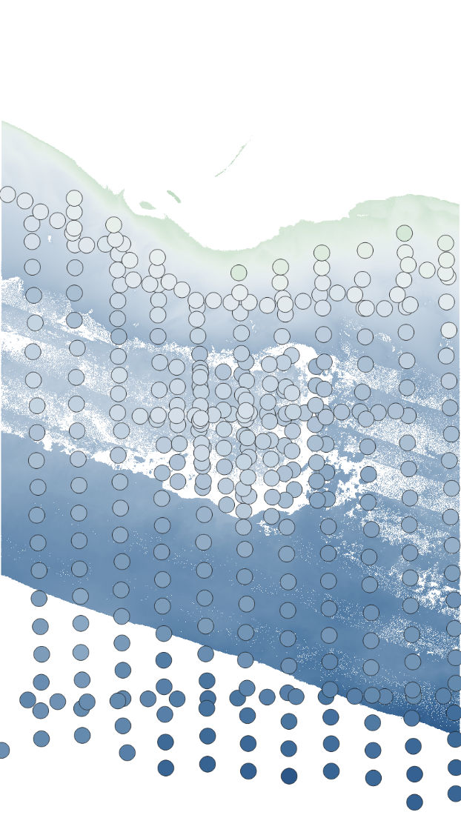
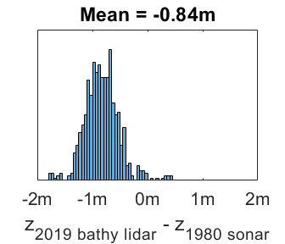
Example: align MLLW sonar to NAVD88 topographic lidar
2019 topographic
lidar¹ (NAVD88)
2019 bathymetric
lidar¹ (NAVD88)
65 m to 300 m gap
1980 sonar²
(MLLW)
0.84 m offset
1980 sonar²
(MLLW)

Slide 14
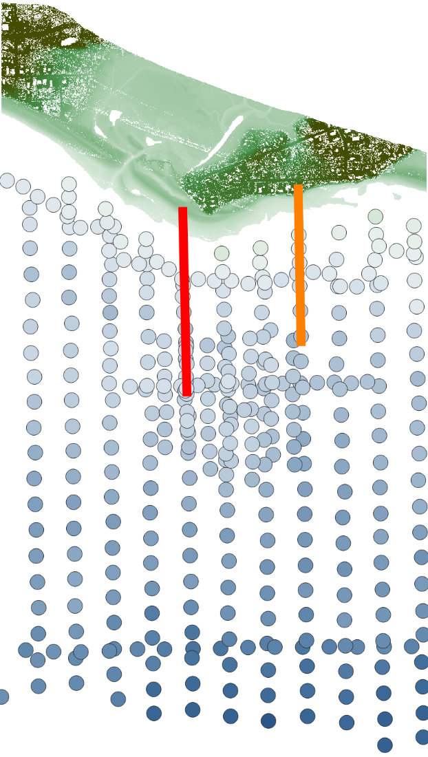
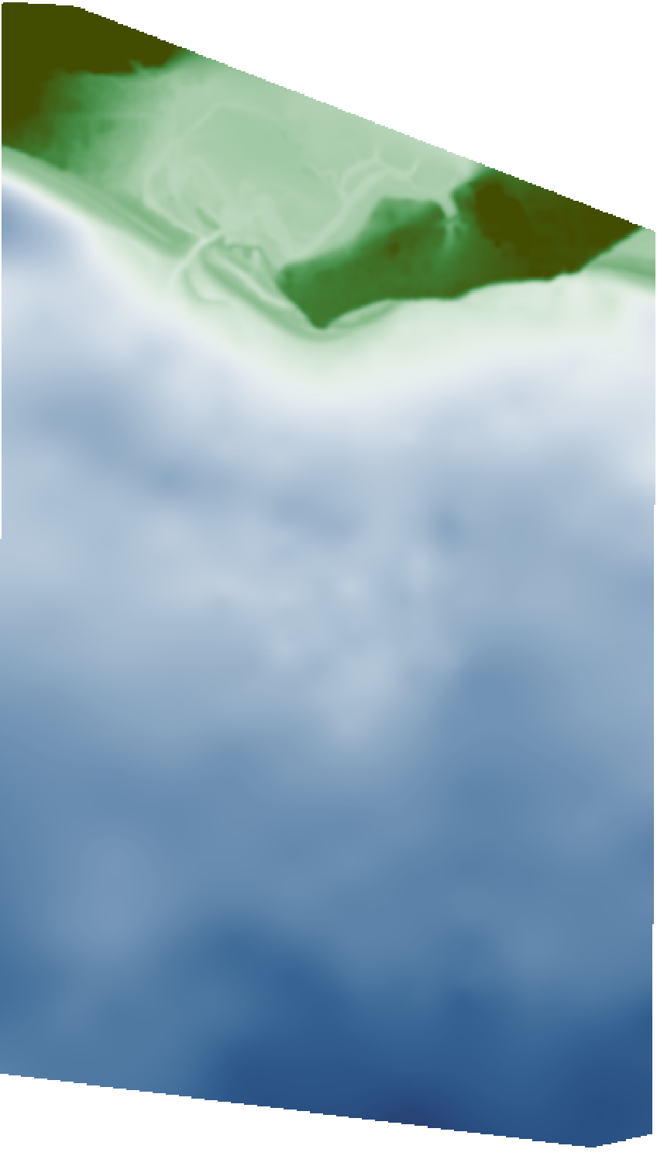
Example: align MLLW sonar to NAVD88 topographic lidar
Merge
$${tz}_{1980}$$
= -1.11 m
Expected translation = -0.84 m

Slide 15
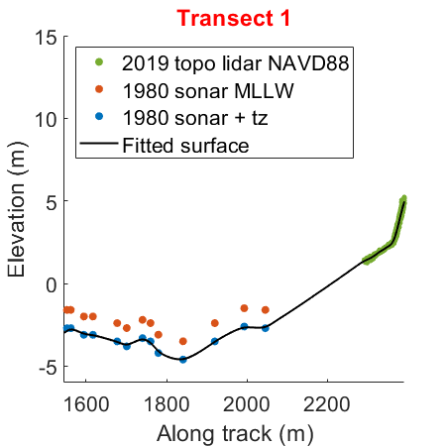
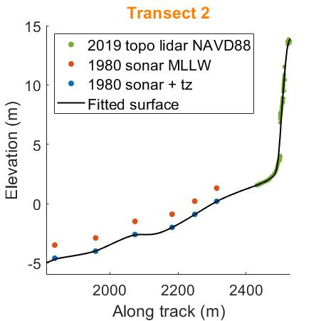
Example: align MLLW sonar to NAVD88 topographic lidar

Slide 16
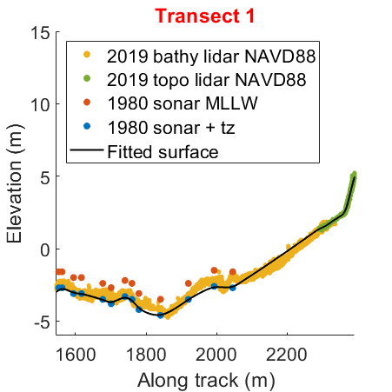
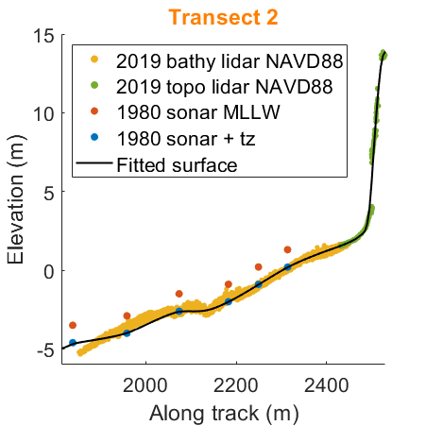
Example: align MLLW sonar to NAVD88 topographic lidar

Slide 17
To facilitate use, the algorithm has been implemented as a writer stage in the point data abstraction library (PDAL)
point_data_1
PSU Surface Fit Writer
$$⋮$$
DEM
point_data_n
Implemented as a writer stage to avoid passing rasters between stages
Sample pipeline (for the example from slide 14):
[
"HomerAk_2019_lidar.las",
{
"type":"filters.range",
"limits":"Classification[2:2]"
},
"HomerAk_1980_sonar.las",
{
"type":"writers.psusurfacefit",
"res":5,
"do_tz":[0, 1],
"filename":"dem_HomerAk.tif"
}
]

Slide 18
Takeaways
PDAL-plugin to merge point clouds from multiple sources into a seamless digital elevation model (DEM) that:
Has no voids or seams
Can estimate vertical translations to address tidal datums
Reduces manual preparation of data
Limitations:
Smoothness is minimized by planar features, which works well for terrain but does not fit features such as buildings
Could use bilateral filter for smoothness; however, this cannot be implemented as a convolution
Water surface points need to be manually removed
Runtime is slow for large DEMs (> 1500 x 1500)

Slide 19
References
NOAA. 2019 USACE NCMP Topobathy Lidar: Alaska Point Cloud files with Orthometric Vertical Datum North American Vertical Datum of 1988 (NAVD88) using GEOID12B. https://coast.noaa.gov/htdata/lidar3_z/geoid12b/data/8837/
NOAA. 1980 NOS Hydrographic Survey: H09877. https://www.ngdc.noaa.gov/nos/H08001-H10000/H09877.html
NOAA. 2008 NOS Hydrographic Survey: H11938. https://www.ngdc.noaa.gov/nos/H10001-H12000/H11938.html
ESRI. Empirical Bayesian Kriging (Geostatistical Analyst). https://pro.arcgis.com/en/pro-app/tool-reference/geostatistical-analyst/empirical-bayesian-kriging.htm
ESRI. Topo to Raster (3D Analyst). https://pro.arcgis.com/en/pro-app/tool-reference/3d-analyst/topo-to-raster.htm

Slide 20
University Park, Pennsylvania 16802 Phone: 814-865-6531
PSU/ARL Geospatial Intelligence Dept. Contact Info:
Shawn Hough
Department Head
814-863-5307
sth104@arl.psu.edu

