Slide 1
Agency IT Modernization: using Data Fabric Architecture & ML / AI Technology
USCENTCOM Data Symposium 2/2/21
Presenter: Richard Walker, SVP
rwalker@denodo.com

Slide 2
Agency IT Modernization has 3 Goals
Users - deliver Governed Self-Service for Faster Decision Making
IT - enable Data Lakes & multi-Cloud deployments to lower Costs Quickly
Gov. & Sec - provide centralized Catalogs & Policy Engines to assure 100% Compliance Easily
Data Fabric Architecture delivers on all 3 goals
US Army: delivers data 97% faster, saving $4M/yr
Nuclear Weapons Labs: centralized Gov & Security saving 80% on IT costs
FAA: modern Data Services now deployed in Minutes vs Weeks w/ 10% of staff

Slide 3
IT Modernization: Problems with Current Physical Architecture
Costly Replication,
Brittle Pt to Pt Connectivity
& Complex Gov. & Sec.
Data
at
Use
Compounds
Customers
Products
Claims
Data Fabric Net
Data
in
Motion
RDBMS/OLTP
Traditional Analytics/BI
Data Lakes
Cloud Data Stores
Apps and Document Repositories
Data
at
Rest
Data Warehouse
ETL
ETL
ETL
Flat Files
ETL
ETL
ETL
Third Party
Legacy
XML • JSON • PDF
DOC • WEB
Mart
Mart
= Governance & Security
Notes:
Tremendous distribution of data sources and targets
Extreme complexity
Too much replication, too many ways to integrate, integration is the most significant inhibitor to enterprise data and analytics initiatives. We need to be able to provision the data in the right shape, at the right time to the right consumer…Imagine a data fabric layer that abstracts the complexity of underlying data models, schema, structure and provisions data to our business just in time. Imagine a design that can automate repetitive transformations, decisions for developers and allow the business to focus on working on integrated data – that’s the fabric promise

Slide 4
IT Modernization: Data Fabric Requirements
Abstraction
Free Users from complexities of data sources
Logical Representation
Decouple data from the business logic – Single Views of Truth
Agile Integration
Reduce Replication – Faster time to market while reducing IT costs

Slide 5
IT Modernization’s Data Fabric Architecture
Data
at
Use
Compounds
Customers
Products
Claims
Data Fabric Net
Data
in
Motion
Logical Data Layer with Goverened Self-Service
Hi-Performance Query Opt. Engine using ML/AI with Centralized Governance & Security
RDBMS/OLTP
Traditional Analytics/BI
Data Lakes
Cloud Data Stores
Apps and Document Repositories
Data
at
Rest
Data Warehouse
Flat Files
ETL
ETL
Third Party
Legacy
XML • JSON • PDF
DOC • WEB
Mart
Mart
Data Fabric Architecture - automates the design, integration and deployment of data objects regardless of deployment platforms and architectural approaches
Performs continuous analytics and AI/ML over all metadata assets to provide actionable insights and recommendation
Results in faster, informed and, in some cases, completely automated data access and sharing
Notes:
Tremendous distribution of data sources and targets
Extreme complexity
Too much replication, too many ways to integrate, integration is the most significant inhibitor to enterprise data and analytics initiatives. We need to be able to provision the data in the right shape, at the right time to the right consumer…Imagine a data fabric layer that abstracts the complexity of underlying data models, schema, structure and provisions data to our business just in time. Imagine a design that can automate repetitive transformations, decisions for developers and allow the business to focus on working on integrated data – that’s the fabric promise

Slide 6
Gartner: Data Fabric Benefits
By 2023, organizations utilizing data fabrics to dynamically connect, optimize and automate data management processes will:
Reduce time to data delivery by 30% and
Automate manual transformations by 45%.
Gartner - 2019 Magic Quadrant for Data Integration tools
By 2023, data fabric enabled automation in data management and integration will:
Reduce dependency for IT specialists by 20%
Reduce integration costs by 45%.
Gartner - 2020 Magic Quadrant for Data and Analytics Service Providers
Notes:
Placeholder for text (substitute your own text; delete when not used)

Slide 7
Gartner: 5 Key Pillars of a Modern Data Fabric Design
Data Consumers
Data Consumers
Data Fabric
Final Data Integration and Orchestration Layer
Insights and Automation Layer
Active Metadata
Knowledge Graph Enriched With Semantics
Augmented Data Catalog
Data Sources
Data Sources

Slide 8
Gartner: 5 Key Pillars of Modern Data Fabric
Pillar 1 — Strong Data Integration & High Performance Backbone
Support any source and Flexible Cloud Deployment
Pillar 2 — Knowledge Graph Enriched With Semantics
Enriches the passive metadata of data models
Pillar 3 — “Active Metadata”
Adds Usage & Performance metadata
Pillar 4 — Use AI/ML on “Activated Metadata” to drive automation
Deliver faster performance and higher user productivity
Pillar 5 — Augmented Data Catalog – Business Self-Service
Get recommendations on best data sets to use

Slide 9
Data Fabric: Creates Common Schema across all Data Sources – without moving or transforming data
Relational Databases
MS SQL*Server (JDBC, ODBC): 2000, 2005, 2008, 2008R2, 2012, 2014, 2016
Oracle (JDBC): 8i, 9i, 10g, 11g, 12c
Oracle E-Business Suite (JDBC): 12
IBM DB2 (JDBC): 8, 9, 10, 11, 12 for LUW; 9,10 for z/OS
Informix (JDBC): 7, 12
Sybase Adaptive Server Enterprise (JDBC): 12, 15
MySQL (JDBC): 4, 5
PostgreSQL (JDBC): 8, 9
Denodo Platform (JDBC): 5.5, 6.0, 7.0
For multi-location architecture deployments
MS Access (ODBC)
Apache Derby (JDBC): 10
Generic (JDBC)
In-Memory Databases
SAP HANA (JDBC): 1
Oracle TimesTen (JDBC): 11g
Oracle 12c In-Memory
Parallel databases and appliances
GreenPlum (JDBC): 4.2
HP Vertica (JDBC): 7, 8
Oracle Exadata (JDBC): X5-2
ParAccel 8.0.2 (using ParAccel 2.5.0.0 JDBC3g/SSL driver)
Netezza (JDBC): 4.6, 5.0, 6.0, 7.0
SybaseIQ (JDBC) 12.x, 15.x
Teradata (JDBC): 12, 13, 14, 15
Multi-Dimensional Sources
SAP BW (BAPI/XMLA): 3.x
SAP BI 7.x (BAPI): 7.x
Mondrian (XMLA): 3.x
MS SQL Server Analysis Services 200x
Essbase (XMLA): 9, 11
Cloud Data Warehouse
Amazon Redshift (JDBC)
Amazon Athena (JDBC)
Amazon Aurora (JDBC)
Snowflake (JDBC)
Amazon DynamoDB
Azure SQL Data Warehouse
Azure CosmosDB (SQL API and MongoDB API)
Big Data/NoSQL
Apache Hive (JDBC): 0.12, 1.1.0, 1.1.0 for Cloudera 1.2.1 for Hortonworks 2.0.0
MapR-XD, MapR-DB, MapR-ES, Hive, and Drill for MapR 6.1
Impala (JDBC): 2.3
Spark SQL (JDBC): 1.5, 1.6
Google BigQuery (JDBC)
Presto (JDBC)
Web Automation
Denodo’s ITPilot automates extraction from web pages
Indexes and unstructured content
CMS, file systems, pdf, word, text, email servers, knowledge bases, indexes
Elastic Search
Web Services
SOAP
REST (XML, RSS, ATOM, JSON)
OData v2 and v4
Packaged Applications
SAP ERP/ECC (BAPIs and RFC tables)
Oracle E-Business Suite 12
Siebel
SAS (SAS JDBC Driver): 7 and higher
Semantic Repositories
Semantic repositories in Triple Stores / RDF accessed through SPARQL endpoints.
Flat and Binary Files
CSV, pipe-delimited, Regular expression-parsed
MS Excel xls 97-2003
MS Excel xlsx 2007 or later
MS Access
XML
JSON
All files can be locally accessible or in remote filesystems, through FTP/ SFTP/FTPS, and in clear, zipped and/or encrypted format.
Active Directory as source or leveraging security
LDAP v3
Microsoft Active Directory 2003, 2008
Cloud, SaaS, Web Sources with Simplified OAuth Security
Amazon
Google
Facebook
LinkedIn
MS Azure Data Lake
MS SharePoint (by using the OData connector)
MS Dynamics
ServiceNow
Marketo
Salesforce
Twitter via APIs with simplified Oauth integration (1.0, 1.0a and 2.0)
Workday
MS Queues as data source and Delivery
MQSeries
SonicMQ
ActiveMQ
Tibco EMS
Mulesoft
Denodo SDK for Custom Connectors
CouchDB
Lotus Domino
MongoDB and Mongo Atlas DBaaS
Mainframe
IMS
IBM IMS native drivers: 8, 9
IMS Universal Drivers: 11
Hierarchical databases
Adabas (SOA Gateway and Denodo’s SOAP connector): 5, 6
Legacy
Microsoft FoxPro (ODBC)
The following data sources have been successfully tested with Denodo using JDBC and ODBC drivers, WS/SOAP and WS/REST, and DenodoConnect adapters (not exhaustive list):
Apache Solr
Kafka Messages
SAS Files
Hadoop HBase
Hadoop HCatalog
Hadoop HDFS (Avro, CSV, Parquet)
Files in Amazon S3 (incl. Parquet files)
IBM BigInsights
Pivotal HAWQ

Slide 10
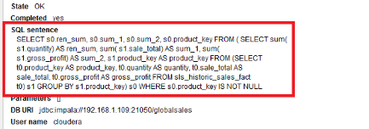
Data Fabric: Perf. 14x Faster vs Reporting Tools
Reporting Tools are not optimized for federation across sources
SELECT c.id, SUM(s.amount) as total
FROM customer c JOIN sales s
ON c.id = s.customer_id
GROUP BY c.id
Denodo: aggregation pushdown
System | Execution Time | Data Transferred | Optimization Technique (automatically selected)
Denodo | 9 sec. | 1.99 M | Aggregation push-down
Tableau | 125 sec. | 292.00 M | None: full scan
Tableau: full scan

Slide 11
Data Fabric: Fast Analytics w/ Massive Parallel Processing (MPP)
Group by ZIP
5. Fast parallel execution
Support for Spark, Presto and Impala
For fast analytical processing in
inexpensive Hadoop-based solutions
Group by ZIP
Group by ZIP
2. Integrated with Cost Based Optimizer
Based on data volume estimation and
the cost of these particular operations,
the CBO can decide to move all or part
Of the execution tree to the MPP
join
join
join
Presto is delivered with the system
2M rows
(sales by customer)
group by customer ID
4. Integration with local
and pre-cached data
The engine detects when data
Is cached or a is native table
in the MPP
1. Partial Aggregation
push down
Maximizes source processing
Reduces network traffic
3. On-demand data transfer
For SQL-on-Hadoop systems,
Denodo automatically generates
and upload Parquet files
Sales
(300 million rows)
Customer
(2M rows)
No DV | DV with MPP | % Increase
10 min | 11 sec | 5,455%
14 min | 34 sec | 2,456%
19 min | 7.5 min | 253%

Slide 12
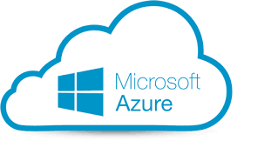
Data Fabric: Supports Hybrid (Multi-Cloud & On-Premise)
US East
Availability Zone
EMEA
Availability Zone
Amazon RDS,
Aurora
Acts as one Logical System – one semantic model
User access any pt in system with Single Sign On
Servers are Distributed close to data sources
Processing delegated to local sources
Sending only result sets across network - minimizes data latency
Caching and MPP to accelerate performance at each node
On-prem
data center
Notes:
As an organization continues on its journey to a multi-Cloud architecture, the Data Fabric becomes more and more important.
As you transition from on-premises, [KCx2] to the initial systems in the Cloud, to moving more and more systems to the Cloud [KC] the Data Virtualization Platform can be used as localized data hubs or gateways that are interconnected [KC] to create a Logical Data Fabric that spans locations. This Logical Data Fabric allows users to access data even when they don’t have a direct connection to the actual data source and is ideal for multi-Cloud or geographically distributed architectures. [KC] This Logical Data Fabric architecture is also easily extensible to add additional locations.
The Logical Data Fabric also provides local control over what data is shared with other users – for example, the administrator in EMEA has control over what data is shared via the Data Fabric node running in AWS EMEA. This provides the data owners with control over how their data is shared and used.

Slide 13
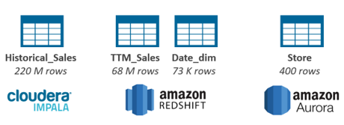
Data Fabric: use ML/AI to Accelerate Analytic Performance
TPCS-DS data:
Distributed in 3 different systems
Tables with hundreds of millions of rows
Summary: total sales by store id, sold_date_id
Query | Execution Time (no acceleration) | Execution Time (acceleration) | Performance Gain | Summary used
Total sales by store and city for last quarter | 14.71 s | 0.47 s | 31.1 x | summary_total_by_store_day
Total sales by year | 15.45 s | 2.38 s | 6.5 x | summary_total_by_store_day
Total sales by quarter, store name and city | 22.49 s | 2.62 s | 8.57 x | summary_total_by_store_day
Total sales in a specific store | 14.36 s | 2.66 s | 5.39 x | summary_total_by_store_day
Total sales in a specific store and year | 14.32 s | 3.18 s | 4.0 x | summary_total_by_store_day

Slide 14
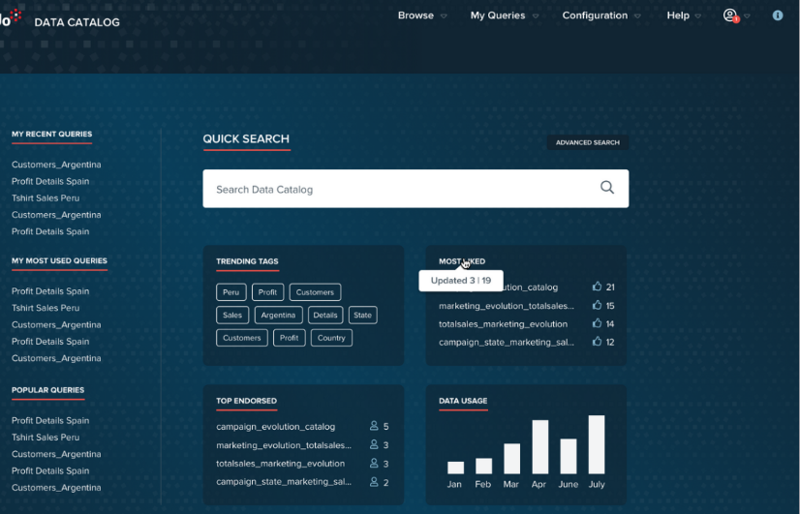
Data Fabric: use ML/AI to Automate Self-Service
Personalized recommendations
and shortcuts to most
used datasets.
MY RECOMENDATIONS
Endorsements and ranking

Slide 15
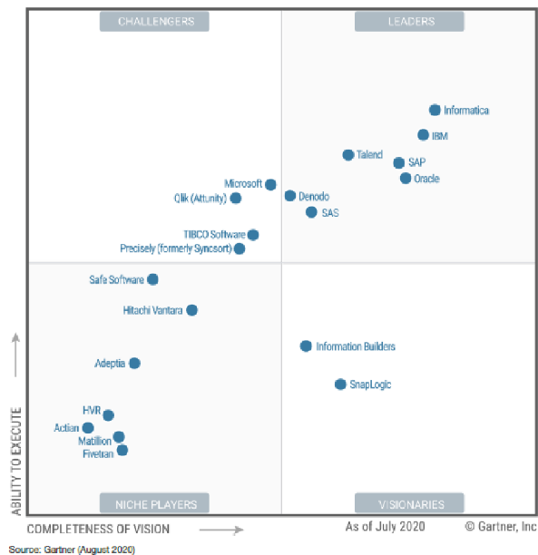
Denodo Data Fabric - Leader in “DI Magic Quadrant”
Delivers cloud/hybrid logical data fabric
1,000 clients worldwide
100% focus on Data Mng for 20 yrs
Strengths
Automates Data Fabric Arch.
Unified semantic, bus. self-service catalog
Dynamic query optimization engine
Active metadata ML/AI algorithms
Ent. Governance & Data Security :
Contextual information delivery & policy engine
Embedded data preparation capabilities
Extensive go-to-market partnerships & results:
Over 100 system integrators
Highly rated service and support metrics

Slide 16
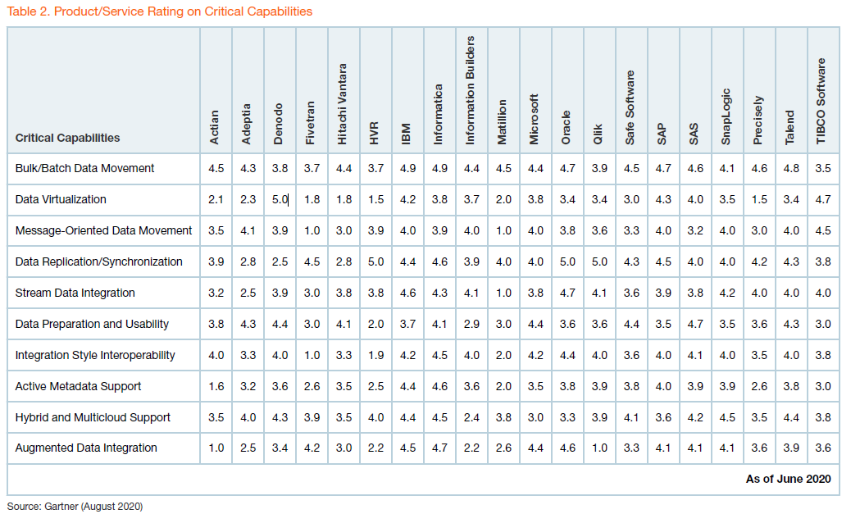
Gartner “Critical Capabilities for Data Integration Tools”
Q3 2020
Score 1 -5,
5.0 highest.
Denodo only 5.0 of all Ratings
Notes:
Denodo has been recognized as a Strong Performer in the Forrester Wave for Big Data Fabric.

Slide 17
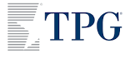
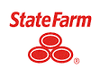
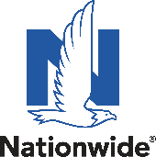
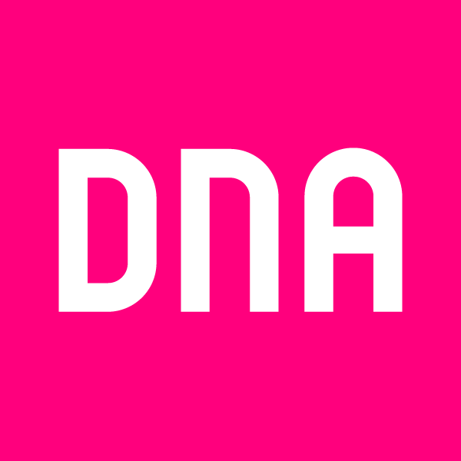
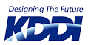
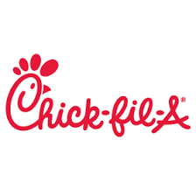
Denodo Data Fabric using ML/AI @ 1K+ Customers today
Energy/Oil & Gas
Technology/Bus Serv
Manufacturing/Trans.
Financial Services
Insurance
Healthcare
Public Sector/Utility
Telecommunications
Retail
Pharma / Biotech
Other
Notes:
(This slide includes customer logos which are NOT public. You may use this only in sales presentation, but don’t leave it behind. Don’t show this slide in webinars or tradeshows where they record.)
Denodo is an award-winning recognized leader in data virtualization. We have been in business since 1999 with more than 250 customers across 30+ industries. Most of our customers are Fortune 500 and Global 2000 companies.

Slide 18
Denodo: Federal Government Deployments
Dept of Defense:
U.S. Army - Materiel Command LDAC/AESIP
Missile Defense Agency (MDA)
Dept of Energy:
National Nuclear Security Administration (NNSA)– LLNL, LANL, Sandia, Kansas City, Pantex, Y-12, Savannah River, Nevada Test, Naval Nuclear)
Fermi Labs
Dept of Transportation:
Federal Aviation Administration (FAA)
Enterprise Services Center (ESC) Division
Dept of Veterans Affairs: Information & Technology
Dept of Agriculture: Risk Management Agency
Dept of Housing & Urban Dev.: Inspector General
Dept of Health & Human Services: Nat’l Cancer Institute
Federally Funded Res. & Dev. Centers (FFRDCs) - MITRE

Slide 19
DOD – Data Fabric Pre-Deployments
DIA – MARS/TALOS
USAF
CDO Data Vault
Adv Battle Mng System (ABMS)
US Army
Corp of Engineers
Futures Command / C5ISR
Joint Strike Fighter (JSF)
Joint Artificial Intelligence Center (JAIC) - Data Readiness Decentralized Vehicle
US Space Force
US Cyber Command

Slide 20
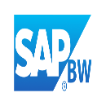
U.S. Army Materiel Command LDAC/AESIP Case Study
BI / Reporting Capabilities
WebLIDB/LMR
Parts Tracker
DODAAC Readiness Analyzer
Customer Satisfaction
Overage Repairable Management
Repairable and Recoverable
Supply Performance Statistics
Aging Deadline Notifications
Cost Driver
DPST
MMIS
ARMT
TPE Planner
Analytics / Visualizations
Analytics / Visualizations
Modeling, Simulation & AI
Fleet Readiness
Fleet Projection
Readiness Improvement Options
Combat Slant
CWT and ZPARK
SSA ASL Performance
Class IX Parts Impacting Readiness
Class VII and IX Asset Visibility
FMC Percentages % by UIC or LIN
Condition-Based Maintenance (CBM)
BI / Reporting Capabilities
Presentation Layer
Modeling, Simulation and Artificial Intelligence
Semantic / Transformation Layer
Data Analytics
Data Staging Area
LMI DST; COA Analysis, OIB Optimization
CBM
ExASL: Stockage determination
PSCC: Optimization of storage and distribution
COMPASS: enables Level of Repair Analysis (LORA) studies
CASA: Life Cycle Cost (LCC)/Total Ownership Cost (TOC) decision support
Army Air Clearance Authority
Non-ERP Transactional
ERP Transactional
Legacy
Data Foundation Layer

Slide 21
ROI – Creating Data Services vs Traditional Methods
Traditional method – using Oracle tools create extensive materialized database views
& publish as web services
Data Virtualization method – create logical database views in DV leaving data in original sources and publish web services.
Performance tests – queries across both methods were within a few % of each other
97% Faster using Data Virtualization Time
With same staff - completed the same views/ web services in Denodo as in Oracle data stores in less than 3% of the time.
Minimal Expertise Req’d with DV - Note that the team used DV without any product training from Denodo whereas Oracle required extensive expertise to build out the views and web services..
Saving over $4 MM per year
Reduced labor, SW, HW & storage costs
Dramatically shortened timeline for the Modernization/ Convergence project.
Data integrations completed faster than report writers can keep up with, which has never happened before.
Traditionally took weeks or months to complete integration work and now is done in minutes.

Slide 22
Denodo Deployments
Data Fabric: Ent. Gov & Security
DOE’s
National Nuclear Security Administration (NNSA) Facility Locations
Data Fabric is hi-perf.
Gov. & Security Layer to share data Intra- and Inter-Sites
E.g. Sharing of Eng. & Prod. BOM across sites is now done in real time
Naval Nuclear Laboratory
Denodo Deployed
Notes:
Security - this becomes an important part of any organization. if you start putting this new data layer in place, how do I manage security. A validation of DV security capabilities happened when the the nuclear weapons labs of the United States Department of Energy selected Denodo for exactly that reason. Denodo was able to deliver a robust sophisticated security architecture. none of our customers come close to the security requirements they had to manage. They had to control access to this information that was being generated at all the different labs and then be shared with all the different facilities across the nuclear weapons complex.
Denodo met their requirements and is now implemented. they made a presentation atthe TDWI conference around the benefits of this platform, the speed to market and the robustness of our security capabilities. it's being used in the classified environment I'm sure that any of your security requirements that you bring up we will be able to address.

Slide 24
Data Fabric: Enterprise wide value
Agility Challenge | Solutions Provided by Data Virtualization
Business Decision Agility | Speed: Deliver Information 10X Faster Data Virtualization delivers in real-time One data service can be published in multiple formats: database table, web service, XML, Excel file, widget, etc.
Time to Solution Agility | Flexible: Easily Change with Business Needs Virtual data “services” cost less to create and maintain than data migration scripts. (2 weeks => 2 days of IT labor) Logic for joining, transforming, and cleansing data can be managed in one place, rather than embedding the same logic in multiple reporting systems and data integration scripts.
Resource Agility | Low Cost: 50-80% Less than Traditional Data migration scripts create physical data copies; usually several copies (typically 5 - 10 for every entity). Current 5 yr cost of processing 500GB? $125k - $250k Integrated access to large or external data stores (i.e. Big Data and Cloud storage), which is currently cost prohibitive, can be virtualized at virtually no cost.
Notes:
Business Decision Agility / Time to Solution Agility
According to Denodo, a conservative estimate of 5-10% overall productivity improvement on projects that utilize data virtualization (instead of current DI approaches) is what other companies are reporting. One of the main goals of this study is to test this claim

Slide 25
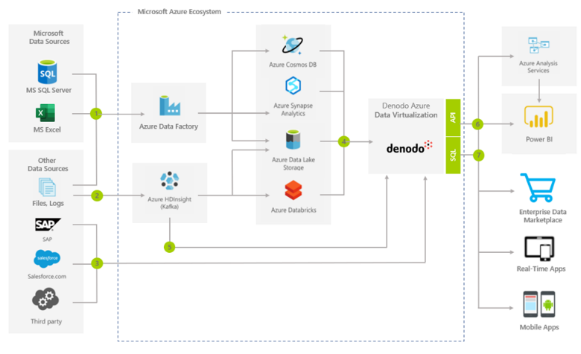
Denodo Data Fabric Architecture in Azure
DATA FLOW
Static data residing on-premise in Microsoft data sources (MS SQL databases, Excel spreadsheets etc.) extracted, transformed, and moved to Azure Cloud data repositories (Azur Synapse Analytics, Azure Cosmos DB etc.) by Azure Data Factory
Real-time data (e.g. web-logs) loaded to Azure Databricks with Azure HDInsights
Third-party on-premise (SAP, Oracle) and cloud data (Salesforce etc.) connected to Denodo Data Virtualization platform
Azure-based data sources (Azur Synapse Analytics, Azure Data Lake Storage, Azure Databricks) connected to Denodo Data Virtualization platform providing unified hybrid abstraction layer
Data from Kafka topics can be virtualized in Denodo platform for real-time alerting and dashboarding
All connected data sources are combined, secured, and exposed as Data Services over SQL ( and API interfaces.
Exposed virtual datasets consumed by Power BI, analytical applications, Data Science tools, Enterprise Marketplace portals, any real-time and mobile applications.
1
2
3
4
5
6
7

Slide 26
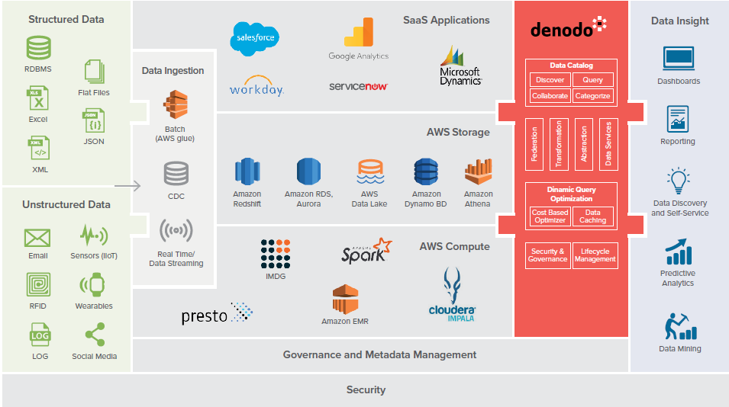
Denodo Data Fabric Architecture in AWS

Slide 27
IT Modernization: Data Fabric Next Steps
POC’s can be done in Days at No Cost
Contact: Spencer Biles, Denodo, sbiles@denodo.com
Content
Free Data Fabric Architecture Class – 1x/Month or On-Demand – contact Spencer
Free Test Drive on AWS, Azure or GCP – Denodo.com
Case Studies & Demos – Datafest User Conference – Denodo.com
“The Agile Data Management and Analytics Conference”

Slide 29
Appendix: Commercial Data Fabric Deployments
Guardian – Data Marketplace for End Users
Intel – Enterprise Data Services Layer for both Oper. & Analytics
Charles Schwab – Multi-Cloud Hybrid Deployment
Walmart – Logical Data Warehouse (LDW)
Visa – Complex Real-time Pricing Analytics
Caterpillar – IOT Enrichment drives Predictive Maintenance

Slide 30
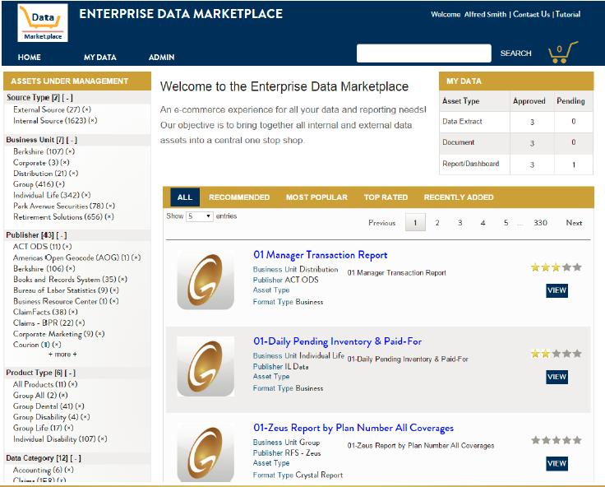
3rd Gen. DV: Data Marketplace

Slide 31
Intel 3 Tier DV Deployment
Bus Users – web Information Self Service tool to discover data & create User Views & export to reporting tools
Lines of Bus – resp. for 2ndary 100’s Bus Views on top of Corp views – can add local sources (note 1)
Ctr. Of Excel. – resp. for creating ~20 Corp. Views on top of enterprise systems
Rev. of
Chip A3?
Sales of
Cust P?
Proj. 32
Del. Date?
Chips
Shipped?
Denodo DV Platform
Finance
Views
Sales/Mrk
Views
Eng.
Views
Oper.
Views
Customer
View
Product
View
Facility
View
Partner
View
Note 1: Have over 1,000 dev. in lines of Bus. COE train 20 per month.
31

Slide 32
Intel’ Enterprise Wide DaaS Architecture
26 lines of bus. WW consume Denodo data services
2,000+ APIs in production using over 300+ data sources
2+ Million queries/day
500+ cores deployed WW, act as one Logical system
Deliver data 90% faster to Users
6 yrs in Production with Zero Downtime
Data Consumers
Operational
Analytical
1
2
2
API Management
EARA/F5 moving to Apigee
2
1
iPaaS
Data Delivery
MuleSoft
AI, DS, Kafka, AMQ, etc.
3
1
1
3
Data Virtualization
Denodo
1
Data Sources
SQL, NoSQL, TD, HANA, Big Data, SaaS, etc.
Primary
Recommended
Option
Exception
1
Secondary
2
Exception
3

Slide 33
Intel Case Study
Intel DV Success Metrics
Value Driver | Metric | Goal | Actual
Time to Develop | Time to develop web service in days | 50% | 90%
Time to Deploy | Time to Deploy web service in days | 50% | 90%
TTM | Overall time it takes to make web service available for use | 60% | 90%
Time to Engage | Time it takes for business to engage with IT | 75% | 75%
Performance | Performance of web services | 50% | 60%
Impact Analysis | How fast can we perform impact analysis | 50% | 90%
Enterprise Architectural Alignment | Ease at which data from disparate sources can be integrated | Security, data classification | High
33
Notes:
So in this slide, this is Intel's numbers with regard to what they were able to achieve versus what their goals were with implemented the data virtualization platform. so they were expecting a two to one improvement from the standpoint time to develop, time to deploy, time-to-market, and time to engage. notice when I talked about time being the number one thing. they tracked this with four different types of Time metrics along with performance impact analysis & enterprise architecture alignment. their goal was a 50% improvement and they achieved almost an order of magnitude improvement with regard to this platform.
This is a difference maker for them as the impact on the business of a saving a month is potentially worth $1 billion in extra revenue. imagine what the ROI of this platform is to Intel when you invested only a $million. Your organization could also achieve this type of ROI.

Slide 34
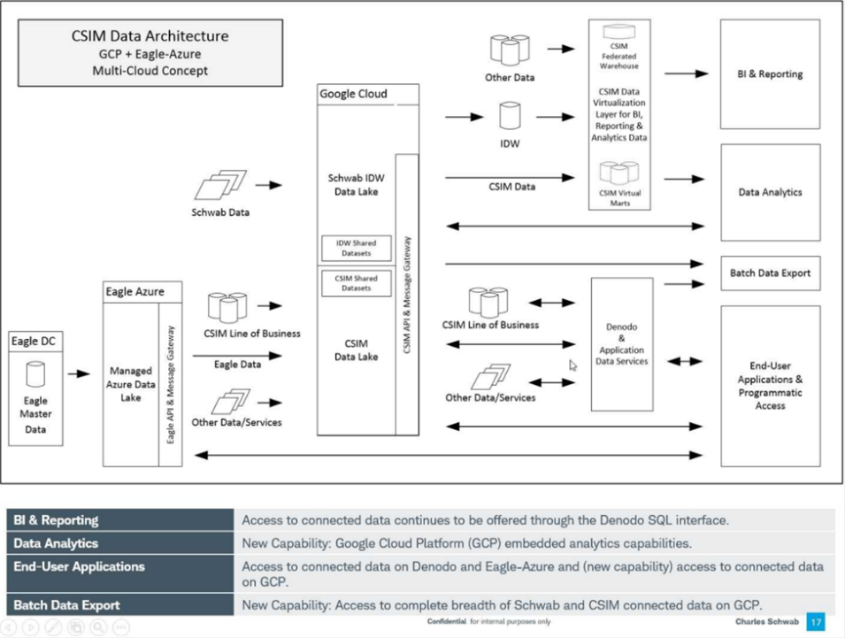
Multi-Cloud Architecture

Slide 35
Walmart – Why They Invested in LDW
ROI Potential: Savings of $40 Million in IT Costs & Business Process Improvements
- by Converting from Physical to Logical Data Marts
How LDW Data Virtualization Solves Problems
Provides Real Time Access to Ecommerce Data Sources – Leads to Real time sync
Avoids inventory inconsistencies: reduces loss of sales & saves $ in fewer accounting reconciliations.
Faster Overall Processing – Information delivered 98% faster from 60 days to 1 day.
Faster generation of IRS Reports speeds up tax return collection by months. DV eradicates the need for the expensive physical replication into Data Marts.
Governance & Security Compliance– Business Self Service + Single Point of Entry
Assures right data is used for the right use case.
Data security easily enforced as data is filtered based on user consumption roles and privileges without having to physically secure the data in each data source.
Eliminates 1,000’s of pt to pt connections greatly simplifying creating and maintenance.

Slide 36
Complex real time pricing analytics – views with 4k columns, 120+ joins, across 5 PB of data spread over multiple sources. Not possible before.
Notes:
Analyze all the transactional data into Hortonworks, trends, new products trying to build single views of truths for different users and analysts

Slide 37
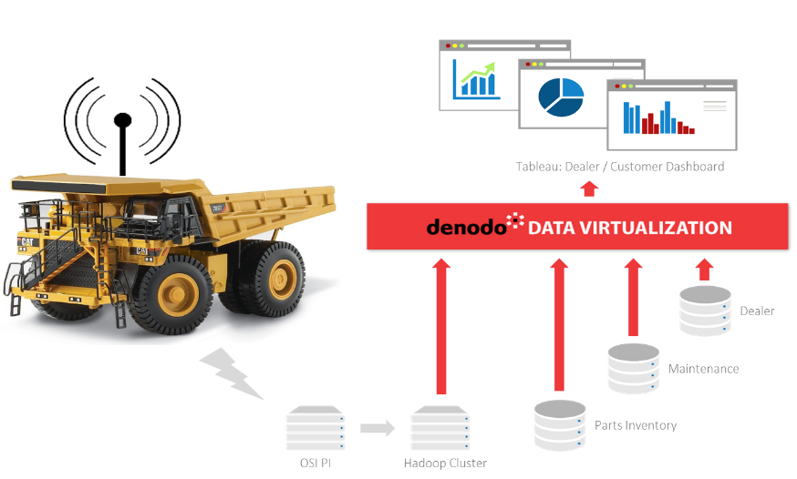
Caterpillar – IoT data drives Predictive Maintenance
Denodo Platform
Denodo is used to provide contextual data for predictive analytics processing of the streamed data (for preventative maintenance purposes).
Streaming Data
Telemetry data is streamed to Hadoop (via OSI PI application) for analysis using Spark
Notes:
Caterpillar Inc. is an American Fortune 100 corporation $55B revenue and 102K employees, which designs, develops, engineers, manufactures, markets and sells machinery, engines, financial products and insurance to customers via a worldwide dealer network. It is the world's largest construction equipment manufacturer.^{[3][4][7]} In 2018, Caterpillar was ranked #65 on the Fortune 500 list^{[8]} and #238 on the Global Fortune 500 list.^{[9]} Caterpillar stock is a component of the Dow Jones Industrial Average.^{[10]}
Caterpillar Inc. traces its origins to the 1925 merger of the Holt Manufacturing Company and the C. L. Best Tractor Company, creating a new entity, the California-based Caterpillar Tractor Company.^{[11]} In 1986, the company reorganized itself as a Delaware corporation under the current name, Caterpillar Inc. Caterpillar's headquarters are located in Deerfield, Illinois; it announced in January 2017 that over the course of that year it would relocate its headquarters from Peoria, Illinois, to Deerfield, Illinois, scrapping plans from 2015 of building an $800 million new headquarters complex in downtown Peoria.^{[12][13]}
The company also licenses and markets a line of clothing and workwear boots under its Cat / Caterpillar name.^{[14]}Caterpillar machinery is recognizable by its trademark "Caterpillar Yellow" livery and the "CAT" logo.^{[15]}

