Slide 1
Shockwave™ Presentation
Massive Light
Travis Eubanks, PhD

Slide 2
Shockwave™ Features
These features are in development and subject to change:
Increases Wireless Capacity like Water in a Larger Pipe
Large Wireless Instantaneous Bandwidth: ≤ 6000 MHz
Low Distortion: > 80% Fidelity Factor
Flexible Frequency Range: 2400-9000 MHz
Flexible Output Power for Range and Data Rate
I/Q Transmitter and Receiver
Composed of a Patent Pending Antenna and Patent Pending RF Front End with a Commercial FPGA
Capacity Limited by Pipeline Size
Increased Capacity

Slide 3
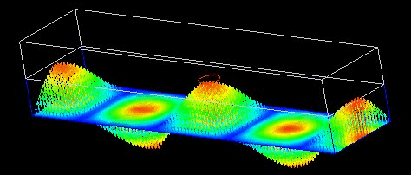
Antenna Summary
These features are in development and subject to change:
2:1 VSWR simulated from 2000-12000 MHz
> 80% fidelity factor simulated with Gaussian pulses up to 6000 MHz wide
Swept gain pattern allows for small size (1” x 1” x 1.5”) and low distortion
3D printed in polycarbonate-like SLA material for cost and weight reduction
Electromagnetic Simulation

Slide 4
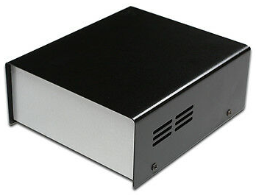
RF Front-end Summary
These features are in development and subject to change:
Dual-side band frequency flexible I/Q transceiver with 2400-9000 MHz available
Commercial off-the-shelf design tested with 1 mW (0 dBm) output power
Adjustable power, center frequency, and bandwidth available
Miniaturizable to custom requirements
Small Electronics Case

Slide 5
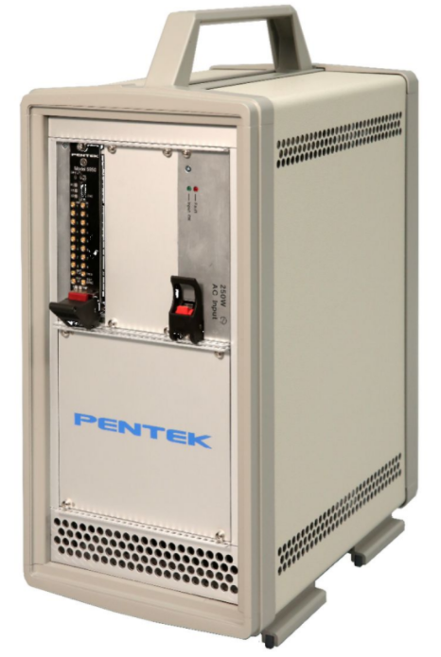
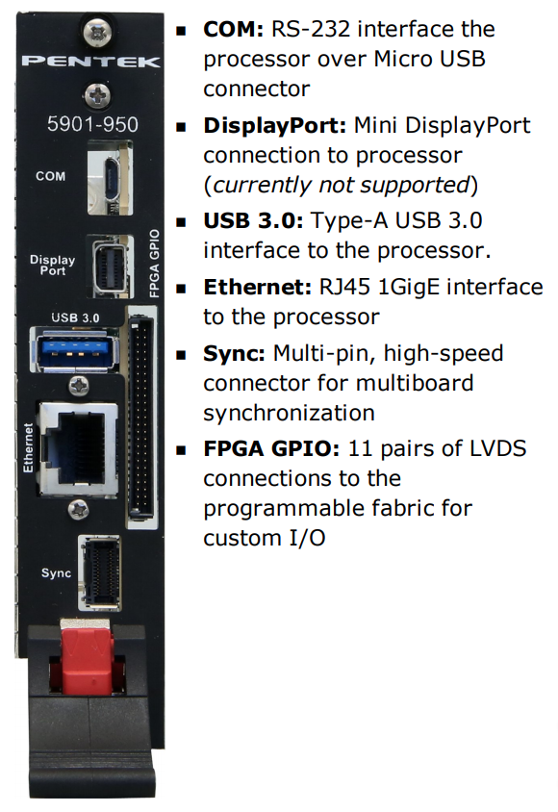
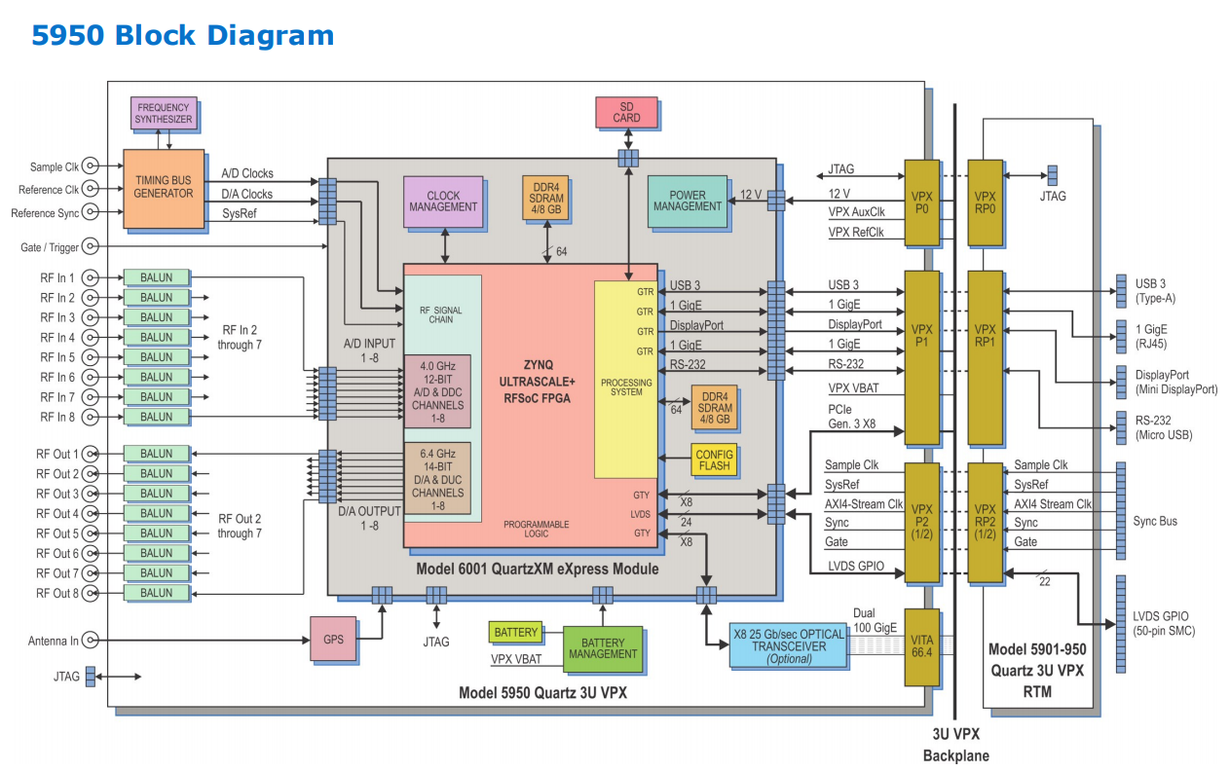
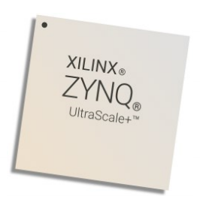
FPGA Features
These features are in development and subject to change:
Pentek 5950 Quartz Board and 3U VPX Chassis
Xilinx RFSoC Ultrascale+ Gen 1 FPGA IC
DC-2000 MHz of baseband bandwidth available in 16 channels

